Slide 1
Turning Conflict into Collaboration
RISE to the Challenge: Resolve, Innovate, Support Engage
CADRE’s 8th National Symposium October 28, 2021
Presented by
Jessica Velez and Danielle Vota

Slide 2
The Conflict Resolution Program
SPARC- Mediation for special education related disputes
IEP Meeting Facilitation
Design Customized Trainings
Free Resources:
https://www.bidenschool.udel.edu/ipa/serving-delaware/crp
Notes:
The Conflict Resolution Program (CRP), part of the University of Delaware's Institute for Public Administration (IPA), is a unique resource dedicated to building statewide capacity for collaborative approaches to the resolution of conflict.
The Special Education Partnership for the Amicable Resolution of Conflict (SPARC) is a statewide special education dispute-resolution program that supports families and schools to work collaboratively to address the educational needs of exceptional children.
We also offer free resources such as agenda templates for IEP meetings and guides for how to have difficult conversations.

Slide 3
MAPping Change, LLC
Private Conflict Coaching
Collaborative Meeting Design
Public and Customized Workshops
Resources and information:
www.mappingchange.com

Slide 4
Welcome!
Virtual Meeting Expectations
Turn your camera on.
Stay on mute when you’re not speaking.
Share any questions you have in the chat.

Slide 5
Workshop Agenda & Objectives
Today’s presentation is an opportunity to
Understand the collaborative problem-solving process.
Practice new skills.
Leave with practical tools you can put into use tomorrow.

Slide 6
Recognizing and Appreciating Differences
Reflect on your expectations for what is:
“Normal”
Appropriate
Professional
Good vs Bad
Right vs Wrong
Where do these expectations come from?
What unconscious biases or underlying assumptions do we have? How does it influence our interactions with others?
You cannot look at a person who seems difficult to you without also looking at yourself.
– Jeffrey Kottler
Notes:
When we find ourselves in an emotional disagreement with someone, it’s important to recognize and appreciate the differences we all bring to the table. Whether it’s what we think is the best path forward, why we support a certain solution, or how we communicate that information, these differences make us stronger.
We need to take time to recognize any unconscious biases, unspoken expectations, or underlying assumptions we might have going into the conversation. ie. what is professional, what is appropriate, what is “good” or “right” (white western culture)

Slide 7
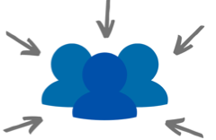
Recognizing and Appreciating Differences (cont.)
Consider how your perspectives and interpretations might be influenced by your…
Personal and family values
Community values
Experiences
Income
Education
Cultural identity
Religious or spiritual beliefs
Geographic location
Notes:
We are all deeply influenced by our extremely unique experiences, but we tend to expect other people’s decisions and conclusions to come from the same place. So before we talk about working with others, it’s important to acknowledge what’s ours to work on first.

Slide 8
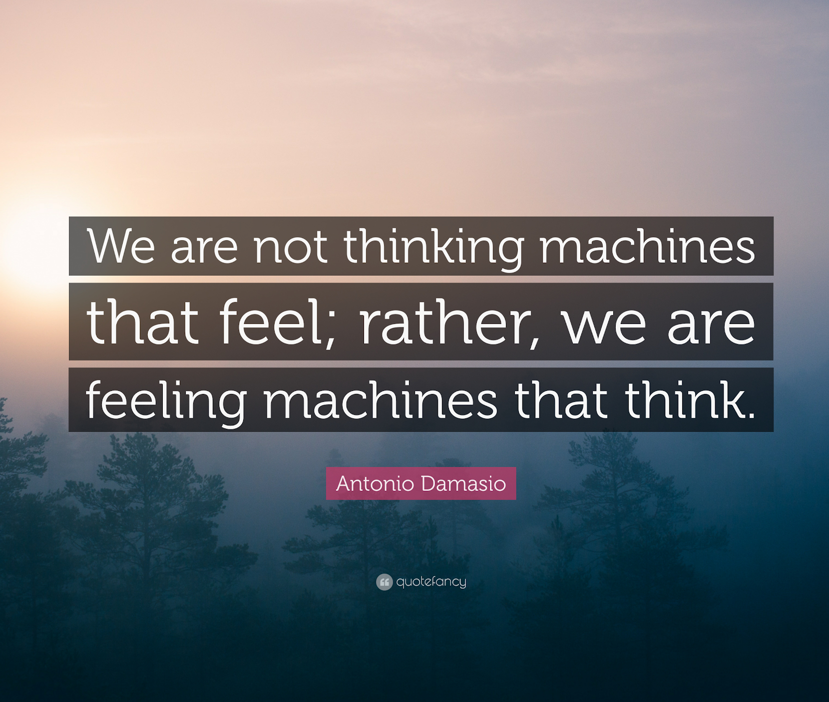
Managing Emotions
Expect and accept that life is emotional.
Recognize and manage your own emotions.
Acknowledge and respect the emotions expressed by others.

Slide 9
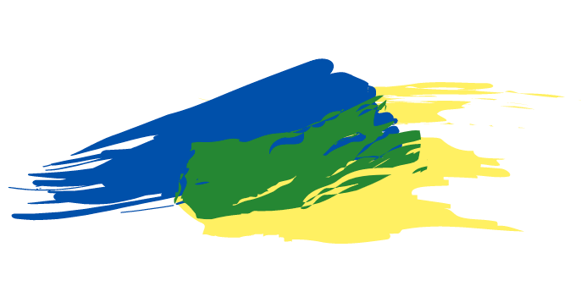
Collaborative Problem-Solving
Collaboration is a process for finding creative ways to meet the underlying needs of two or more people.
Use this for conflicts in which:
The relationship and outcome really matter to you.
You want a win-win solution.
You are open to a unique solution that works for both sides.
Notes:
Conflict is inevitable, especially in the special education world where there a many people deeply invested in the success of a student and each having a unique expertise and perspective on how to support them. When we find ourselves facing a disagreement with others, we have options for how we respond: argue until we win, give in to the other idea, or even pretend the disagreement isn’t happening. But when it comes to working in the best interest of a student, it takes more effort than that.

Slide 10
Step 1: Airing All Concerns
An opportunity for everyone to share and feel heard.
First person briefly shares their perspective on the situation.
Second person actively listens without interruption and summarizes what they’ve heard back to the first person.
Second person shares, and first person listens.

Slide 11
Listening to Concerns
Listen to understand the speaker’s point of view.
What happened? (facts)
How do they feel? (feelings)
What do they want? (wants)
What do they need? (needs)
“To listen fully is to be ready to be surprised.”
- Tara Brach

Slide 12
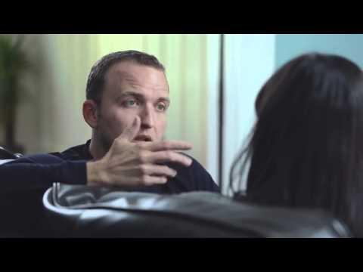
Listening Video

Slide 13
Caution!
When active listening, be sure not to
Interrupt
Judge or criticize
Give advice or suggestions
Bring up your own experiences
Plan your response
Make assumptions
Notes:
Effective communication requires us to listen with a purpose. That means instead of listening to respond we should listen to understand.

Slide 14
Sharing Your Concerns
Tips for Success
Focus on the present situation.
Speak only from your perspective.
Tell them what you want using launder language.
Pause to recognize what you’re feeling and why.
Prepare an I-Statement that answers:
What happened?
How do you feel?
What do you want/asking for?
Why do you want it?
Notes:
Once it’s your turn to speak, It’s important to center yourself emotionally while listening to others, but also before and while speaking yourself. So take a moment to pause and check in with yourself emotionally before speaking.

Slide 15
Sample I-Statements
These meetings are a circus! You just keep bringing more people in so my opinion will be out-voted!
I feel stressed when there are more than six people in our meetings because I don’t know when it’s my turn to speak.
This is ridiculous! You’re trying to cut out team members who disagree so you can get your way!
Use a sticky note on Jam Board to change this prompt into an I-Statement.

Slide 16
Sample I-Statements (cont.)
These meetings are a circus! You just keep bringing more people in so my opinion will be out-voted!
I feel stressed when there are more than six people in our meetings because I don’t know when it’s my turn to speak.
This is ridiculous! You’re trying to cut out team members who disagree so you can get your way!
I’m worried when the meeting invitees are limited because I value the different expertise each person brings.

Slide 17
Step 2: Clarifying the Problem
Fill in the holes. Be able to answer these questions:
What happened?
How do they feel?
Move your attention from your/their wants to your common needs.
Ask a new question that addresses everyone’s needs and allows for multiple creative solutions.
What do they want?
What do they need?
Notes:
This is probably the most important step of the process and takes the most time and skill. When done correctly, this step really sets you up for success. Step 2 is about getting to the core of your disagreement. It’s about separating the person from the problem (This team member is being unreasonable! -> I disagree with their proposed approach.) refocusing from our wants to our needs (I do/do not want the student to receive this reading intervention -> I need this student to have the support to improve reading skills.) and then crafting a “new” problem that takes all needs into account and puts everyone on the same side (how can we support this student to reach their set reading goal?).

Slide 18
Filling in the Holes
Ask open-ended questions to dive deeper
Can you tell me more about…?
Can you describe what that would look like?
Can you talk about how you came to that conclusion?
Notes:
We shouldn’t assume the when people first to come to us with an issue or an idea that they have all theirs thoughts and points already flushed out. Communication is a process we all use to get clarification oh what we really think, feel, want, and believe. So be patient, wait to give advice or your opinion, and ask those clarifying questions to help get to the root of what’s really going on.

Slide 19
Moving from Wants to Needs
What you want
Why you want it
Experiences
Fears
Beliefs
Concerns
Values
Notes:
When we’re stuck on what you want and what I want, we end up in a win or lose situation. When you get into your why you want you want, then you can figure out a more creative solution.

Slide 20
Moving from Wants to Needs (cont.)
I want a smaller meeting.
I want a bigger meeting.
I need to feel heard.
I value diverse perspectives.
Notes:
Once you’ve been able to uncover each person’s underlying needs (through asking good, open-ended questions and listening carefully), you can create a “new” problem to solve that will address both people’s needs and will allow for greater flexibility in how you solve the problem.

Slide 21
Asking a New Question
Draft a question that will address both people’s underlying needs and generate creative solutions.
Notes:
Once you’ve been able to uncover each person’s underlying needs (through asking good, open-ended questions and listening carefully), you can create a “new” problem to solve that will address both people’s needs and will allow for greater flexibility in how you solve the problem.

Slide 22
Asking a New Question (cont.)
I want a smaller meeting.
I want a bigger meeting.
I need to feel heard.
I value diverse perspectives.
How can we hold a meeting so that all necessary participants can attend and have an opportunity to speak and feel heard?
Notes:
Once you’ve been able to uncover each person’s underlying needs (through asking good, open-ended questions and listening carefully), you can create a “new” problem to solve that will address both people’s needs and will allow for greater flexibility in how you solve the problem.

Slide 23
Practice
I want shorter meetings.
I want longer meetings.
My experience is that shorter meetings stay focused.
I believe dedicating more time will help us accomplish more.
Create a new question that combines the needs of both sides.
Notes:
Once you’ve been able to uncover each person’s underlying needs (through asking good, open-ended questions and listening carefully), you can create a “new” problem to solve that will address both people’s needs and will allow for greater flexibility in how you solve the problem.

Slide 24
Practice (cont.)
I want shorter meetings.
I want longer meetings.
My experience is that shorter meetings stay focused.
I believe dedicating more time will help us accomplish more.
How can we structure our meetings so we accomplish our goals and maintain our focus?
Notes:
Once you’ve been able to uncover each person’s underlying needs (through asking good, open-ended questions and listening carefully), you can create a “new” problem to solve that will address both people’s needs and will allow for greater flexibility in how you solve the problem.

Slide 25
Step 3: Brainstorming Solutions
Set a time limit (and keep it short).
Invite everyone to contribute as many ideas as possible.
Do not criticize any ideas while the list is being generated.
You can build off of previous ideas.
Record the ideas publicly.
When the time has ended, review the list and quickly discuss the pros and cons of each suggestion.
Notes:
Dv There are more solutions to brainstorm once we create a joint problem statement that focuses on what both people need, rather than just narrowly on what they want.

Slide 26
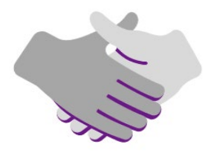
Step 4: Develop an Agreement
Document, as needed, the specific details of the agreement.
Who is responsible for each part of the agreement? Is it balanced?
What is the timeline? Is it reasonable? Flexible?
2. Reality-test the agreement to ensure success.
What could prevent this plan from working?
What adjustments need to be made to ensure success?

Slide 27
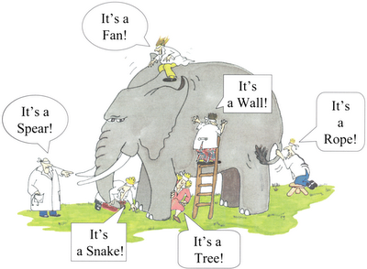
Putting the Pieces Together
None of us is as smart as all of us.
Ken Blanchard
Notes:
When it comes to working through complex problems, it’s important to remember that each of us holds only one puzzle piece. The more puzzle pieces we seek and are open to, the more comprehensive our solutions will be. Using the ACBD collaborative problem solving process helps us to bring out the best in all of us to craft a unique and creative solution.

Slide 28
Feel free to reach out!
Jessica Velez
Conflict Management Professional
Mapping Change, LLC
jessica@mappingchange.com
Danielle Vota
Conflict Resolution Practitioner
Conflict Resolution Program
Biden School of Public Policy & Administration
vota@udel.edu

