Slide 1
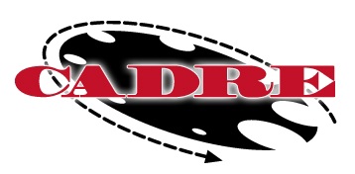
Exploring the Cultural Dimensions of Conflict
Sukh Singh
Willamette University College of Law
February 28, 2013
11:30 am – 12:45 pm PACIFIC TIME
Note: The PowerPoint is currently available on the CADRE website:
www.directionservice.org/cadre/singhwebinar.cfm
Technical Stuff:
All phone lines are muted – press #6 to unmute your phone during the Q&A.
Please enter any technical difficulties into the chat box.
Thank you for taking the time to answer the pre & post webinar poll questions! (Note: The poll questions will appear on your screen until we remove them)

Slide 2
Exploring the Cultural Dimensions of Conflict
Sukhsimranjit Singh, LL.M.
Associate Director, Center for Dispute Resolution
Director, LL.M in Dispute Resolution
Willamette University-College of Law,
Salem, Oregon.
singhs@willamette.edu,
503-375-5369 (o)

Slide 3
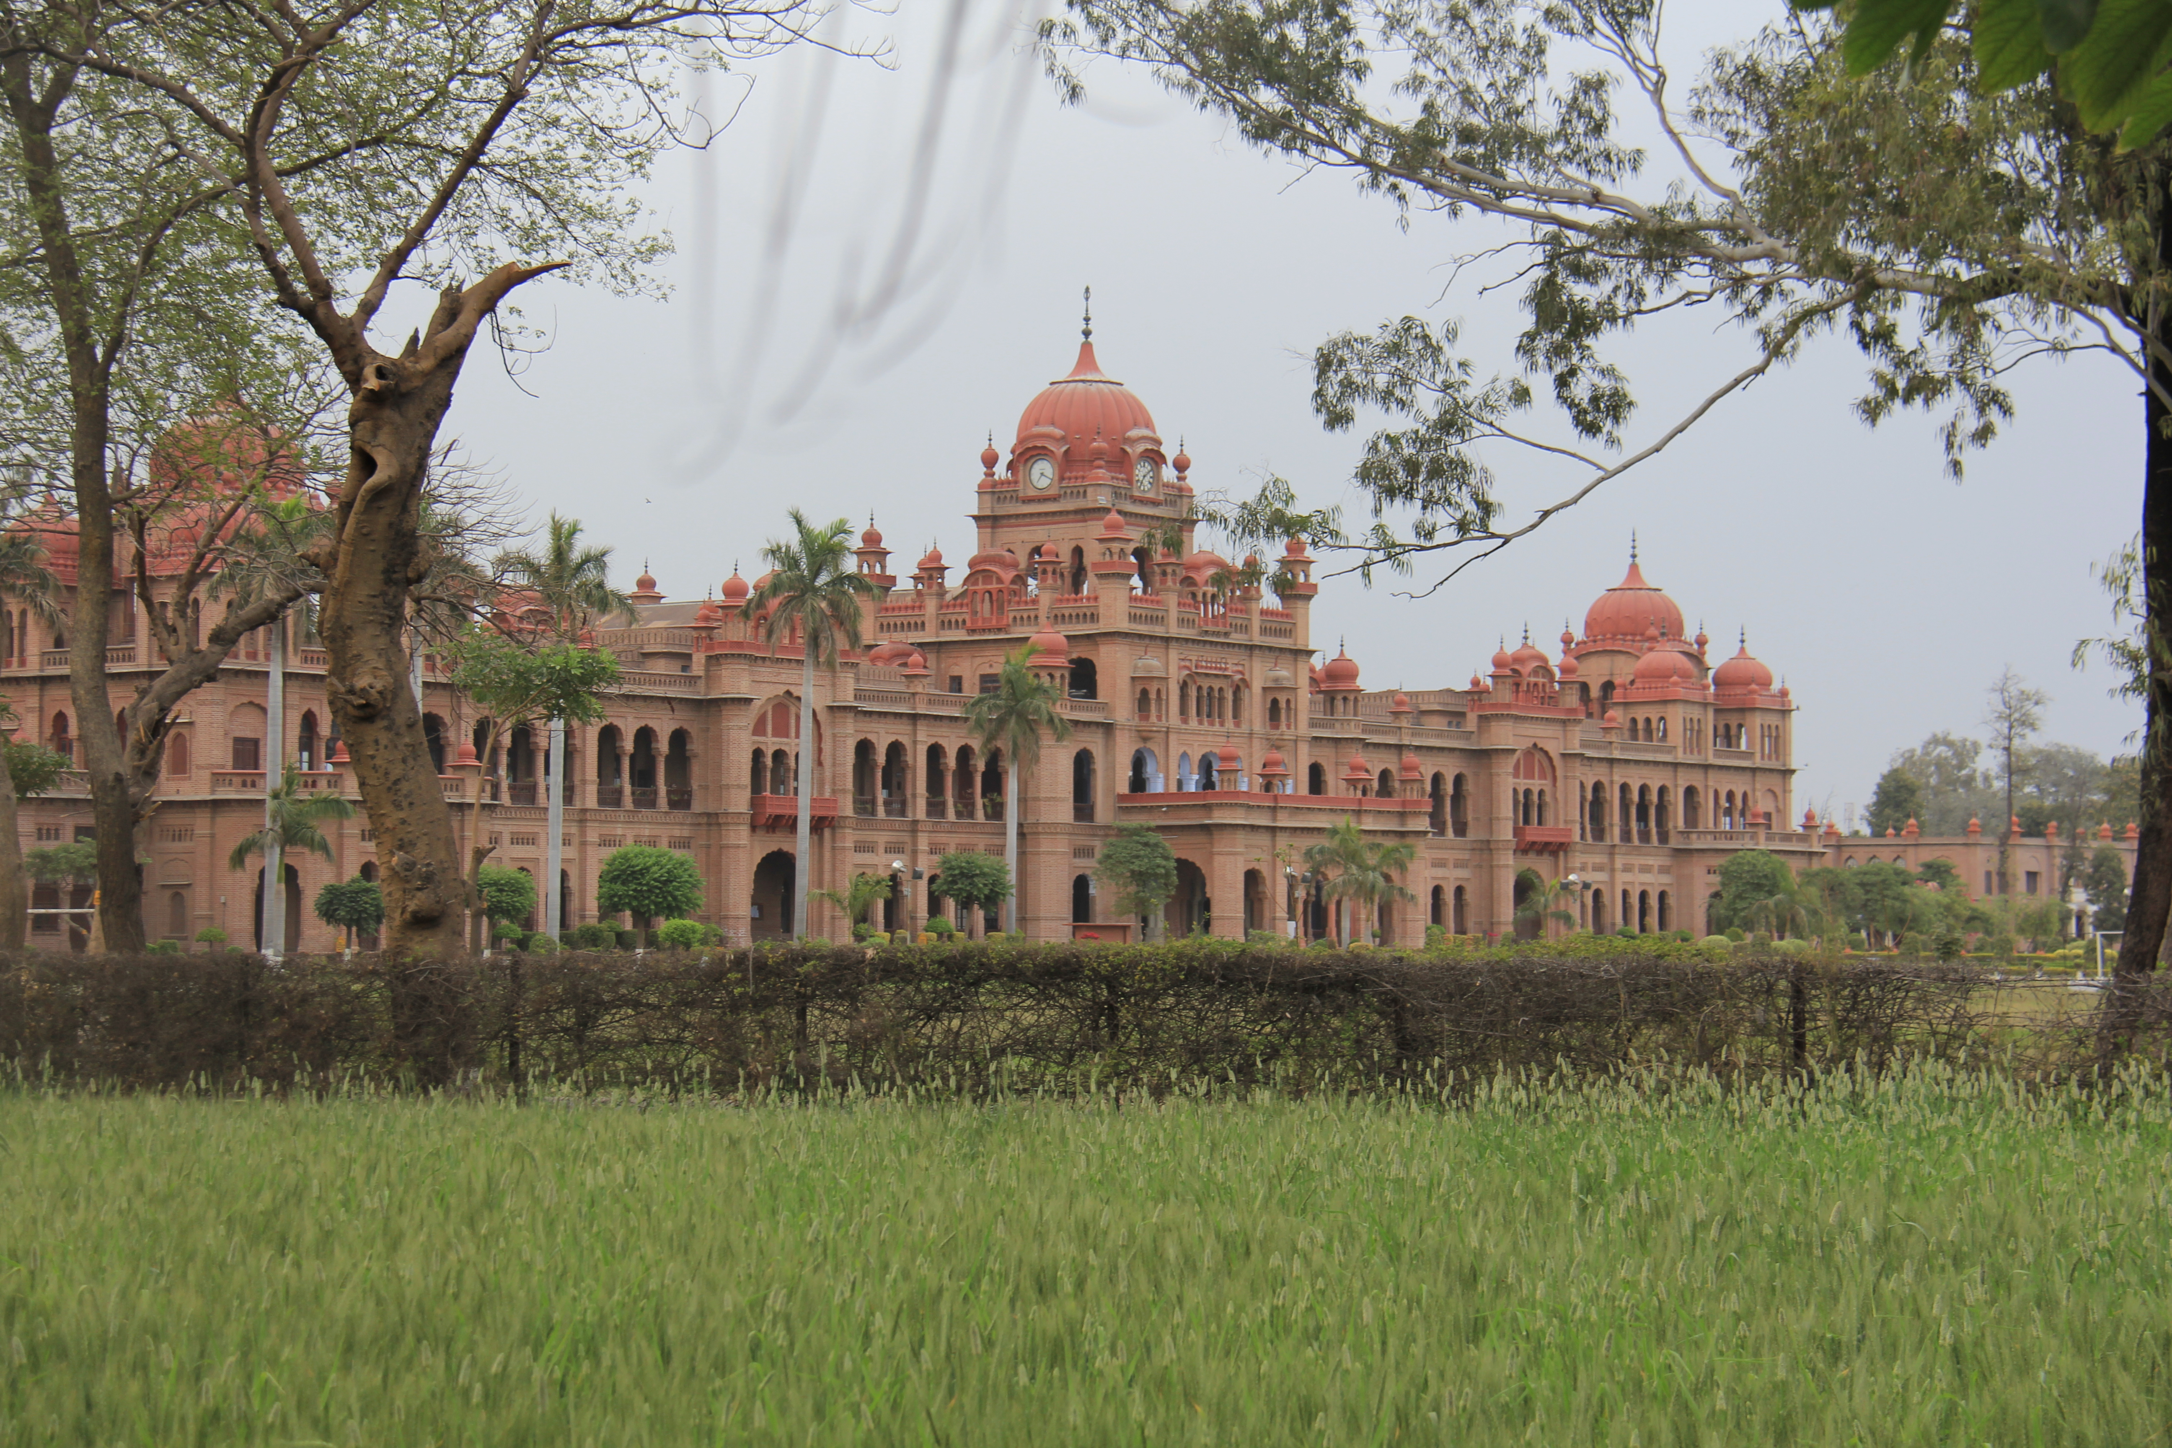
What is my culture?
Indo-
-American
Mediator
Teacher
Sikh
Father
Husband
Son

Slide 4
Framework for my Talk
Dimensions of Conflict
Defining Culture
Cultural Influence on Conflict
Conflict Resolution and Culture
Resources

Slide 5
Initial Request
“There should be zeal to learn about a new culture. There should be an honest non-judgmental approach to learning the new culture. Take it this way. A new culture will only adopt you if you are willing to accept that culture without inhibitions.”
Stella Ting Toomey & Leeva C. Chung

Slide 6
(A) Different Dimensions of Conflict
Cultures perceive and address conflict differently
See Bee Chen Goh Et All “As We See It”

Slide 7
University of Mumbai - American vs. Indian Perspectives

Slide 8
Arranged Marriage and Conflict

Slide 9
Willingness to Learn

Slide 10
Awareness of our “own” culture

Slide 15
(B) WHAT IS CULTURE?

Slide 16
Definitions…
The term culture constitutes the following essential elements:
Patterned way of thinking
of a group
Based on value
Followed over a period of time
See Sukhsimranjit Singh, 14 Cardozo J. Conflict Resol. 1 at 105

Slide 17
Culture is the “air” you breathe in.
It also constitutes (what we often forget!)
Religion
Identity
Core Values
Our set World-views
Our Belief Systems and Traditions

Slide 18
BROAD VIEW OF CULTURE
National
Organizational
Personal

Slide 19
(C) CULTURAL DIMENTIONS
 | INDIVIDUALIST | COLLECTIVIST
 | Satisfy needs of the individual before those of the group Autonomy, independence, and personal freedom are highly valued Only one-third of world’s population | Survival of the group ensures well-being Identity tied to primary group (“in-group” = usually family) Harmony and interdependence are stressed and valued

Slide 20
CULTURAL DIMENSIONS
Internal Control is within the individual No limits on what you can do/become if you make the necessary effort You are responsible for what you do | External Some things in life are predetermined There are limits beyond which you cannot go Success is a combination of efforts and good fortune

Slide 21
CULTURAL COMPETENCY
Your (m) Cultural Awareness
Cultural Consciousness (moment to moment)
Time and Goal Orientation

Slide 22
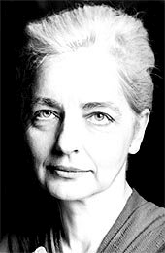
Your Cultural Awareness

Slide 23
Your Cultural Awareness

Slide 24
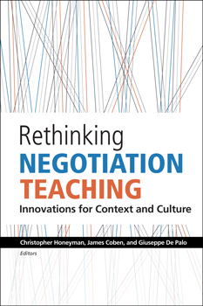
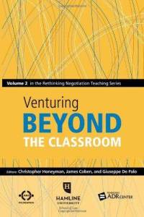
Your Cultural Awareness

Slide 25
CULTURAL CONSCIOUSNESS (MOMENT TO MOMENT)
A longer Journey; because it’s inward
Learning to control our biases & our reliance on shortcuts
On generosity, compassion, and understanding
Humbleness, dya & confidence in “them” and “us”

Slide 26
TIME ORIENTATION
No to Cultural Coercion
No to Cross-Cultural Disrespect
No to One-dimensional Approach to Conflict
No to Always making the Conflict about Culture

Slide 27
GOAL ORIENTATION
Your Culture dictates your Goals
Just like each one of us
We are one yet so distinct

Slide 28
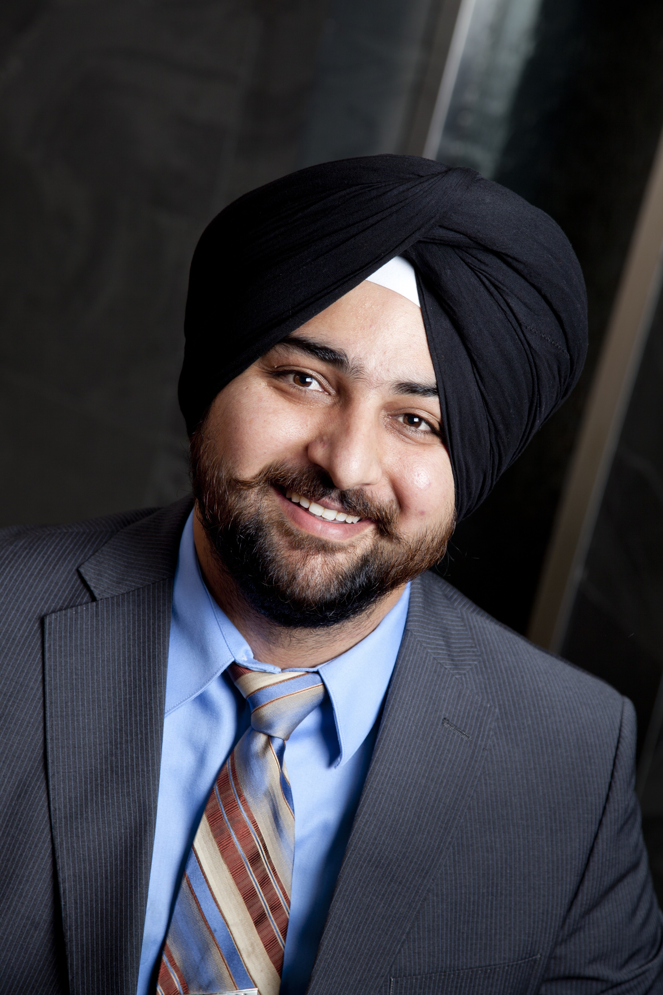
Thank You
Thank you for your time.

Slide 29
Upcoming CADRE webinar! The Mediator's Mind: Insights from Psychology and Neuroscience Richard Birke Director, Center for Dispute Resolution, Willamette University College of Law May 1, 2013 11:30 am – 12:45 pm PACIFIC TIME More details will be available on the CADRE website soon: http://www.directionservice.org/cadre/webinarindex.cfm

