Slide 1
Playing Nicely Together: Family-Centered Practices that Can Help Practitioners Work with Families May 19, 2015 2:30 pm – 3:45 pm ET (11:30-12:45 PT) Note: The PowerPoint is currently available on the CADRE website http://www.directionservice.org/cadre/playingnicelywebinar.cfm Dial in: 1-877-512-6886 ID: 679 683 6031
Technical Stuff:
All phone lines are muted – press #6 to unmute your phone during Q&A.
Use a phone line for best audio quality.
Please enter any questions or technical difficulties into the chat box.
Thank you for taking the time to answer the webinar poll questions! (Note: The poll questions will appear on your screen until we remove them)

Slide 2
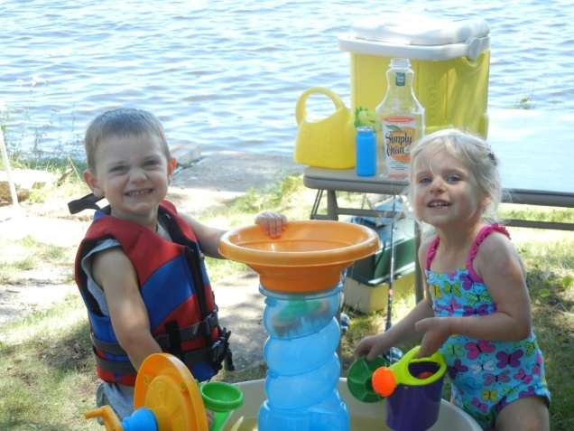
Playing Nicely Together: Family-Centered Practices that Can Help Practitioners Work with Families

Slide 3
Presenters
Megan Vinh, ECTA Center & DaSy Center
Judy Swett, PACER & ECTA Center
Amy Whitehorne, CADRE
Yvette Plummer Burkhalter, Denver Metro CPRC
Kristen Clarke Reaves, Cherry Creek Schools, CO
Special thanks to Anne Lucas of the ECTA Center & DaSy Center, who served as advisor and content reviewer.

Slide 4
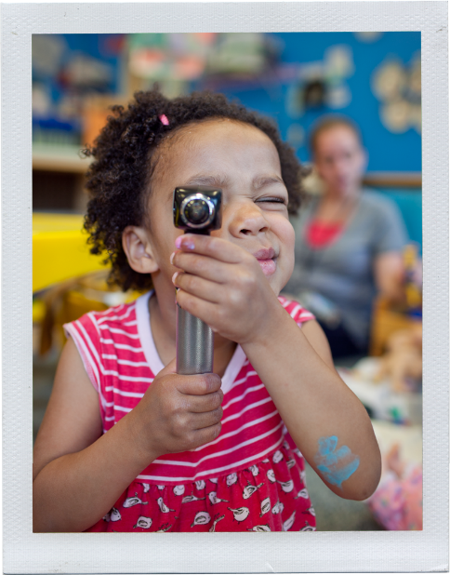
Content Overview
Relationship Building Blocks
Family Practices
Relationship Timeline
Some of the content featured in this webinar was adapted from:
DEC Recommended Practices in Early Intervention/Early Childhood Special Education
Key practices underlying the IEP process: Supporting Family Participation, Inclusive Practices, and Positive Outcomes for Preschool Children with Disabilities
Agreed upon Practices for Providing Early Intervention Services in Natural Environments

Slide 5
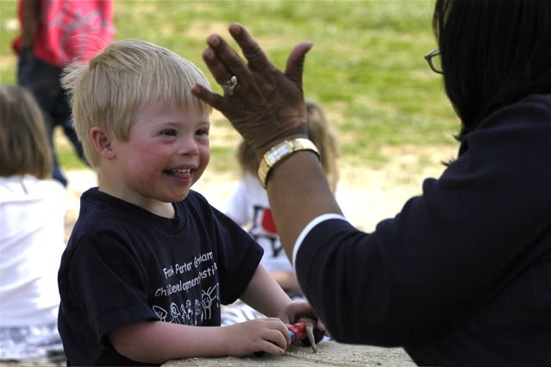
Relationships
Built over time
Based on a foundation of:
Honesty, accountability, and trust
Mutual respect
Good communication
Acknowledged agreement to work together in the best interest of the child
Rooted in attitude of being nonjudgmental and flexible

Slide 6
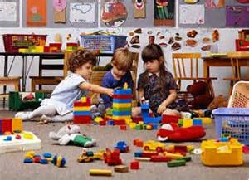
Building Blocks of Relationships
Honesty, Accountability and Trust are the:
Foundation of all successful relationships
Outcomes of consistency, predictability and follow-through
Result of the value placed on both families’ and practitioners’ experiences and perceptions
Reflection of what we say and do

Slide 7
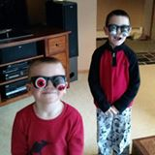
Building Blocks of Relationships
Mutual Respect is characterized by:
Self-respect
Appreciation and respect for new or different points of view
Exploration of your own feelings
Awareness of personal values when working with children and families

Slide 8
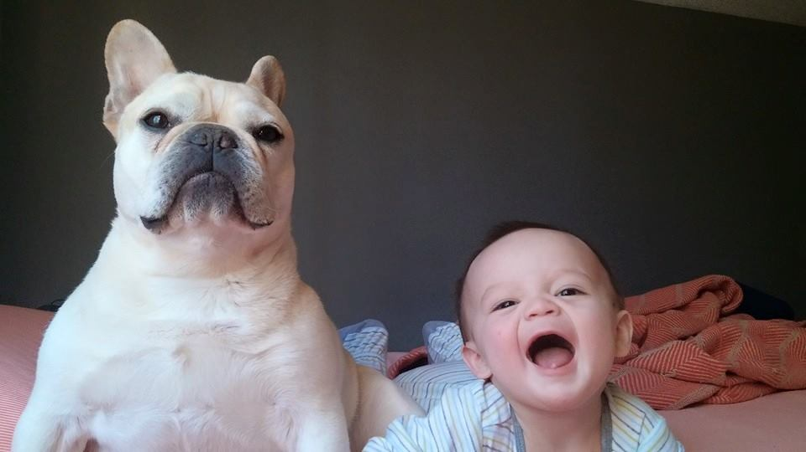
Building Blocks of Relationships
Good Communication is demonstrated by:
Conversation
Active Listening
Sharing Information
Strong Working Partnerships

Slide 9
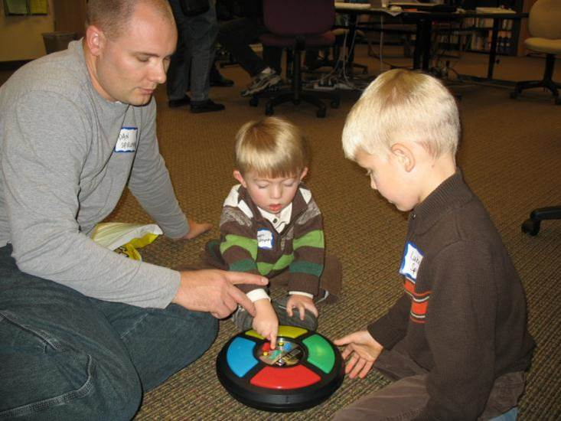
Building Blocks of Relationships
Acknowledged Agreement to work together in the best interest of the child results in:
Mutual understanding
Families and professionals becoming wiser about the child
Shared understanding of the child leading to better outcomes for the child

Slide 10
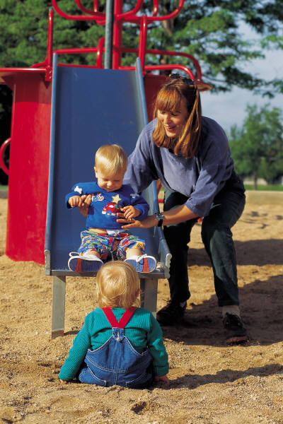
Building Blocks of Relationships
Acknowledged Agreement to work together in the best interest of the child results in:
Ongoing, open communication
Increased family awareness and involvement

Slide 11
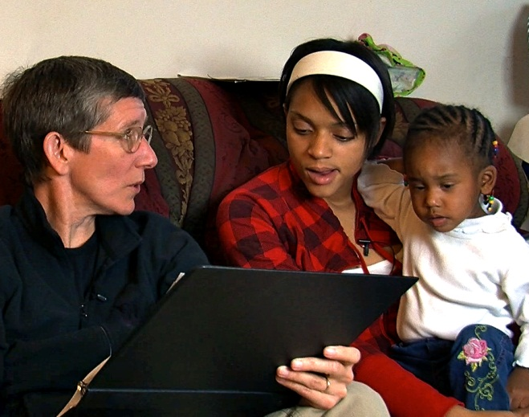
What are you doing to build and support family-professional relationships?
Please share
your stories
in the
chat box!

Slide 12
Family Practices – What are They?
Activities that:
Promote family members’ active participation in decision-making
Lead to the development of a high quality service plan or education program
Support families in achieving the goals they have for their children

Slide 13
Three Types of Family Practices
Family-Centered Practices
Family Capacity-Building Practices
Family and Professional Collaboration

Slide 14
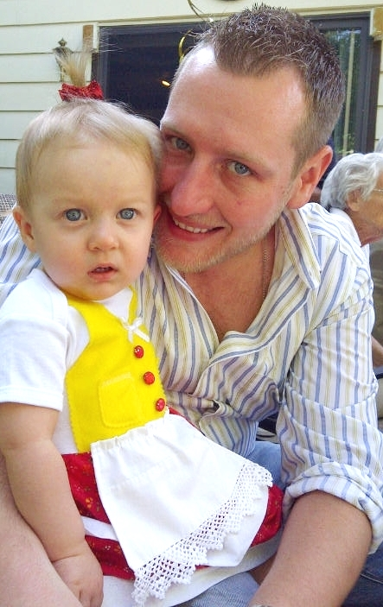
Family-Centered Practices
Practices that:
Treat families with dignity and respect
Honor each family’s own strengths
Respond to every family’s own circumstances
Ensure family members have complete, unbiased information necessary to make informed decisions
Support participation in everyday activities as part of family and community life

Slide 15
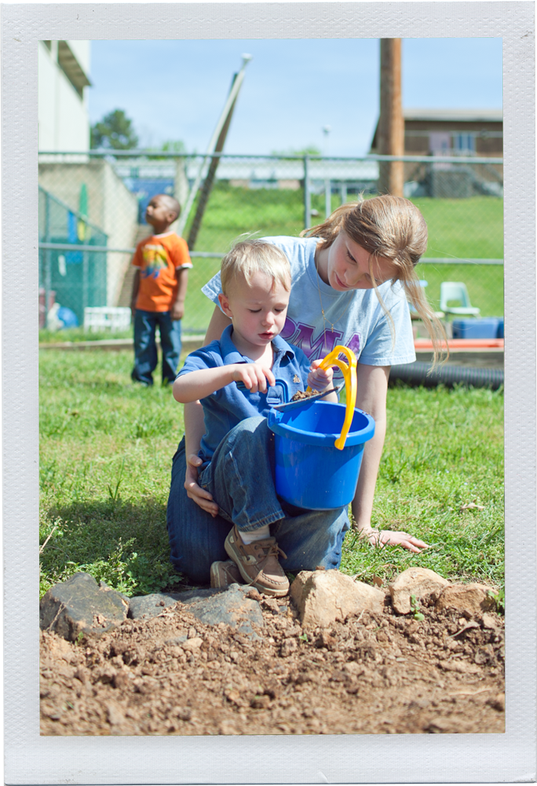
Family Capacity-Building Practices
Practices that:
Help families recognize the important roles that they play in their children’s development and education through everyday activities
Afford families opportunities to build capacity relating to their children’s development and education

Slide 16
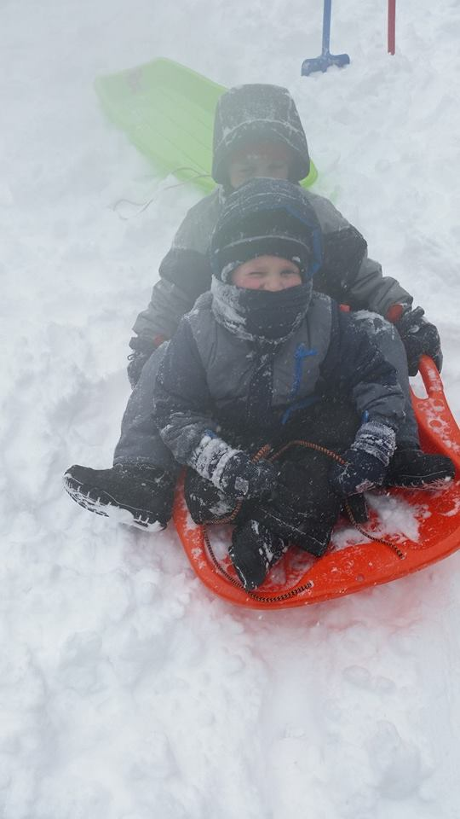
Family Capacity-Building Practices, cont.
Practices that:
Create possibilities for families to participate in their children’s education and development
Support families to develop advocacy skills and their ability to educate others about their children’s strengths and needs

Slide 17
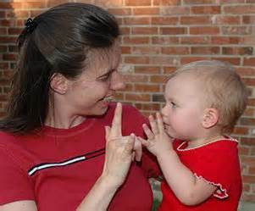
Family & Professional Collaboration
Practices that:
Build trusting relationships between families, practitioners, and educators
Provide genuine opportunities for the family and professionals to work together to create mutually agreed-upon goals and outcomes that support the child’s development and education

Slide 18
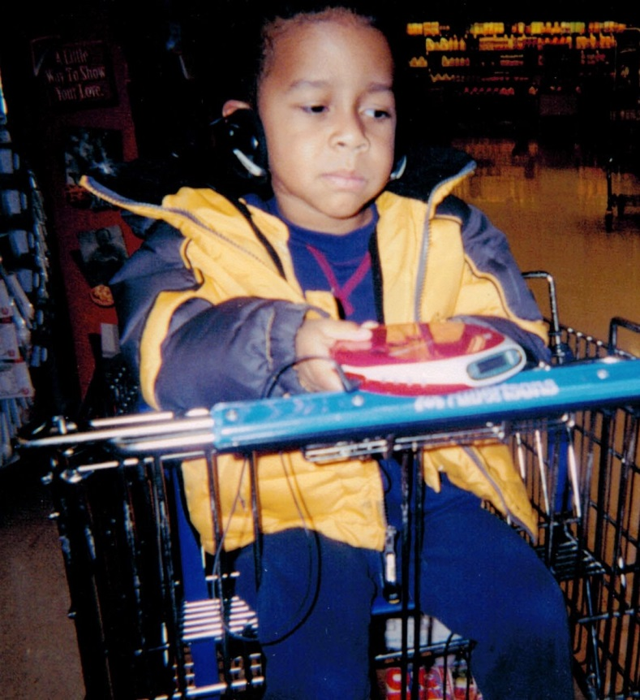
Family & Professional Collaboration, cont.
Practices that:
Support families in using opportunities to be involved in their children’s development and education
Encourage cooperative problem-solving

Slide 19
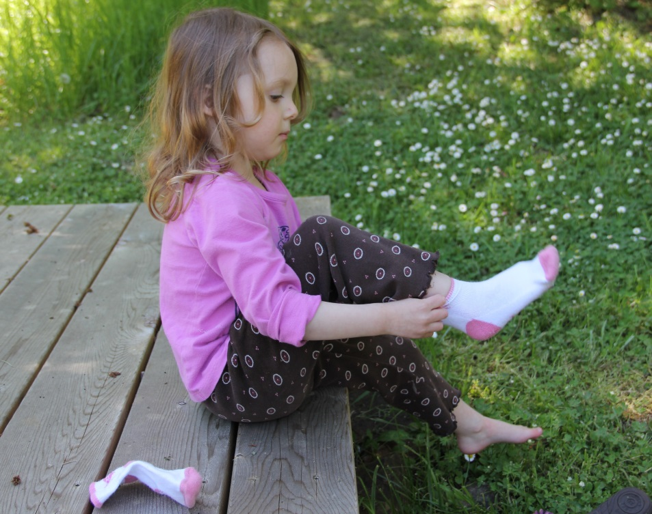
What are your experiences with practices that support family engagement?
Please share
your stories
in the
chat box!

Slide 20
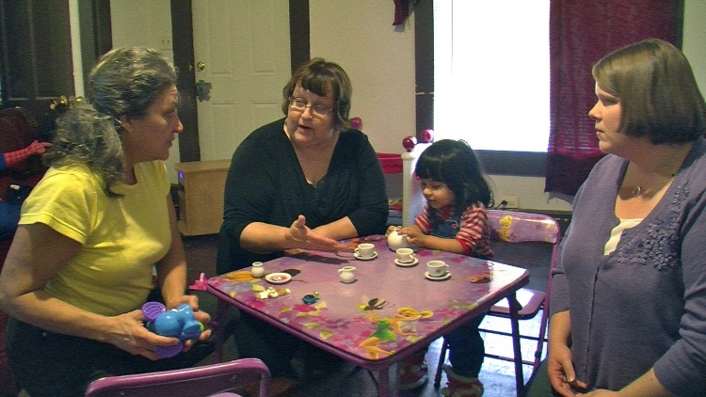
Relationship Timeline
Initial Contact & Establishing Rapport
Working Together (Meetings, Evaluations)
Over the Long Haul…

Slide 21
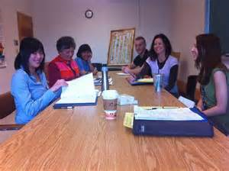
Initial Contact & Establishing Rapport
Begin with a trusting, respectful inquiry, to guide conversation about the child’s educational and developmental needs
Introduce the concept of working as a “Team” from the beginning
Acknowledge the strengths of all those involved – family and practitioners
Balance the time spent with the family listening and sharing

Slide 22
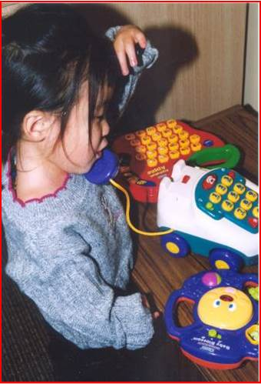
Initial Contact & Establishing Rapport, cont.
Encourage sensitivity to all aspects of diversity
Develop an understanding of the family’s support system
Ask the family how they view their role in their child’s education and development
Develop an understanding of family concerns, priorities, and available resources

Slide 23
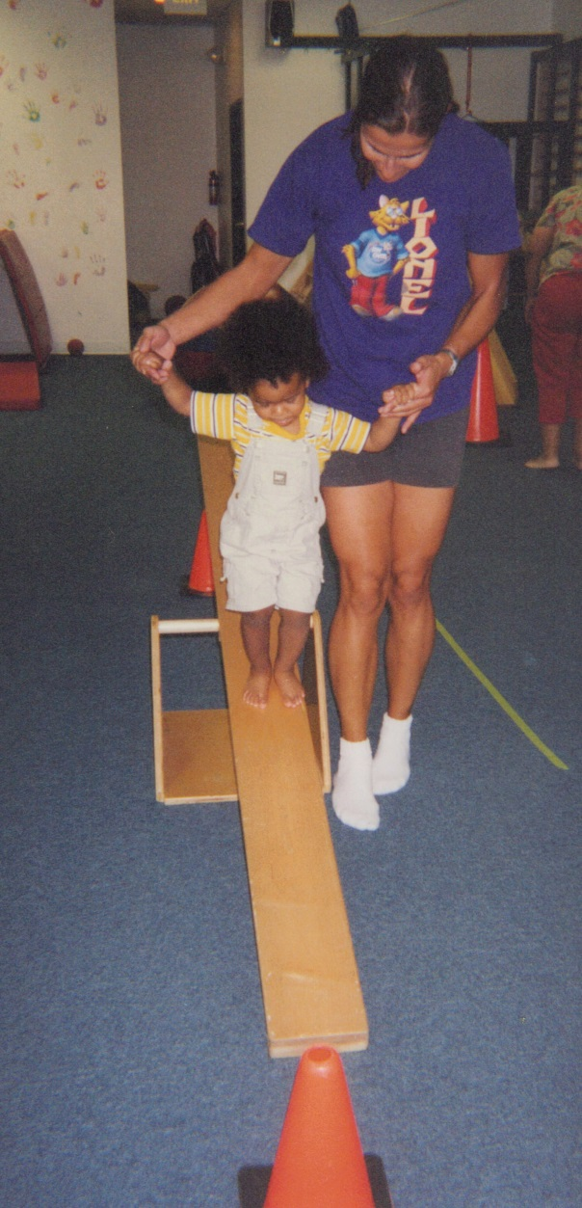
Working Together (Meetings, Evaluations)
Make sure that the family knows they’re a core part of the Team
Work as a Team – Everyone gets to share observations, provide suggestions, raise questions, and be heard
Honorable Intentions – Assume that all team members are working for the best of the child
Walk the Talk – Work collaboratively

Slide 24
Working Together (Meetings, Evaluations), cont.
Use warm and welcoming communication styles and social behaviors
Meet expectations – Be credible and follow though with plans that’ve been made
Balance the time spent listening and sharing
Use words that everyone can understand – Try to avoid jargon. If you use it, explain what it means and make sure others are okay with it

Slide 25
Over the Long Haul…
Revisit the relationship regularly to be sure everyone is working well together
Jointly consider new strategies, activities, or routines
Revise goals and outcomes as a Team

Slide 26
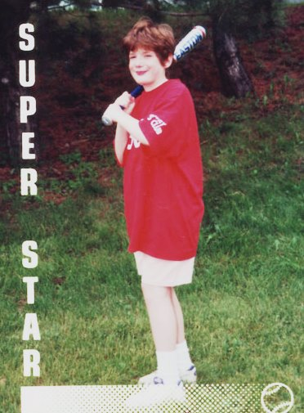
Over the Long Haul….
Step up to assist when others could use some help
Connect with families regularly, between meetings
Be aware of resources available in the community to support the student and family

Slide 27
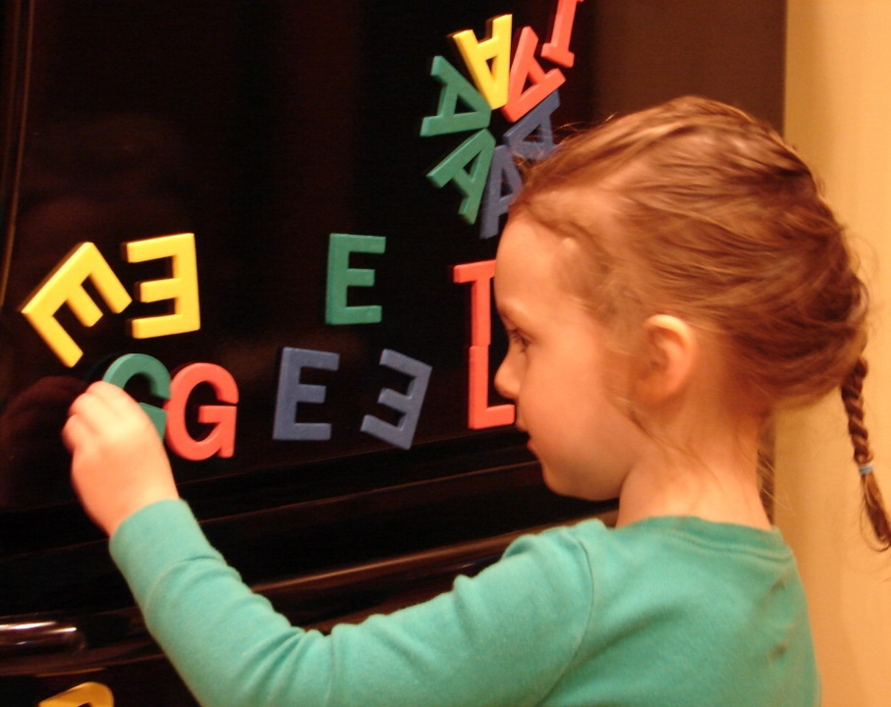
What are you doing to nurture and maintain your family-professional relationships?
Please share
your stories
in the
chat box!

Slide 28
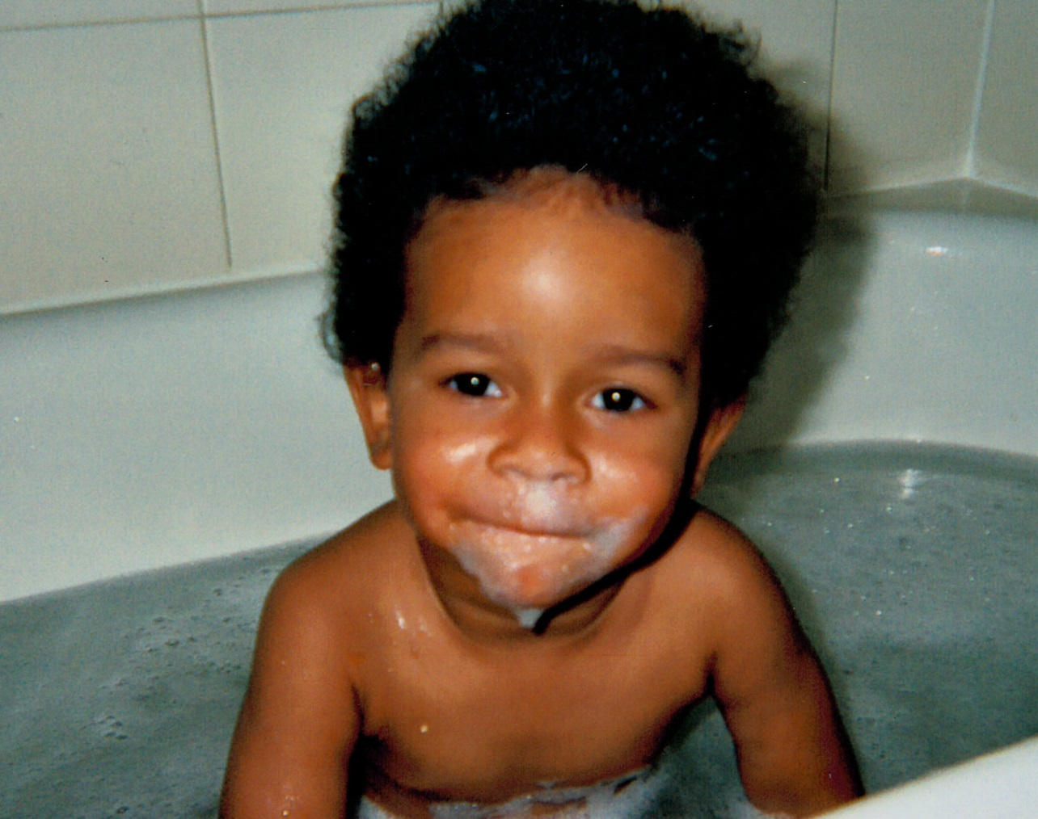
Any questions or comments?
Thank you!

Slide 29
Contact Information
Megan Vinh, ECTA Center & DaSy Center
megan.vinh@unc.edu
Judy Swett, PACER & ECTA Center
jswett@pacer.org
Amy Whitehorne, CADRE
awhitehorne@directionservice.org
Yvette Plummer Burkhalter, Denver Metro CPRC
yvettep@denvermetrocprc.org
Kristen Clarke Reaves, Cherry Creek Schools, Colorado
kreaves3@cherrycreekschools.org

Slide 30
Resources
Division for Early Childhood. (2014). DEC recommended practices in early intervention/early childhood special education 2014. Retrieved from http://www.dec-sped.org/recommendedpractices (Division for Early Childhood)
NECTAC Workgroup on Principles and Practices for the IEP Process. (2012, October). Key practices underlying the IEP process: Supporting family participation, inclusive practices, and positive outcomes for preschool children with disabilities. Retrieved from http://ectacenter.org/topics/iep/iep.asp (ECTA Center)
Workgroup on Principles and Practices in Natural Environments, OSEP TA Community of Practice: Part C Settings. (2008, February). Agreed upon practices for providing early intervention services in natural environments. Retrieved from http://ectacenter.org/topics/eiservices/keyprinckeyprac.asp (ECTA Center)

Slide 31
Thank you for joining us! Please take a few minutes to respond to this brief survey about your experience: Webinar Survey https://www.surveymonkey.com/s/playingnicely

