Slide 1
Parent Center Initiatives in Early Dispute Resolution Philip Moses, Jan Serak, Jody Manning, Timothy Riveria, Ana Espada January 22, 2015 2:30 pm – 3:45 pm ET (11:30-12:45 PT) Note: The PowerPoint is currently available on the CADRE website http://www.directionservice.org/cadre/parentsearlydr.cfm Dial in: 1-877-512-6886 ID: 679 683 6031
Technical Stuff:
All phone lines are muted – press #6 to unmute your phone during Q&A.
Use a phone line for best audio quality.
Please enter any questions or technical difficulties into the chat box.
Thank you for taking the time to answer the webinar poll questions! (Note: The poll questions will appear on your screen until we remove them)

Slide 2
Parent Center’s Role in Wisconsin Early Dispute Resolution Jan Serak, WI FACETS PTI

Slide 3
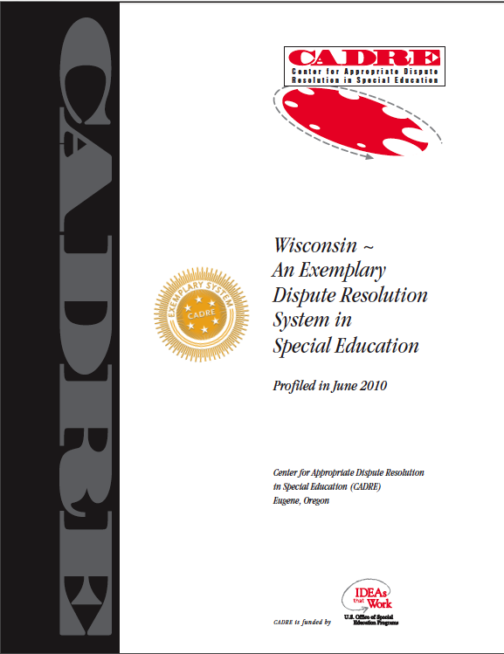
WSEMS Intro
Funded by WDPI since 1996
2014-15 Discretionary grant: $498,196
WI FACETS: $70,647
Nationally-recognized Exemplar
WSEMS partners:
Jan Serak, WI FACETS CEO & Parent
Nissan Bar-Lev, CESA 7 SpEd. Director
Nina Meierding, Mediator
WSEMS staff:
Jane Burns, Burns Mediation Services
Nelsinia Wroblewski, WI FACETS Parent Services Coordinator &
WSEMS Latino Outreach Specialist

Slide 4
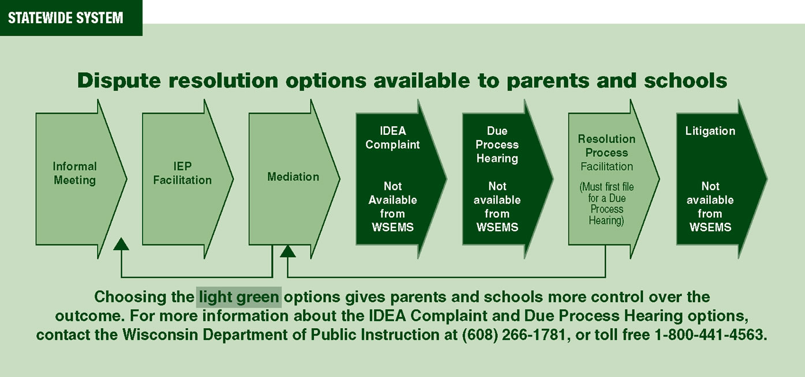
WSEMS DR Options

Slide 5
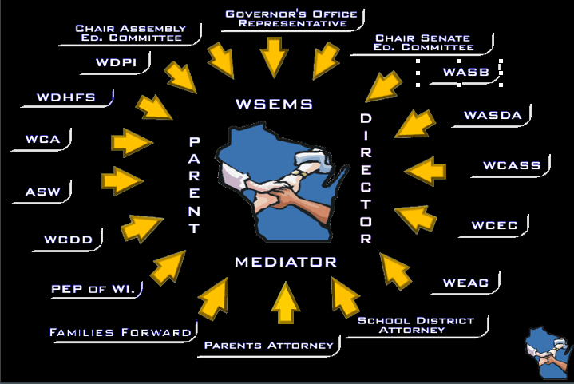
1996 WSEMS Stakeholders Council
PTI
Council’s initial work led by WSEMS Partners (Jan/CPRC, Nissan, Marquette Univ. Center for DR)

Slide 6
Current Stakeholders Council
Parent Stakeholders
Alianza Latina (CPRC)
ARC Wisconsin
Autism Society of WI
WI FACETS (PTI)
WI Family Ties
WI Board for People with DD
School Stakeholders
WI Assoc. of School District Admin.
WI Assoc. of School Boards
WI Council for Exceptional Children
WI Council of Admin.of Spec.Services
WI Education Association Council
Assoc. WI School Administrators
Attorney Stakeholders
Smith Amundsen
Buelow Vetter
Schott, Bublitz & Engel, SC
Disability Rights WI
Other Stakeholder Groups
WI Charter Schools Assoc.
WI Physical Therapy Assoc.
WI Occupational Therapy Assoc.
WI School Psychologists Assoc.
WI School Social Workers Assoc.
WI Speech & Lang. Assoc.
WI Statewide Parent/Educator
Initiative
Wrap Around Services
State Department Stakeholders
Governor's Office
Senate Education Committee
Assembly Education Committee
WI Dept. of Public Instruction
WI Dept. of Human Services

Slide 7
Current Council Tasks
Meet in-person biennially
Continue to advise the System
Members represent viewpoint of own stakeholders
Vigilance for neutrality
Annual review of external evaluation
Input when changes to the System are considered: IEP facilitation, Resolution Meeting facilitation, FIEP time limit
Input for other issues critical to the System
Help with training of roster neutrals
Promote use of the System
Help with outreach to respective constituencies
Identify training opportunities
Disseminate WSEMS information (Link to WSEMS website, distribute System materials, invite WSEMS to exhibit at events, advertise WSEMS trainings)

Slide 8
WSEMS Roster Neutrals
WSEMS Partners/staff interview & select neutrals
25 neutrals for 3 options List of WSEMS Neutrals:
http://www.wsems.us/mediators.html
WSEMS Partners/staff plan & provide required initial 5-day & annual 1-day training
WSEMS Partners/staff approve continued inclusion of neutrals on roster

Slide 9
Burns Mediation Services Intake Coordination Process
Request
Received
Facilitated
IEP
PTIC is not involved directly
Neutral
Intake
Coordinator
Parties’ Choice
(self-determination)
Mediation
Resolution
Meeting
Screening
Education
Analysis
Provide feedback to parties
Birth to 3
Mediation

Slide 10
WI Stats
Year | FIEP Req. | FIEPs Held | Medtn Req. | Medtns Held | Agreement Rate Med.
2013-14 | 43 | 27 | 68 | 43 | 81%
2012-13 | 19 | 11 | 75 | 50 | 88%
2011-12 | 23 | 18 | 49 | 34 | 85%
2010-11 | 24 | 11 | 76 | 51 | 92%
2009-10 | 25 | 15 | 70 | 47 | 91%

Slide 11
Longitudinal Surveys
 | IEP Facilitation (2004-13) | Mediation (2000-13)
Satisfaction with the process | 88% (n=958) | 88% (n=1895)
Would use the same neutral again | 85% (n=936) | 89% (n=1895)
Would use the process again | 87% (n=957) | 88% (n=1869)
Notes:
Our Stakeholders’ Council agreed that we should use a similar Evaluation process with Facilitated IEPs as we do with Mediation, to measure how the process is working.
All participants in the IEP Facilitation Meeting & the facilitator are asked to complete a survey about their experience.
We have provided you with a copy of these surveys.
The information is provided anonymously and remains confidential.
Only thing shared publicly is aggregate data like the longitudinal data (for 9 years) that is shown on this slide.
We are very transparent with these results – sharing them annually with our WSEMS Stakeholders’ Council, the WI Dept of Public Instruction, our Mediators, and, as you can see, during our training of parents & schools.
This data is particularly significant given the nature of the group that seeks the IEP Facilitation option. There are about 125,000 students with disabilities in Wisconsin. While the vast majority of these IEPs proceed smoothly, some do not. This small group of parents/schools end up distrusting each other. It is significant that through the IEP Facilitation process – these participants acquire a positive and trustful view of the IEP process and each other.

Slide 12
Outreach, etc.
As WSEMS Partner:
Website development
Co-Training
Materials development & dissemination
En Español
Write DPI grant reports
Write annual grant application
As WI FACETS PTI
Promote WSEMS DRO
Provide training
Prepare parents for & support them in mediation & FIEPs
http://wsems.us/

Slide 13
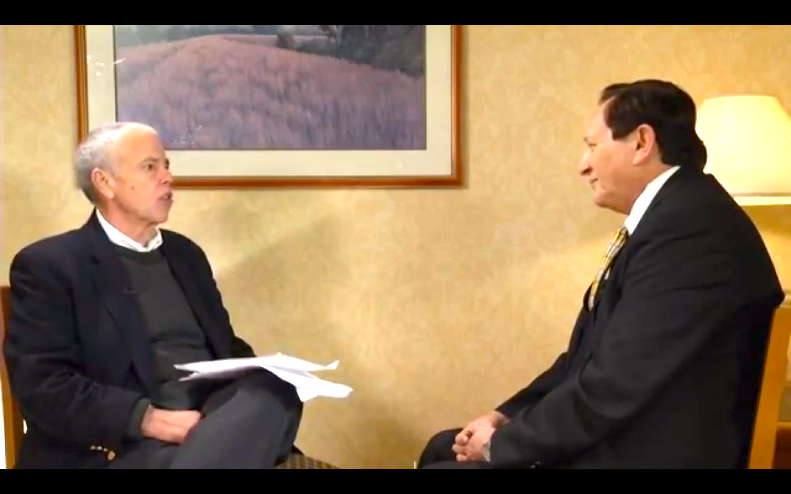
CADRE: Voices from the Field www.directionservice.org/cadre/barlevinterviews.cfm
Notes:
n.

Slide 14
Resources
WI Special Education Mediation System www.wsems.us/about/who-we-are/
WI FACETS www.wifacets.org/programs/statewide-projects
CADRE Exemplar Collection www.directionservice.org/cadre/exemplar/matrix.cfm
CADRE Voices from the Field www.directionservice.org/cadre/barlevinterviews.cfm
Center for Parent Information and Resources
www.parentcenterhub.org/?s=dispute+resolution
WI Department of Public Instruction
http://sped.dpi.wi.gov/sped_wsems

Slide 15
PACER Center
Jody Manning
Parent Training and Information Center Co-Director

Slide 16
MN’s additional dispute resolution option
Conciliation Conference
10 calendar days from date of receipt of objection
5 school days – final proposed offer of service

Slide 17
MN Department of Education
Offered request for proposals to work with parents of children with disabilities re: dispute resolution
PACER applied
Have received funding for this project via MDE for 5 years

Slide 18
ADR project – previous year Goal: Provide individual assistance
General assistance regarding disputes
524 parents
Follow-up contacts w/ written information, review of records, referrals
Assistance w/ complaints
Discussion – 533 parents, issues often resolved
Help w/ filing complaint – 15 parents
Developed checklist handout for filing complaint:
http://www.pacer.org/parent/php/PHP-b17.pdf

Slide 19
Goal: Provide training
Live and web training* on dispute resolution, with an emphasis on underserved families.
640 attendees statewide*.
160 attendees were Spanish, Somali, or Hmong.
Presented in native language.
Developed and piloted a new live training* and webinar* on communication within special education and the dispute process.
78 attendees statewide*.
97% rated training excellent or very good.
*trainings under this grant only

Slide 20
Goal: Outreach to families to build parent capacity.
Publish articles in PACER’s PACESETTER and E-news
Distribution of 150,000 persons.
Newly dedicated dispute resolution web page.
http://www.pacer.org/disputeresolution/
Brochure on dispute resolution options.
(http://www.pacer.org/parent/php/php-a25.pdf)
Translated into Spanish, Somali, and Hmong languages.
Shared in workshop folders.

Slide 21
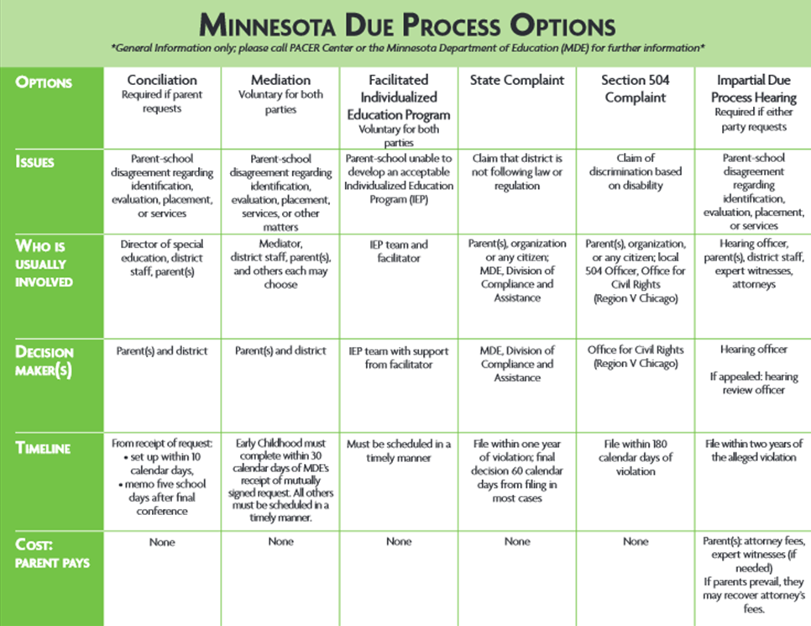
Minnesota Due Process Options *General information only; please call PACER Center or the Minnesota Department of Education (MDE) for further information*

Slide 22
Goal: Provide personal assistance at dispute resolution meetings.
Helped parents prepare for dispute resolution meetings
Attended dispute resolution meetings w/ parents statewide
Participated in 142 dispute resolution meetings statewide
Meetings could be up to 8 hours from PACER
Attended some meetings via conferencing

Slide 23
Current year project goals:
Continue to:
provide individual assistance about dispute resolution to families*.
help parents prepare for and attend dispute resolution meetings statewide*.
assist parents with the complaint process*.
*all tabulated separately from other projects

Slide 24
Current year project goals (continued):
RFP: “The project goals are to reach diverse geographic and ethnic populations, using culturally responsive practices and participants’ native languages, as organizations:
increase parents’ understanding of collaboration for education planning;
improve parents’ skills in communication, self-advocacy and conflict resolution;
increase parents’ knowledge of proactive, positive strategies and interventions to deal with mental health issues”

Slide 25
Current year project goals (cont.):
New curriculum/ workshops:
“Helping Your Child Succeed in School”
“Talking with the School About My Child”
“Ten Important Rights in Special Education”
Train parents on how to effectively communicate and plan with the school for a child with mental health, emotional or behavioral needs.
English, Spanish, Hmong, Somali
Onsite individual assistance to diverse families in greater Minnesota following training.

Slide 26
Thank you!
www.PACER.org

Slide 27
Parent Center Initiatives in Early Dispute Resolution
Timothy Riveria, Staff Attorney
Advocates for Justice and Education, Inc.
Notes:
This presentation was given by Tim Riveria to the

Slide 28
Project Inception
AJE is the PTI Center in DC
Provides advice and training to parents along with direct assistance
In 2013, State Education Agency (OSSE) provided funding to AJE to develop and assist with the implementation and training for Facilitated IEP Program

Slide 29
Foundation
Information Gathering
CADRE
Parent Centers with FIEP Projects
Other states in the region
Trained AJE Staff
Role plays
Began developing referral tools in intake

Slide 30
Program Design
Formed Resolution Project to manage FIEP Program
Resolution Project Director responsible for
Staffing FIEP referrals
Overseeing basic operations
Collection and compilation of evaluation data

Slide 31
Materials
Program brochure for parents
Informational materials for school staff
Procedural materials for facilitators
Agreement with LEA
FIEP evaluation tools
Post FIEP evaluation for parents and guardians
Post FIEP evaluation for special education coord.

Slide 32
Stakeholder Buy-In and Process Tools
Focus group with…
SEA and LEA Representatives
Advocacy organization
Educators
Neutrality concerns by school staff
Review of materials
Review of forms and materials by focus group
Notes:
Traditional school system does not expel ES kids and practically can’t suspend for more than ten school due to alt. school setting requirement.

Slide 33
Facilitators and Outreach
Recruited Facilitators with knowledge of DC special education system and IDEA
background in: conflict resolution, decision-making processes, effective communication, understanding group dynamics, facilitating meeting
Outreach
FIEP brochure and information on website
Parent trainings on FIEP

Slide 34
LEA Partnership & Launch
Traditional school system agreed to participate
Addressed school concerns about liability, privacy concerns, intake of parents
Pilot moving forward in three schools this year
Holding trainings for staff at the pilot schools within next few weeks
We will begin accepting referrals after the trainings

Slide 35
Advocates for Justice and Education, Inc.
25 E Street, NW, 4th Floor
Washington, DC 20001
(202) 678-8060
www.aje-dc.org
timothy.riveria@aje-dc.org

Slide 36
Expanding Special Education Mediations into suspensions

Slide 37
Agenda
Will briefly discuss:
Advocates For Children of New York City
Mediation in New York State
Mediation and Discipline
Suspension Pilot Project overview
Why mediation?

Slide 38
About Advocates For Children of NY
AFC is an educational advocacy organization that protects the right of students in NYC to a quality education, focusing on children who are at-risk.
AFC provides free legal services to families as well as training and resources that prepare families to advocate for themselves
Staffed with advocates and attorneys to work in different ways to achieve one end: A quality education for NYC children
Impact Advocacy & Litigation
Individual Advocacy
Workshops and Trainings
Public Policy

Slide 39
How Mediation Works in NYS
NYS Education Department contracts out special education mediation to NYS Dispute Resolution Association
Non-profit agency that provides community dispute resolution services through the Unified Court System of the State of NY.
NYSDRA coordinates the provision of special education mediation through local Community Dispute Resolution Centers in the Bronx, Manhattan, Brooklyn, Queens and Staten Island.
NY Peace Institute is contracted to work with Manhattan & Brooklyn

Slide 40
Mediation and Discipline. When?
AT ANY POINT. But, in particular, during the earlier suspensions and exclusions.
The Manifestation Determination Review
Once a child has a suspension which triggers an MDR, the MDR itself can be mediated.
If the family/school disagree with the result of the MDR, Mediation can be used instead of an appeal or going to an impartial hearing.

Slide 41
AFC and the NY Peace Institute Propose a Superintendent Suspension Pilot Project
To help work out alternative approaches to superintendent suspensions that often have negative results for students.
To provide parties the opportunity to be heard and validated and to develop reasonable and workable plans for the future.
To provide an opportunity to discuss and evaluate the student’s immediate conduct.
To improve student behavior and reduce the reliance on adversarial suspension hearings that can harm relationships.
To reduce the national trend that funnels children out of public schools and into the juvenile and criminal justice system through harsh disciplinary policies.

Slide 42
Pilot Overview
Two tracks of mediation:
Fast track - option to mediate is given to the school and families between the date that the superintendent suspension is issued and the date of the hearing (five day period).
Mediation occurs on the day of the suspension hearing.
Anticipated results:
Fewer suspension hearings, fewer long term suspensions, and more productive dialogue between the schools and families about student behavior.
If the parties do not wish to mediate or a mediation agreement is not reached during the interim period, the traditional suspension hearing process continues.
If the school and family are unable to mediate because of time/scheduling constraints, the day of hearing still remains.

Slide 43
Why Mediation?
Address the immediate issues regarding the suspension allegations
Review the charges and evidence and discuss the specific behavior and circumstances
Provide an opportunity to discuss follow-up actions
Possible Outcomes:
Withdraw the suspension because allegations were not adequately supported - student returns to school immediately.
Allegations are supported and the parties negotiate the disciplinary result -including a range of disciplinary outcomes outside of suspension, including guidance conferences, community service, referral to CBO, Restorative Justice Circle, etc.
Agreement to plead no contest and negotiate the disciplinary result.
No agreement or disciplinary result - proceed to hearing.

Slide 44
Possible outcomes of Mediation as well as follow-up Restorative Justice Processes
Lower recidivism rates
Improved relationships between parents and schools leading to greater collaboration
Fewer days out of school=better grades
Resolution of concurrent criminal cases, if also pending
Interruption of the “School to Prison Pipeline”
Increased student reengagement
Reduction of behaviors leading to suspensions

Slide 45
Reasons why AFC/NY is doing mediations
Scheduled in a timely manner
within a few days vs. 45 days from receipt of request, and possible recusals because of backlog impartial hearings filed
DOE personnel with authority to make decisions must be present
Issues can be resolved in a timely, non-adversarial manner
No cost to parent or district
Does not deny other due process rights
before, during or after
NY Peace Institute mediators are highly trained

Slide 46
Thank you for joining us! Please take a few minutes to respond to this brief survey about your experience: Webinar Survey https://www.surveymonkey.com/s/parentearlydr

Slide 47
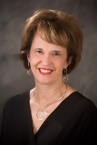
Upcoming Webinar: Trusting Family-Professional Partnerships: Preventing, Resolving, and Moving Beyond Disputes with Ann Turnbull April 2, 2015 2:30 pm – 3:45 pm ET (11:30-12:45 PT) Registration Open!

