Slide 1
CADRE Webinar September 12, 2018
Skilled Dialogue Revisited:
JOINING & HARMONIZING Diverse Perspective
Isaura Barrera, Ph.D.
(isaurabarrera@mac.com)
Professor Emerita
University of New Mexico
Lucinda Kramer, Ph.D.
(lkramer@nu.edu)
Professor, National University
Costa Mesa, CA

Slide 2
Skilled Dialogue at a Glance
© Barrera & Kramer, 2017; please do not use in part or in whole without referencing

Slide 3
SKILLED DIALOGUE
Choosing
Relationship
Over Control
Setting
the Stage
for Miracles
Welcoming
Sense-Making
JOINING
Allowing
Appreciating
HARMONIZING

Slide 4
Scenario
Mr. Jacoby, and elementary special education teacher, wants to talk to Mrs. Ricardo, Patrick’s mom, about some of Patrick’s behaviors. Mrs. Ricardo hasn’t returned any of Mr. Jacoby’s calls. When Mr. Jacoby has a chance to talk to Mrs. Ricardo, she quickly tries to shut down the conversation by saying, “I don’t want to talk about Patrick’s behavior again. Tell me how he’s doing in reading?” Mr. Jacoby tries again and asks, “What makes it difficult for you to talk about Patrick’s behavior?” This time, Mrs. Ricardo does not change the subject. Her eyes tear up and she says, “I feel like you are always picking on Patrick. I’m sure he’s not the only one acting like that in your class. What am I supposed to do? I can’t do anything about his behavior at school. I can barely manage it at home.”
(NOTE: See Barrera & Kramer (2017) for more detailed analysis and discussion of other scenarios.)

Slide 5
Procedural Steps
CAUTION: Even though, for purposes of this presentation, Skilled Dialogue’s various steps are discussed in a linear fashion, they are in fact cyclical and reiterative .
Steps often need to be revisited depending on how interactions progress. If you find it difficult to appreciate the others’ views, for example, it may be that you need to allow more time for them to express those views, or perhaps, you need to give more attention to making sense of those views. Similarly, if one disposition seems difficult to set in place, it may be that the other needs to be strengthened.

Slide 6
Step 1: Set your dispositions
Disposition
The predominant stance with which you approach what you do

Slide 7
Choosing Relationship over Control

Slide 8
Setting the Stage for Miracles

Slide 9
Step 2: Honor other’s identity
Acknowledge and accept boundaries that define other’s identity as evidence-based

Slide 10
Pre-Requisite Strategies

Slide 11
Step 3: Establish reciprocity
Recognize that each person in an interaction is equally capable; honor all voices

Slide 12
Support Strategies:

Slide 13
Step 4: Be responsive
Identify and affirm connections between diverse perspective

Slide 14
Key Strategy: JOINING

Slide 15
Key Strategy: HARMONIZING

Slide 16
It is our hope that Skilled Dialogue will help you establish “brave spaces” from which to create shared understandings that contribute to a collective truth enriching to all of us.
“I therefore recommend that you and the other side establish a ‘brave’ space,” a
learning environment that emboldens you to embrace [differences], take personal
risks, and reconsider perspectives.” (Shapiro, 2017)
“Dialogue is not about trying to change anyone’s opinions but is about understanding
that people’s opinions, their truths, can actually be a contribution to a collective
truth. This is perhaps the fundamental purpose of dialogue—to create a shared
understanding beyond our individual points of view.” (Zaiss, 2002)

Slide 17
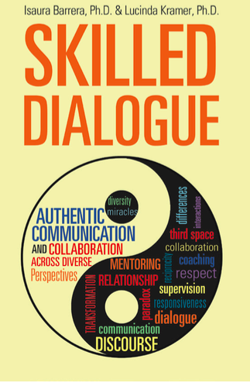
The material in this presentation has been adapted from Barrera & Kramer, 2017. Given the time and format constraints we could only summarize much of the information contained in the book, which explores Skilled Dialogue in greater depth and specificity. It also contains multiple resources for greater understanding of 3rd Space, a key concept of Skilled Dialogue.

Slide 18
Contact Us
You may contact us directly at any time to ask questions, get further information and/or request presentations.
We are available for a limited number of
both online and onsite presentations each year.
isaurabarrera@mac.com
lkramer@nu.edu

