Slide 1
Productive Conversations
Through Empathy
Stephanie Weaver and Lenore Knudtson
July 10, 2018
11:30 am – 12:45 pm PT (2:30 pm-3:45 pm ET)
Note: The presentation will be available on the CADRE website: https://www.cadreworks.org/events/productive-conversations-through-empathy
Technical Stuff:
Please enter any questions or technical difficulties into the questions box.
Thank you, in advance, for taking the time to respond to the brief survey at the end of the webinar!

Slide 2

Productive
Conversations
Through
Empathy
Emotional Intelligence
Productive Conversations
Empathy, Not ownership
Circle of concern
Discussion
Stephanie Weaver and Lenore Knudtson
Pingora Consulting

Slide 3
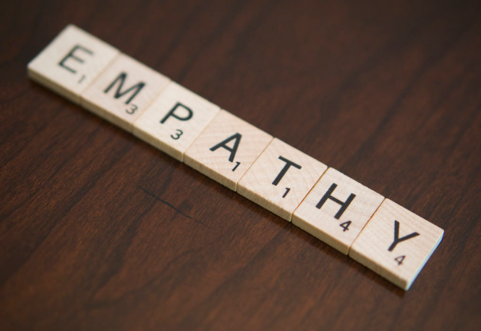

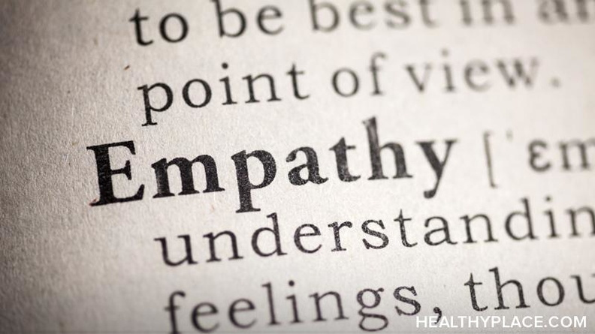
Empathy, not ownership.
What is it?
How do you get it?

Slide 4
Empathy: What is it?
The great liberator.
The ability to understand the feelings of another.
Without experiencing those feelings as your own.
Demonstrating compassion without infringing on your beliefs.

Slide 5
Empathic Concern
You aren’t sharing the same painful feelings as another person, e.g. sadness or fear.
How to Stay Empathic Without Suffering So Much, Amy L. Eva (May 4, 2017).

Slide 6
Empathic Concern cont.
The Science: Neurology of Empathy
When we give and receive empathy, we produce the neurotransmitter oxytocin.
Oxytocin creates a sense of trust and cooperation
Leading with empathy can reduce the likelihood of conflict.
How to Fight Stress with Empathy, Arthur P. Ciaramicoli (January 11, 2017).
The Art: The Eyes of Another
Empathy is the art of seeing the world as someone else sees it.
When you have empathy, it means you can understand what a person is feeling in a given moment, and understand that his actions made sense to him.
ImproveYouSocialSkills.com

Slide 7
Don’t Take it Personally
Through empathy, the listener is less likely to take something done or said personally, or focus only on the negative instead of the positive in a situation.
How to Fight Stress with Empathy, Arthur P. Ciaramicoli (January 11, 2017).

Slide 8
Empathy Training
Doctors who participated in empathy training interacted more compassionately with patients, yet their stress levels decreased.
Those who lack empathy often pick up the stress of others without knowing why – a concept that researchers call “second-hand stress.”
The Surprising Health Effects of Empathy, Charles Poladian (June 26, 2012).

Slide 9
Empathy vs. Sympathy
Empathy is when you understand the feelings of another but do not necessarily share them.
Sympathy is when you share the feelings of another and make them your own.

Slide 10
Empathy: How do you get it?
Yourself
Building Empathy
Others
Understanding Yourself
Understanding Others
Nonverbal Empathy
Empathy, ImproveYourSocialSkills.com.
Nonverbal
Continuum

Slide 11
Yourself: Give Permission
Give yourself permission to experience the feelings that you have.
On a fundamental level, you should accept that your emotions are part of you. Accept and recognize your emotions.
If you understand what it’s like when you feel an emotion, you’ll be better able to understand and interact with a person feeling something similar.

Slide 12
Others: Find Perspective
In any moment, imagine what it would be like to be that person.
During every interaction, ask yourself: How does this situation appear to the other person?
Rather than trying to find out how the other person sees things, we try to convince them to see things our way. Instead of accepting that the other person will always see things differently, we get angry at them for not seeing things the same way we do.

Slide 13
Nonverbal: In Harmony
There is a nonverbal element to responding to empathy as well.
Your words and your nonverbal signals work together to communicate.
Without Nonverbal Empathy, you lack authenticity.

Slide 14
Empathy Continuum
Ignorance
Indifference
Empathy
Negative Actions
Positive Actions
Selfishness
Sympathy
Empathy Continuum, RSA Blog

Slide 15
Emotional Intelligence
Increased personal wellbeing
Increased leadership ability
Increased team performance
Improve decision making
Decreased occupational stress
Reduced staff turnover
EQ
Authentic
Leaders

Slide 16
EQ Defined
Emotional Intelligence or Emotional Quotient, is defined as your ability, capacity or skill to identify, assess, and manage the emotions of one’s self, of others, and groups.
Empathy and emotional intelligence: What is it really about?, International Journal of Caring Sciences (2008).

Slide 17
Authentic Communication
Emotional understanding: healthcare professionals understand the problem through the patient’s point of view.
Respect: recognition and full acceptance of the patient as a person.
Authenticity: honesty, real expression of views without hypocrisy; Warmth and unconditional positive recognition.
Self exposure: health care professional reports personal experiences from his perspective.
Empathy and emotional intelligence: What is it really about?, International Journal of Caring Sciences (2008).

Slide 18
Understand vs. Manage
Empathy and emotional intelligence work together to produce long lasting relationships.
Empathy allows the leader to understand, while emotional intelligence allows them to communicate that understanding.
Empathy and Emotional Intelligence: The Ability to Connect, Anthony Iannarino (February 2010).

Slide 19
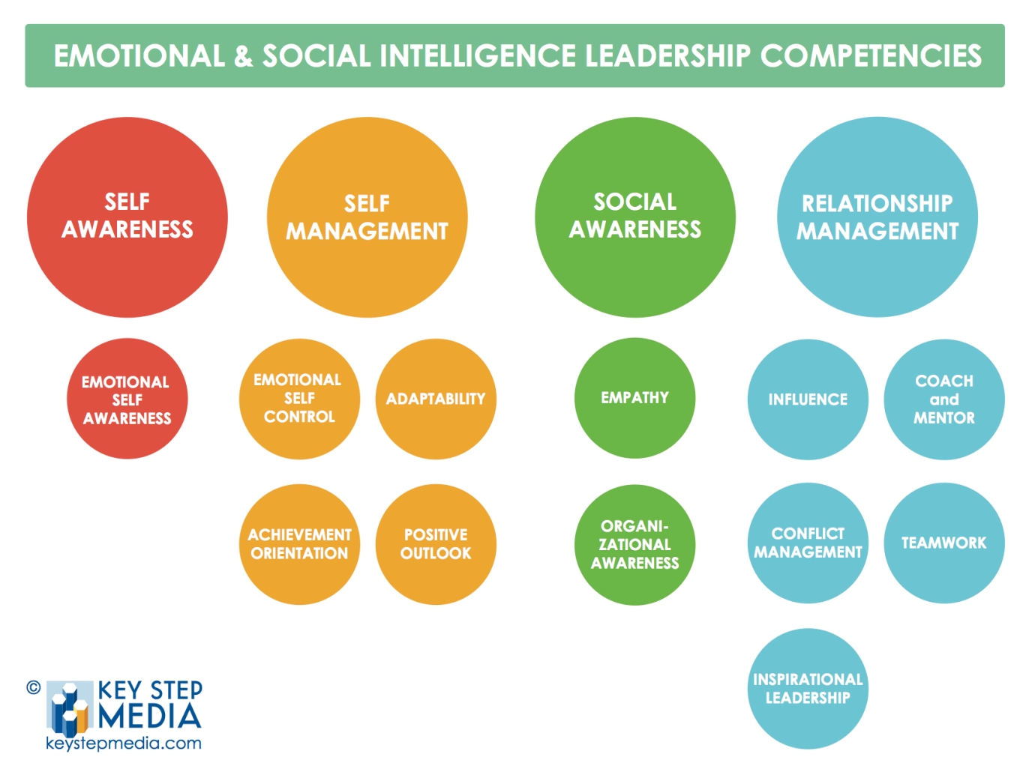
Competencies
Self Awareness
Self Management
Social Awareness
Relationship Management

Slide 20
Self Awareness
The ability to understand our own emotions and their affects on our performance.

Slide 21
Self Management
Emotional Self-control: The ability to keep disruptive emotions and impulses in check and maintain our effectiveness under stressful or hostile conditions.
Achievement Orientation: Striving to meet or exceed a standard of excellence; looking for ways to do things better, set challenging goals and take calculated risks.
Positive Outlook: The ability to see the positive in people, situations, and events and persistence in pursing goals despite the obstacles and set backs.
Adaptability: Flexibility in handling change, juggling multiple demands, and adapting our ideas or approaches.

Slide 22
Social Awareness
Empathy: The ability to sense others’ feelings and perspectives, taking an active interest in their concerns and picking up cues about what others feel and think.
Organizational Awareness: The ability to read the group’s emotional currants and power relationships, identifying influencers, networks, and organizational dynamics.

Slide 23
Relationship Management
Influence: The ability to keep have a positive impact on others, persuading or convincing others in order to gain their support.
Coach and Mentor: The ability to foster long term learning or development of others by giving feedback, guidance, and support.
Inspirational Leadership: The ability to inspire and guide individuals and groups toward a meaningful vision of excellence, and the bring out the best in others.
Teamwork: The ability to work with others toward a shared goal; participating actively, sharing responsibility and rewards, and contributing to the capability of the team.

Slide 24
Lean in…
What would happen if more leaders were of the mindset to know a little more about the people at the table, care a little more about their needs, and showcase their strengths to give them opportunities for success?
Know more.
Do you know what’s the most important to each of your team members? Not what you think is, but what actually is most important? If you don’t, how can you support them in achieving their goals in their careers and in their lives – let alone, giving their best to you? How do you know how to motivate them?

Slide 25
Care more.
The learning here is simple. We are all distracted. But when you’re meeting with a team member, or an employee or anyone for that matter, focus. Help that person feel, that to you, they’re the most important person in the room.
Showcase more.
Look for opportunities outside of your group where they can showcase specific strengths that are needed and will benefit the greater organization. Identify opportunities to help them grow as a leader and as a person.

Slide 26
Circle of Concern
Build mutual respect and understanding of different perspectives. An environment must be created that allows individuals to express what they are thinking. I tis up to leaders to evoke safety and assist the ream in building trust.
A leader promoted group participation, allowing all participants to have a voice at the table and fostering the space in which change occurs
A leader is mindful of who is in the circle of concern and looks for ways to expand it.
Expanding Circles
Be Intentional

Slide 27
Expand Your Circle
One way to create and foster the space of change is to expand your “circle of concern.”
We are predisposed to empathize with others in our own social group. We think of those groups as circles.
Because circles can be confining and exclusive, we also have people who are outside our circle.
Making Caring Common, Harvard School of Education (2017).

Slide 28
Be Intentional
Intentionally expand your circle of concern through empathy.
Allow people in your circle who may disagree with you.
Allow people in your circle who don’t look like you.
Allow people in your circle who you have to work hard to understand. It’s liberating!

Slide 29
Zoom in. Zoom out.
Zoom in:
Listen closely and tend to those in your immediate circle, i.e, those at the IEP team table.
Zoom out:
Take in the big picture. Consider perspectives of the people you interact with daily.
Include those who are vulnerable
Develop concern for people who live in very different cultures and communities than their own.

Slide 30
Productive Conversations
Characteristics
School Communities
Dispute Resolution
Strategies
IEP Teams

Slide 31
Characteristics
Goal driven
Relationships
Effective communication
Forward facing
Open mindedness

Slide 32
Strategies
Eliminate mind chatter
Build an agenda
Actively listed
Ask questions
Express, release and repair

Slide 33
Consider how empathy might influence your next conversation
Questions
Contact Us

Slide 34
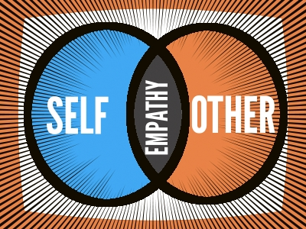
Questions?

Slide 35

PingoraConsulting.com
Thank you!

Slide 36

Thank you for joining us!
Please take a few minutes to respond to this brief survey about your experience:
Webinar Survey https://www.surveymonkey.com/r/EmpathyConversations

Slide 37
Upcoming Webinar
Introducing the Part C Dispute Resolution Family Guides
Co-Hosted with the Center for Parent Information and Resources (CPIR)
September 10, 2018
12:00 pm -1:15 pm PT
More Details Coming Soon – Check the CADRE Website!

