Slide 1
The Transformative Power of Engaging Parents as Partners
Greg Mizel, Associate Superintendent
Jodi L. Payne, Director
Michelle O'Connor-Ratcliff, Poway Unified School District Board Member and Parent
September 29, 2022
Notes:
Hello, I’m Melanie Reese, the director of CADRE, the national center for appropriate dispute resolution in special education.

Slide 2
The Transformative Power of Engaging Parents as Partners
September 29, 2022

Slide 3
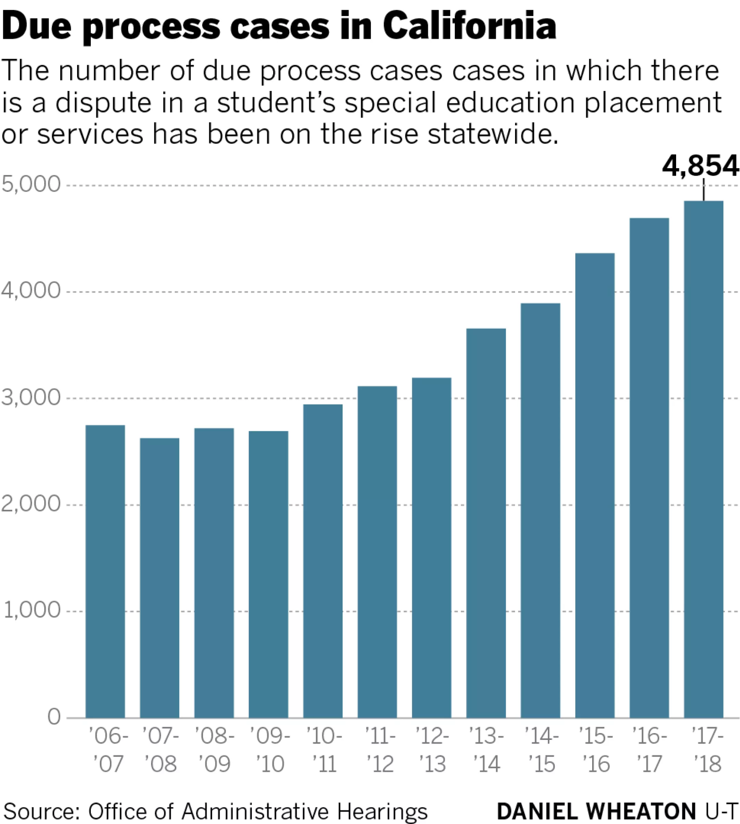
Due Process cases in California
The number of due process cases, in which there is a dispute in a student’s special education placement or services, has been on the rise statewide.

Slide 4
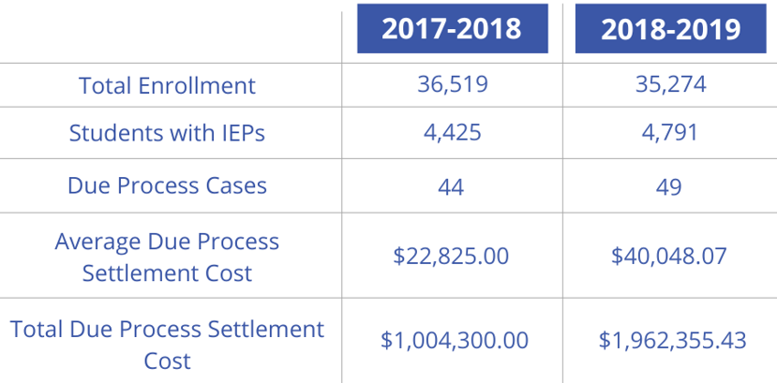
Due Process Case Numbers 2017-19

Slide 5
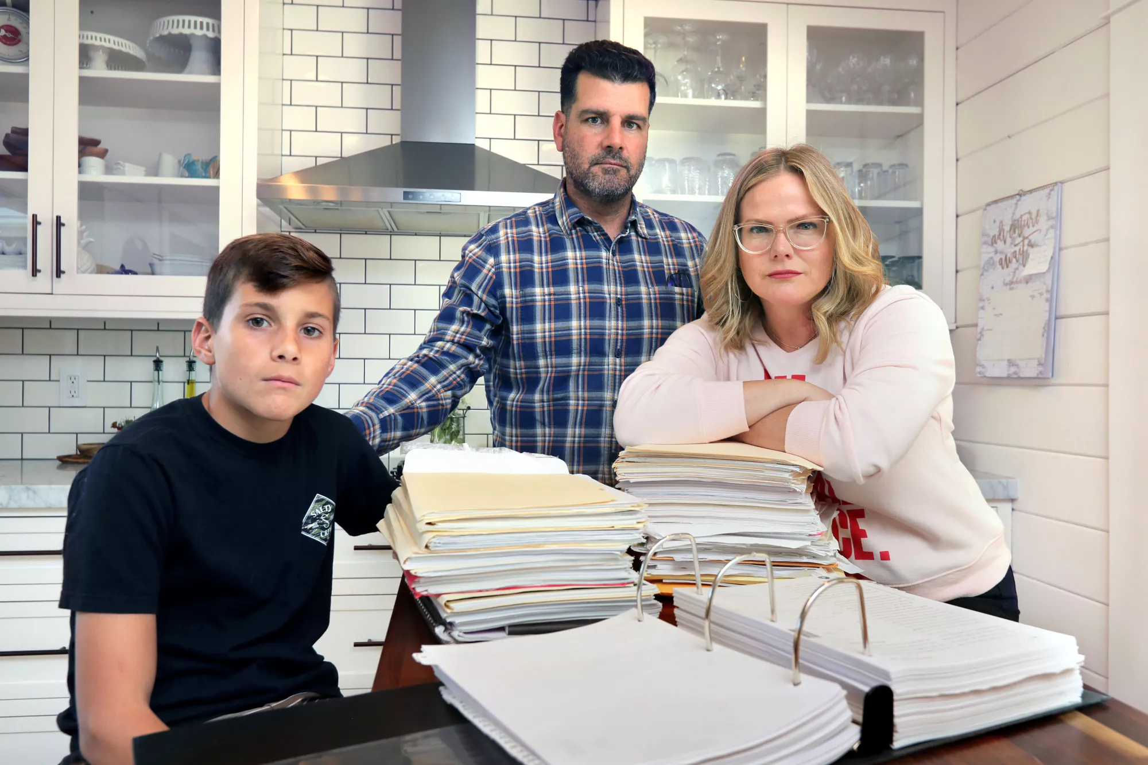
Families endure costly legal fights trying to get the right special education services
Due process cases often pit families and schools against each other, instead of being partners in improving special education, critics say
BY KRISTEN TAKETA
OCT. 6, 2019 11:39 AM PT

Slide 6
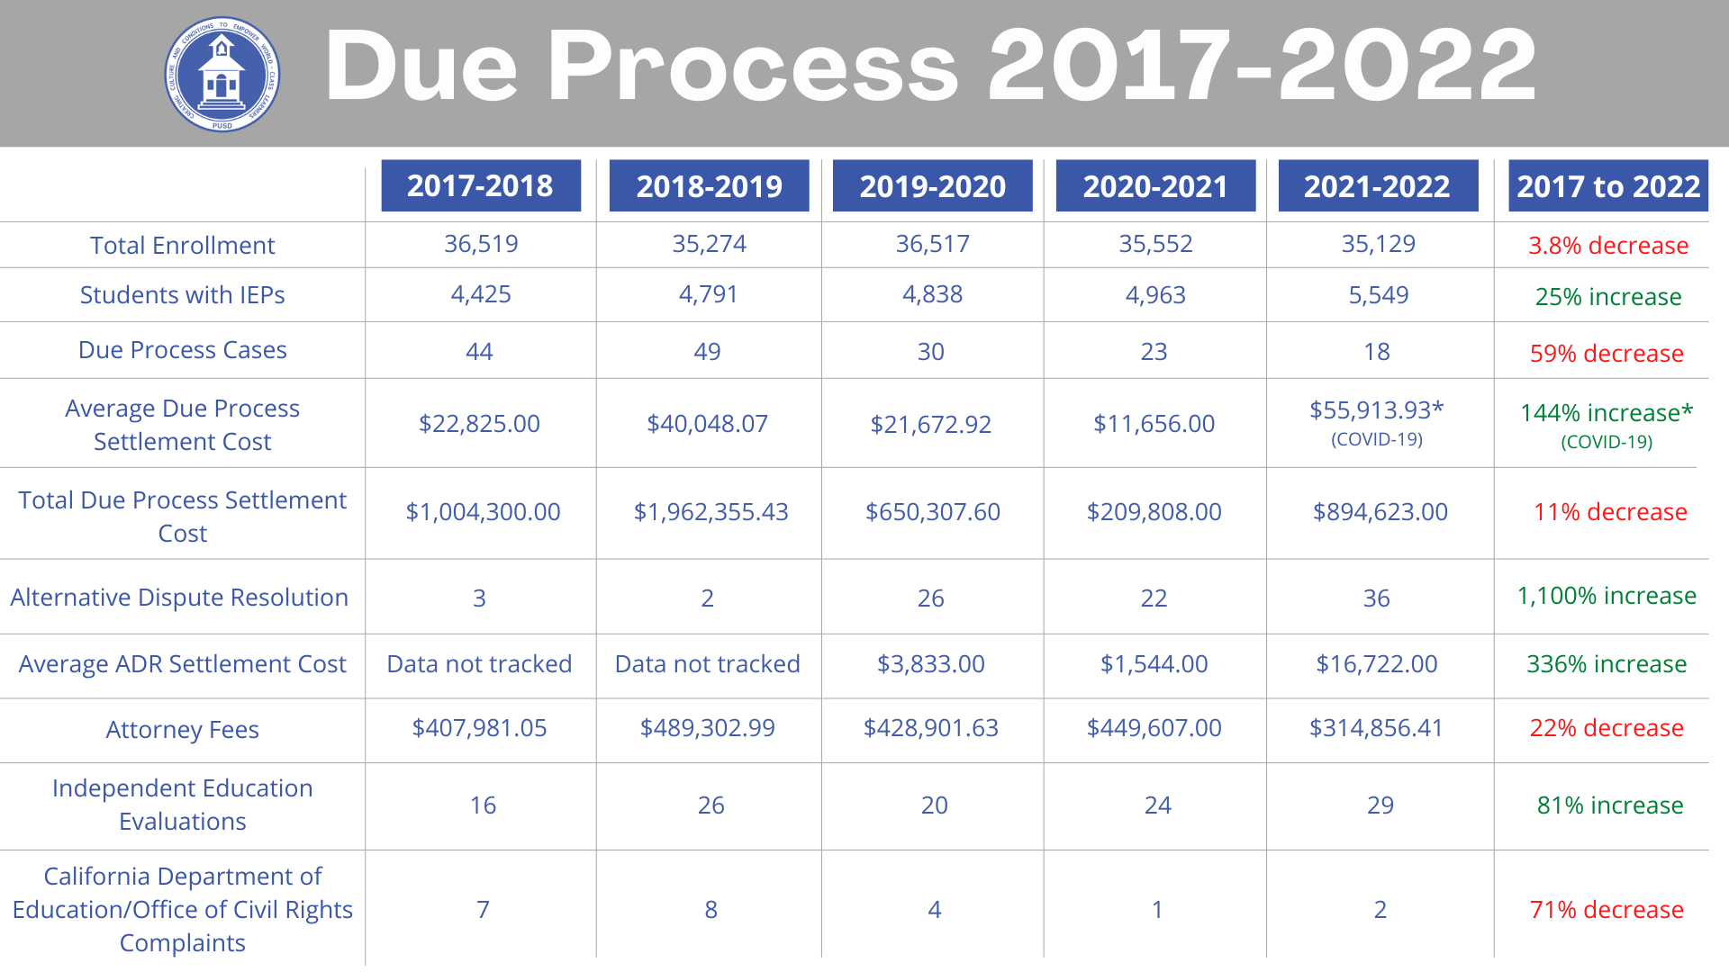
Due Process 2017-2022

Slide 7
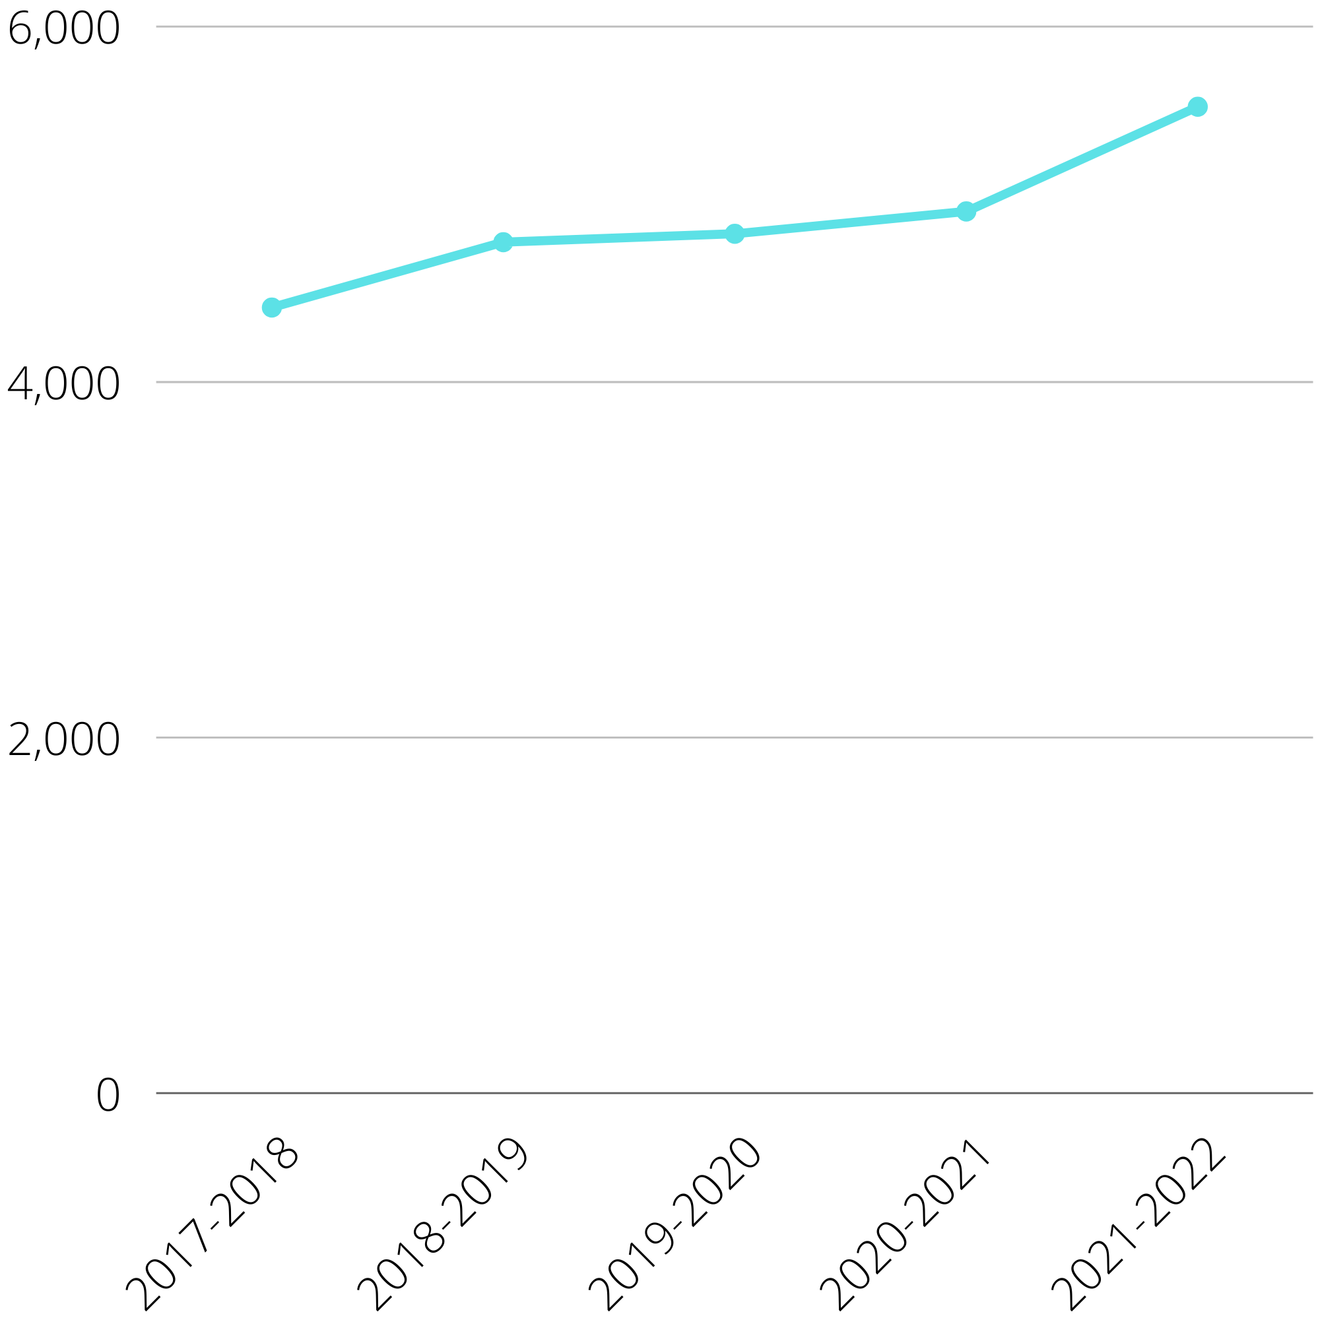
Student with IEPs

Slide 8
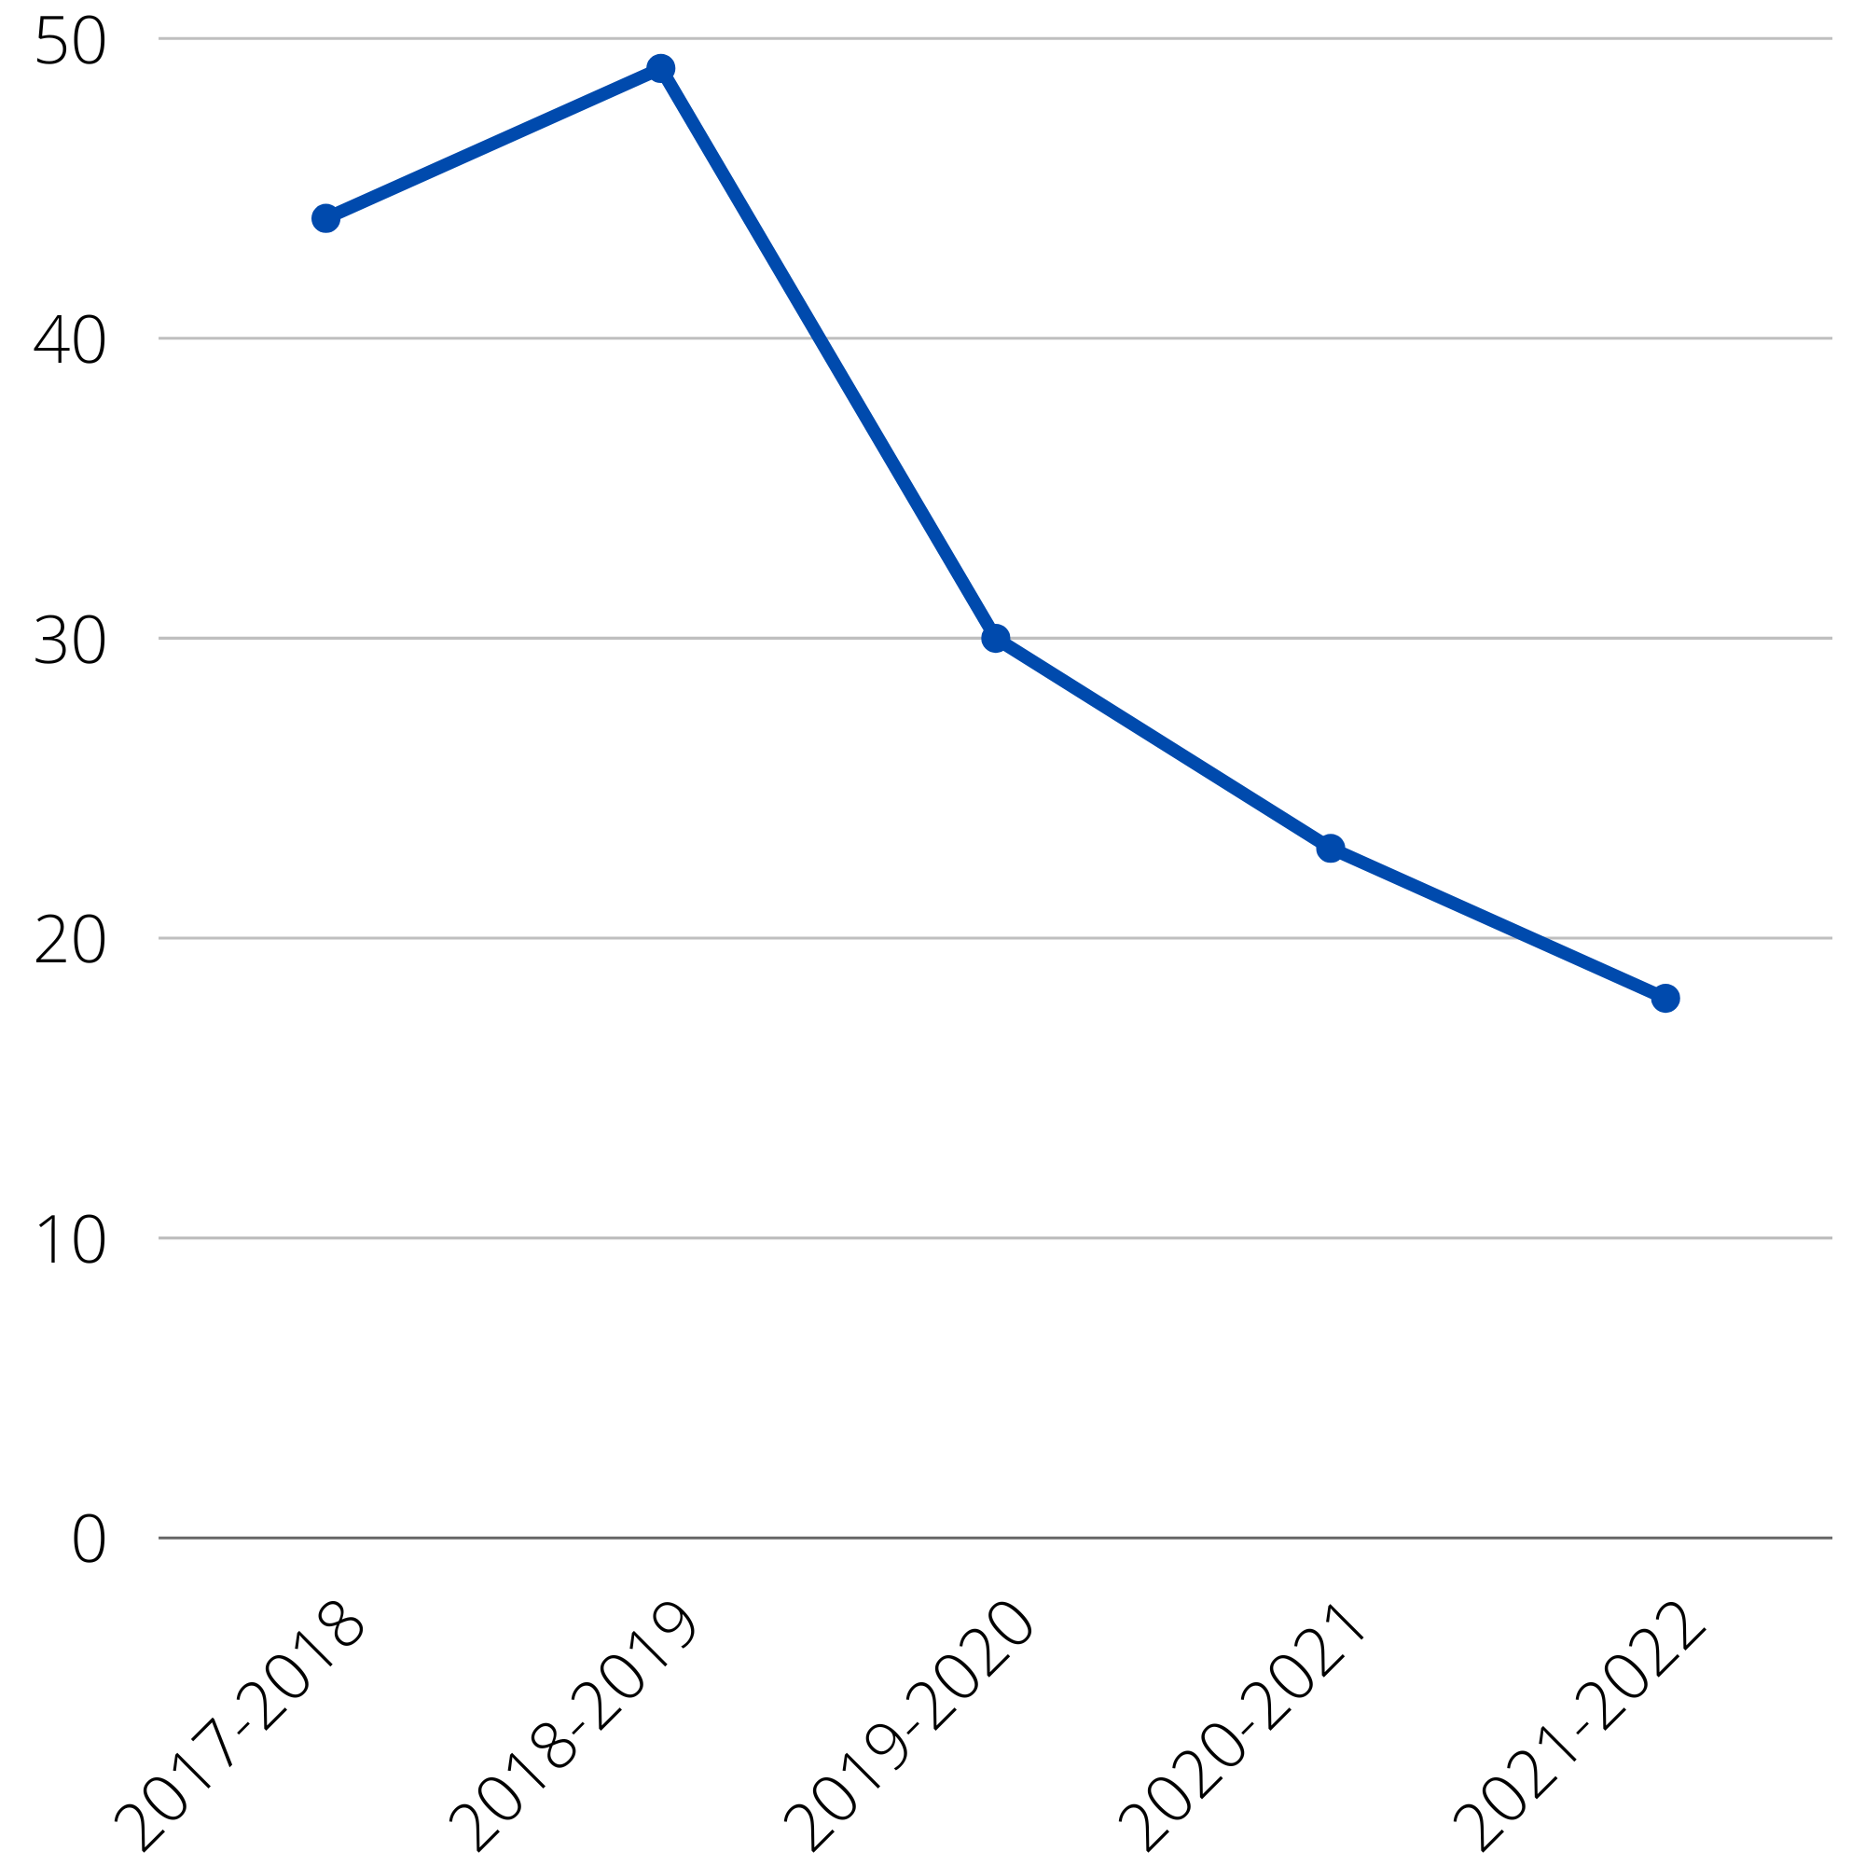
Due Process Cases

Slide 9
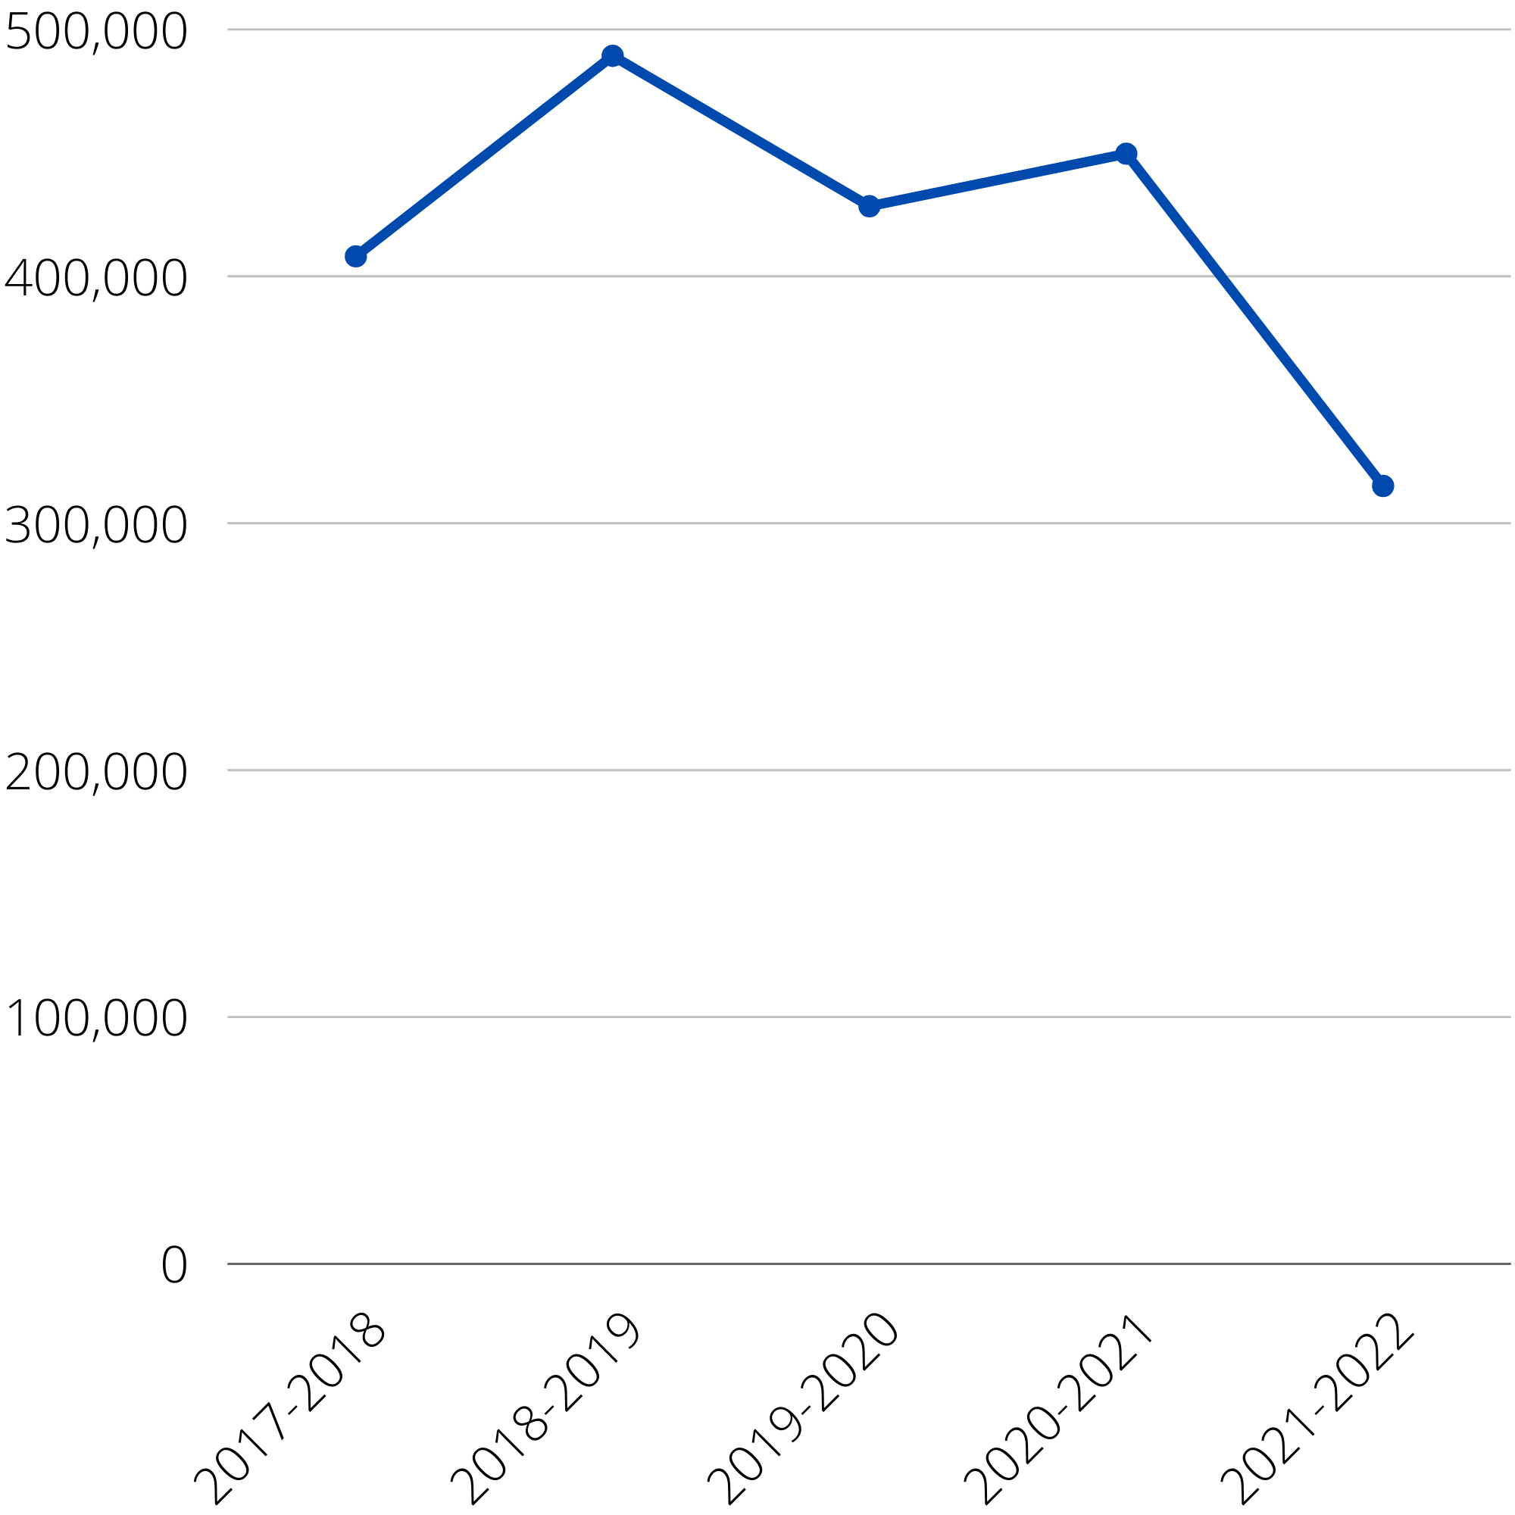
Attorney Fees
Notes:
Also, are these our district’s attorneys or the families’ attorneys that we had to pay as part of settlements?

Slide 10
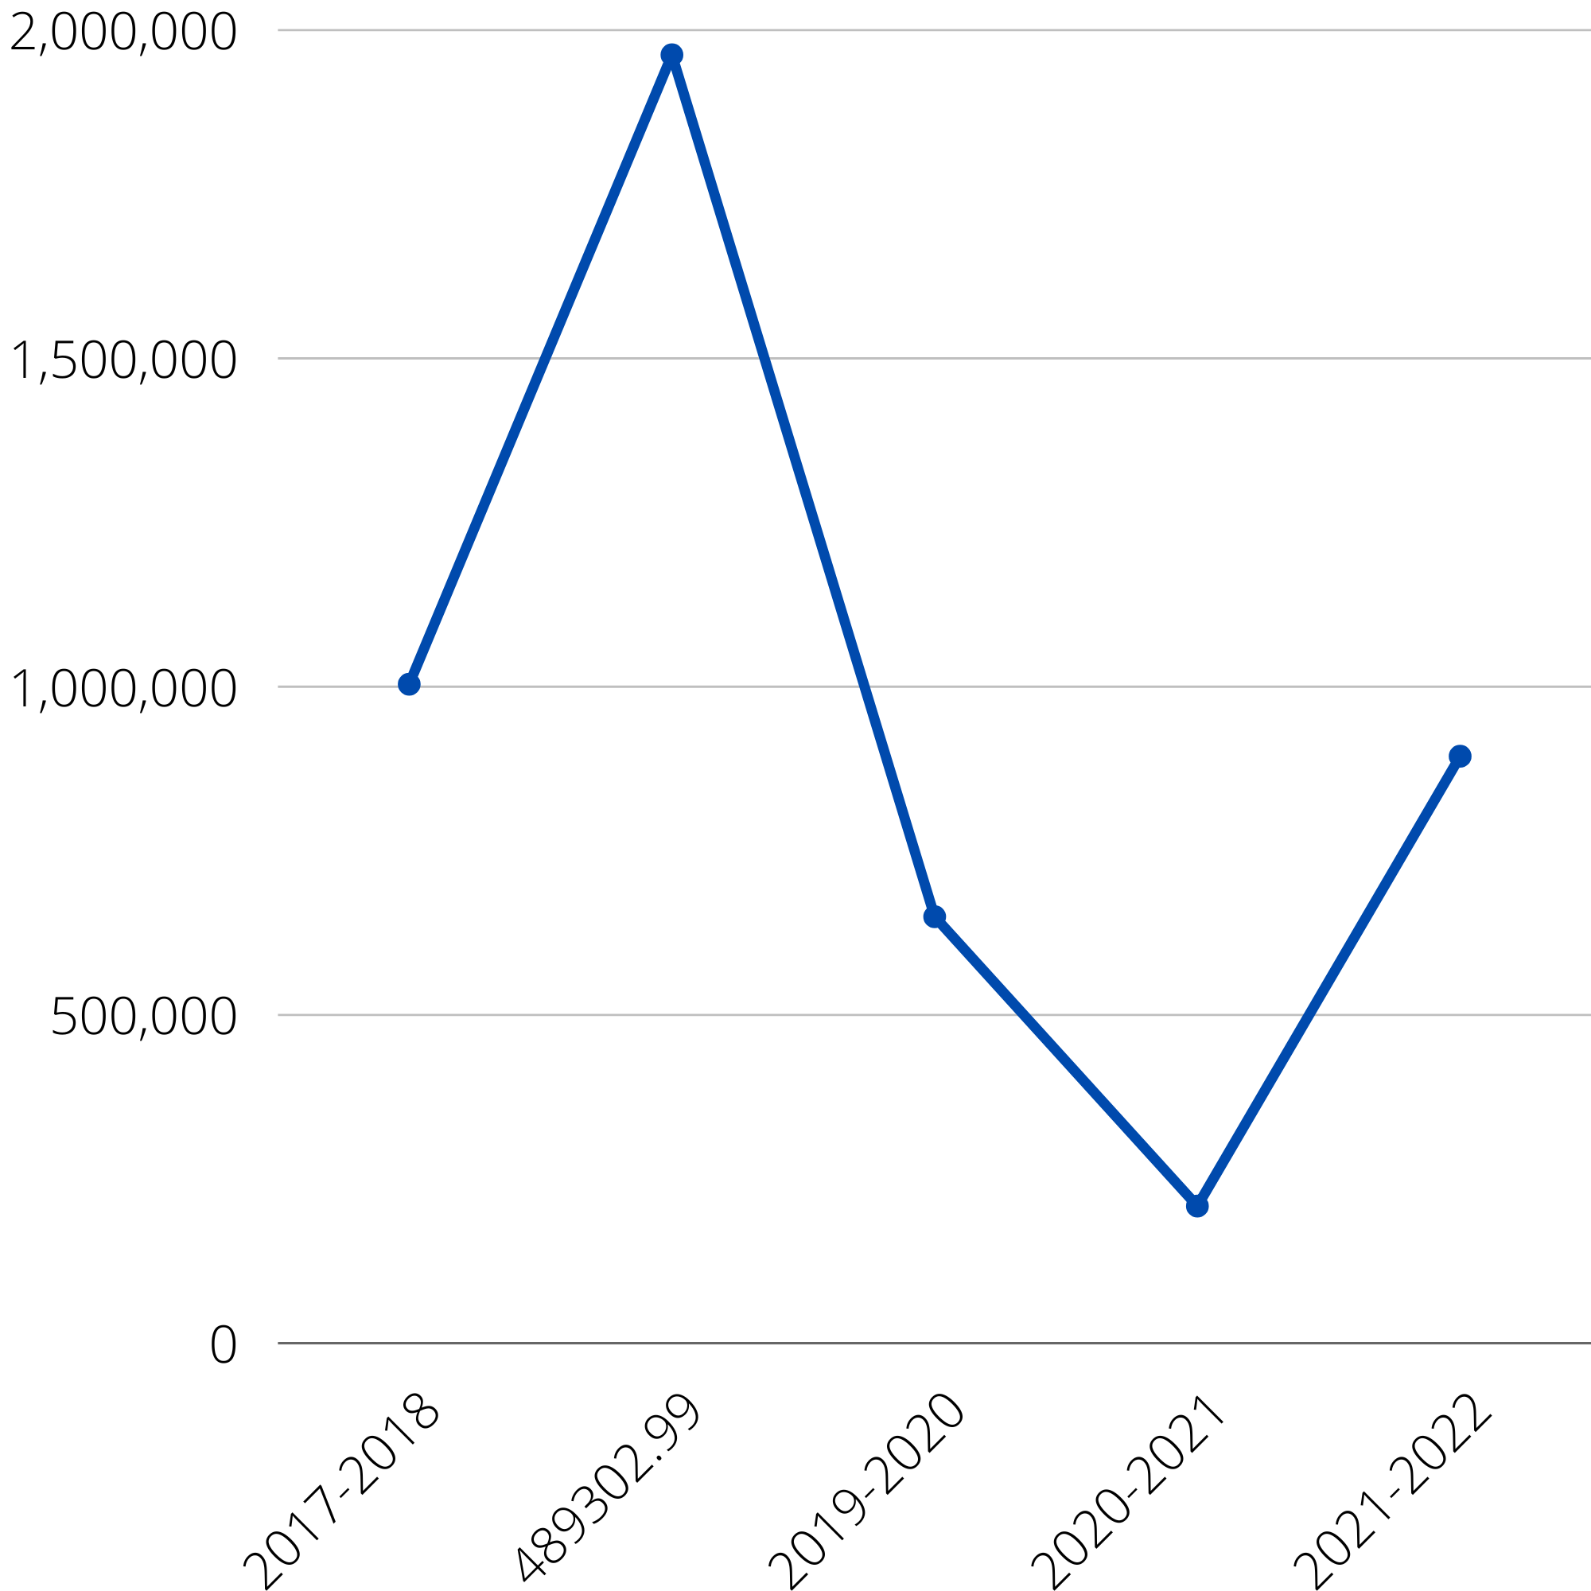
Total Due Process Settlement Cost

Slide 11
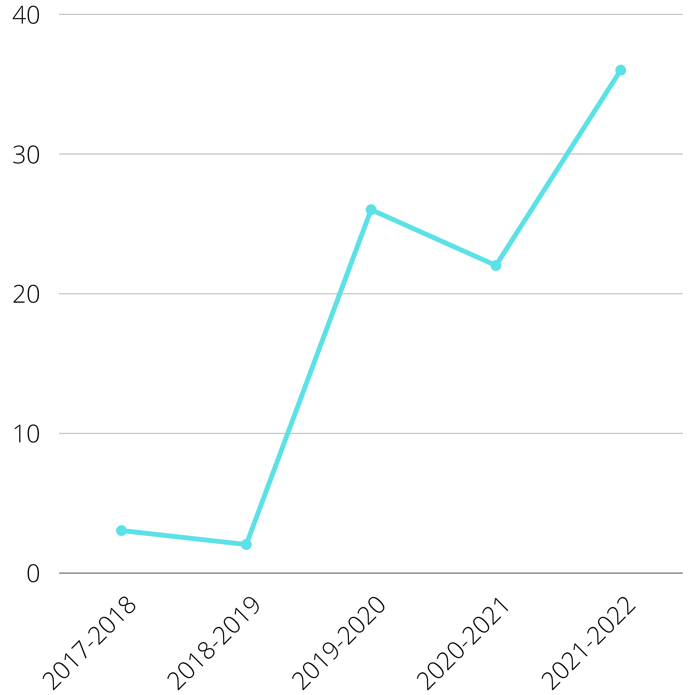
Alternative Dispute Resolution

Slide 12
99.97%
Notes:
PUSD presently supports 5,529 students with disabilities who represent 4,848 families. To date, only .003% of our families have filed either Due Process or participated in an Alternative Dispute Resolution. Put another way, 99.97% of our families are successfully resolving conflict working directly with education specialists or through the IEP process.

Slide 13
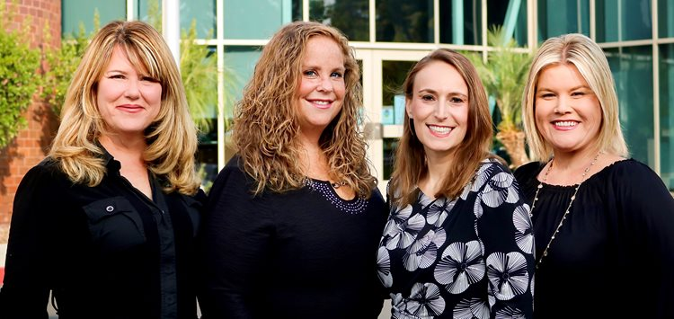
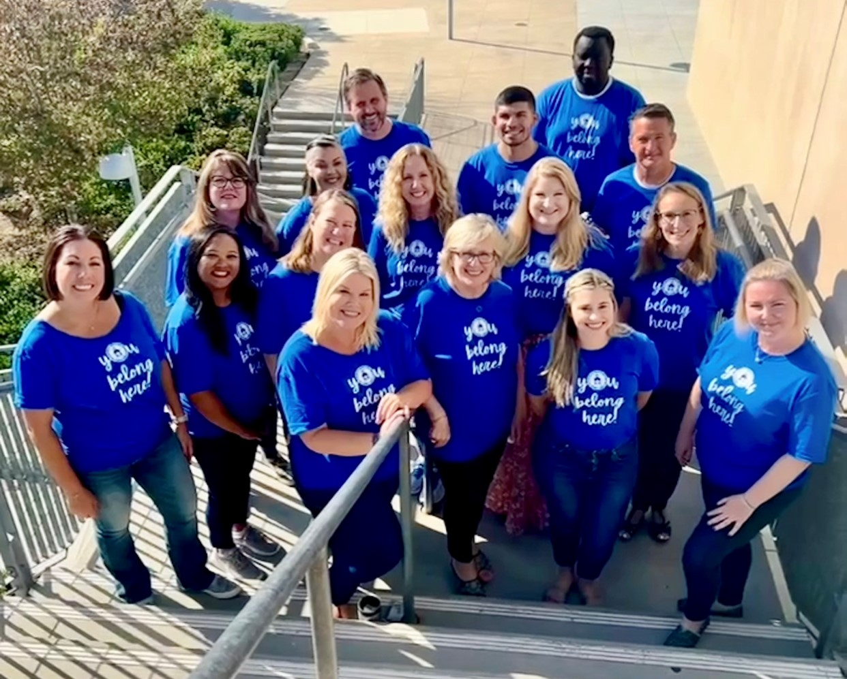
Directors and Program Specialists
During 2021-22 school year:
Attended an average of 85 IEP meetings per month
Participate in an average of 20 pre-staffing meetings per month with IEP teams
Notes:
Program Specialist involvement in the IEP meeting process has helped improve the District’s welcome as well as helped to support stronger student outcomes. Program Specialists attended an average of 85 IEP meetings per month last school year. Additionally, they participated in an average of 20 pre-staffing meetings, monthly, with IEP teams. The support our Program Specialists have provided to education specialists and administrators has helped PUSD more skillfully navigate disagreement as well as reduce procedural errors.

Slide 14
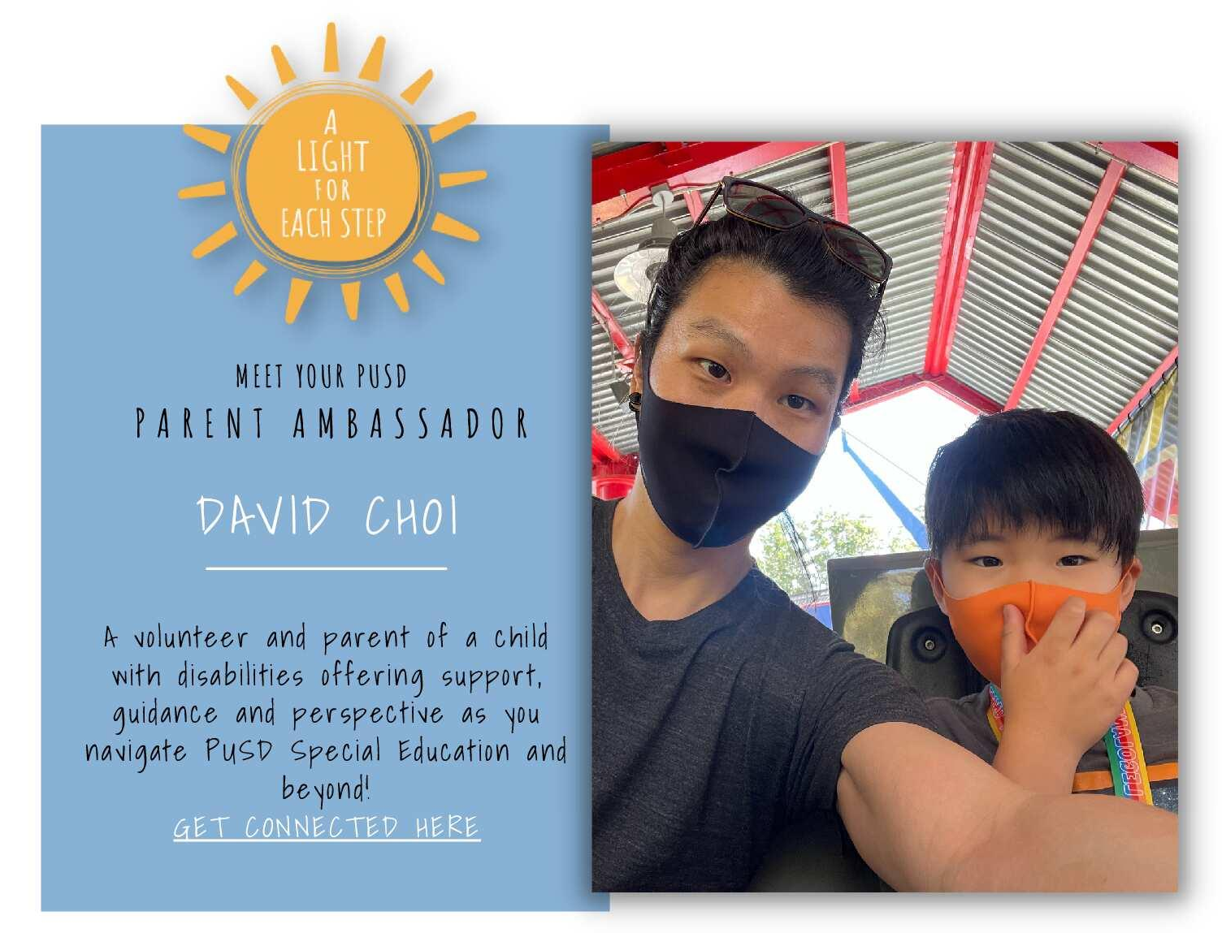
Parent Engagement
Notes:
The newly launched Parent Ambassador Program will certainly improve our parental outreach effort. Over 40 parents have now volunteered to participate in this innovative program! Since Parent Ambassador launch:
Distributed 4,500+ informational fliers on the Parent Ambassador Program to school sites; provided to families in IEP Team Meetings and/or are sent home in student backpacks
“Get Connected” QR code has been accessed by families over 110 times since November 2021
Over 40 parents have volunteered to be a Parent Ambassador

Slide 15
Parent Ambassadors

Slide 16
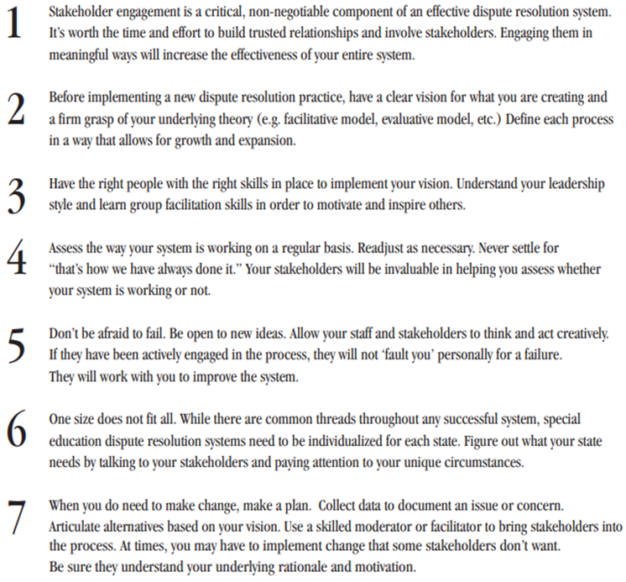
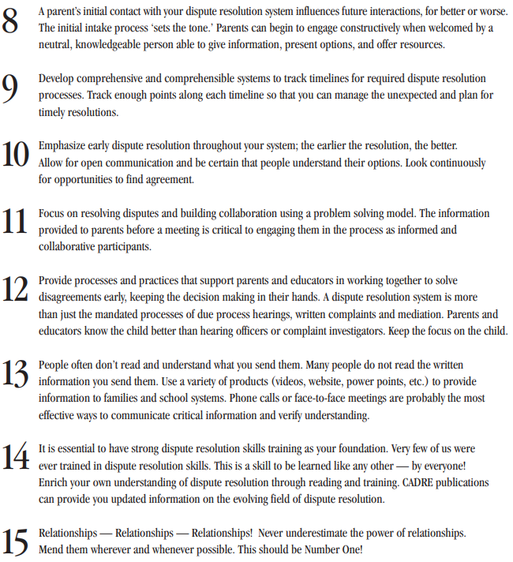
Mediator Mindset
Notes:
Mediator Mindset

Slide 17
Questions

Slide 18
Need More Information?
Visit CADRE online: www.cadreworks.org
Contact CADRE via email: cadre@directionservice.org
Sign up for the CADRE Newsletter!

Slide 19
Thank you for joining us!
Please take a few minutes to respond to this brief survey about your experience:
https://www.surveymonkey.com/r/PowayUSD-Sept2022

