Slide 1

Knowing Your Options:
Introducing the
Part C Family Dispute Resolution
Guides and Resources
September 10, 2018
12:00 pm – 1:15 pm PT (3:00 pm-4:15 pm ET)
Note: The presentation will be available on the CADRE website: https://www.cadreworks.org/events/introducing-part-c-dispute-resolution-family-guides
Technical Stuff:
Please enter any questions or technical difficulties into the questions box.
Thank you, in advance, for taking the time to respond to the brief survey at the end of the webinar!
Notes:
MELANIE REESE: Thank you for joining us for today's webinar, “Knowing your options: Introducing the Part C Family Dispute Resolution Guides and Resources.” A few technical notes: You can enter any questions or comments into the questions section of your control panel. CADRE staff will be attending to those throughout the webinar. There will be time at the end of this presentation for answering questions.
Today’s presentation will be archived and available on the CADRE website at this link.
We would be most appreciative if you would take a few minutes at the end of this presentation to fill out a short evaluation survey.

Slide 2

Today’s presentation is brought to you by
CADRE and CPIR
Melanie Reese, Ph.D.
Center for Appropriate Dispute Resolution
in Special Education (CADRE)
Myriam Alizo
Center for Parent Information & Resources (CPIR)
Statewide Parent Advocacy Network (SPAN)
Notes:
REESE: I'm Melanie Reese, the Director of the CADRE – The Center for Appropriate Dispute Resolution in Special Education Today, I am honored to be joined by Myriam Alizo.
ALIZO I am Myriam Alizo, I am on the Center for Parent Information and Resources (CPIR) housed at SPAN. The CPIR provides Parent Centers with information and resources to assist culturally and linguistically diverse families of children with disabilities across geographic regions in the nation and I also work on the RAISE Center
At the RAISE Center, we work with the seven (7) RSA-funded Parent Training & Information Centers to develop and disseminate information and resources that increase their capacity to serve youth and young adults with disabilities and their families.

Slide 3

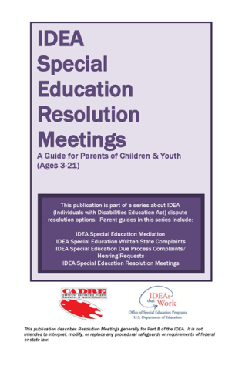


Initial OSEP Initiative
In 2014, CADRE released four IDEA Part B Dispute Resolution Parent Guides.
Also available in:
Arabic
Burmese
Chinese (Simplified)
Hmong
Japanese
Korean
Russian
Somali
Spanish
Portuguese
Vietnamese
Notes:
REESE: In July of 2013, OSEP issued a comprehensive Q&A document that provides information to facilitate appropriate implementation of the IDEA dispute resolution procedures which includes state complaints, mediation, due process hearings and resolution meetings.
Because the Q&A document was quite and very technical, OSEP asked CADRE to develop information more targeted to parents. In response, CADRE, in partnership with OSEP, developed four Part B Parent Guides seen here.
These guides are available in multiple languages and can be ordered directly from CADRE.
Today we’re bringing the companion guides for Part C Families.

Slide 4
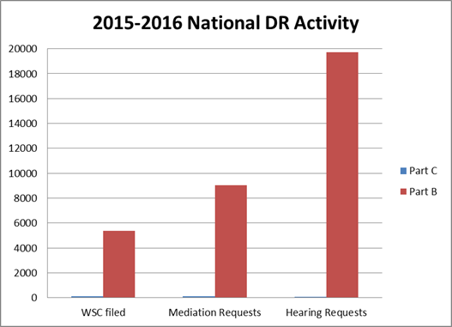
Part C/Part B Data
19,737
9034
5369
125
126
97
Notes:
REESE: This chart compares the activity in Part B with the activity in Part C. As you can see, Dispute Resolution activity in Part C is considerably less than the activity we see in Part B which makes examining trends over time difficult.
However, just because there is low activity does not diminish the importance of ensuring Part C families have the information they need to access their dispute resolution procedural safeguards.

Slide 5
Three Years of
Part C DR Activity:
US & Outlying Areas
Notes:
This chart describes the Part C activity for the states and territories over a three year period.
You can see there has been a slight decrease in written state complaints filed and reports issued over the previous year.
Mediations requested, held and ending in agreements rose over the previous year.
Finally you can see that due process complaints and hearings held fell from the previous year.

Slide 6
WSC Activity 2016-17
118 written State
complaints filed
96 reports issued
66 findings of
non-compliance
“States” includes the 50 states, DC and 5 territories
Notes:
In 2016-17 we saw 118 written state complaints filed nationally, 96 reports issued, with 66 of those reports ending with findings of non-compliance. All of the activity took place in 46% of the states and territories.

Slide 7
Mediation Activity
2016-17
133 mediation requests
76 mediations held
62 mediation agreements
“States” includes the 50 states, DC and 5 territories
Notes:
In 2016-17 we saw 133 requests for mediation nationally, with 76 mediations held resulting in 62 mediation agreements. All of the mediation activity took place in only 12% of the states and territories.

Slide 8
DPC Activity 2016-17
59 DPCs Filed
6 hearings held
52 resolved without a hearing
1 was pending
“States” includes the 50 states, DC and 5 territories
Notes:
In 2016-17 we saw 59 due process complaints filed nationally, with only six hearings held. 52 of the cases were resolved without a hearing. All of the activity took place in only 18% of the states and territories.
As you can see, most of the dispute resolution activity occurs in a fraction of the states.

Slide 9
Goals for Guides
Provide resources to explain, in parent-friendly language, the dispute resolution options available under Part C of the IDEA, specifically:
Mediation
Written State Complaints
Due Process Complaints and Hearings Requests (for states adopting Part C Procedures)
Due Process Complaints and Hearing Requests (for state adopting Part B Procedures)
Notes:
REESE: With the positive reception and wide use of the Part B Parent Guides, we moved forward to meet the same need for Part C families.
Our goal is to provide resources to explain, in parent-friendly language, the dispute resolution options available under Part C of the IDEA.
Specifically, we have developed four family guides to explain parents’ rights to engage in mediation, to file a written state complaint, or to file a due process complaint to request a hearing to resolve their dispute.

Slide 10
Challenges
Balancing the use of legal terminology and maintaining general understanding
Ensuring readability without compromising meaning
Explaining complex processes in a “user-friendly” way
Notes:
REESE: Having been through this process before, we were aware that this type of undertaking poses several challenges. As you are aware, the IDEA is a complicated law.
One challenge was to balance the use of legal terminology and maintain general understanding.
Another challenge was to ensure readability without compromising meaning.
A final challenge was to explain complex processes in a “user- friendly” way.

Slide 11
NOTE: Guides are
Not IDEA Substitutes
In an effort to make the material accessible, we have used different language from the IDEA.
Every attempt has been made to communicate the same meaning.
However, the IDEA is the law. Families should know that these guides are not substitutes for knowing the law.
Notes:
REESE:
We know how complicated it is to explain parents' rights and having tools to share with families. We hope you find these useful, but be aware that they are not a substitute for the actual law in IDEA.
In an effort to make the material accessible, we have used different language from the IDEA.
Every attempt has been made communicate the same meaning.
However, the IDEA is the law. Families should know that these guides are not substitutes for knowing the law.

Slide 12
Development Process
CADRE Team
  Anita Engiles
  Melanie Reese
  Marshall Peter (Senior Consultant)
  Candace Hawkins (Senior Consultant)
OSEP Support
  Lisa Pagano and Jennifer Wolfsheimer
  Tina Diamond and Carmen Sanchez
Notes:
REESE: The development of the guides was an iterative process and involved several CADRE staff including Anita Engiles, Marshall Peter, myself, and Candace Hawkins.
CADRE is very grateful to the tireless efforts of OSEP’s Jennifer Wolfsheimer and Lisa Pagano ensuring our attempts to simplify the IDEA did not change the meaning or intent of the regulations. Lisa and Jennifer collaborated closely with CADRE, even traveling from DC to Oregon to work through these family guides and endured many hours of phone calls as we picked word by word through many drafts.
We also grateful to Tina Diamond, our Project Officer and to Carmen Sanchez for helping us determine the best past to get this information disseminated and for encouraging our collaboration with CPIR.

Slide 13
Review and Revise Process
ESTEEMED REVIEWERS
  Sharon Walsh (ECTA)
  Ed Feinberg (Senior Consultant)
  Miriam Alizo (SPAN)
  Judy Swett, Gretchen Godfrey (PACER)
  Hodan Farah Mohamed (Open Doors for Multicultural Families)
  Luz Hernandez (Philadelphia HUNE, Inc.)
  Larry Ringer (Senior Consultant)
Notes:
REESE: Once we had the four guides to a place where OSEP and CADRE were satisfied, we share them with the following reviewers. For those of you who are part of the parent network, you will recognize the names of very smart uncompromising leaders who have personal traditions of letting you know exactly what it is that they think.
The feedback we received was insightful and challenged assumptions in the most beneficial way possible. Thank you to Ed Feinberg, Myiam Alizo, Judy Swett, Gretchen Godfrey at PACER, Hodan Farah Mohamed at Open Doors for Multicultural Families, a CPRC in Washington State, Luz Hernandez, from Philadelphia Hune, Inc., a Pennsylvania CPRC, and Larry Ringer for his collaboration on the Part C Comparison Chart.
I want to express CADRE’s deep appreciate to Sharon Walsh at the Early Childhood Technical Assistance Center for the fine tooth comb treatment she gave to all four guides. These products are all the better because of the careful reading and feedback we received.
We were delighted to receive extensive feedback from our reviewers. Once we had it all, entered into another demanding process of going through comments with our OSEP partners to figure out how best to integrate and reflect them in the final form. Every comment was weighed and considered. In the end we reached consensus on these four products.

Slide 14
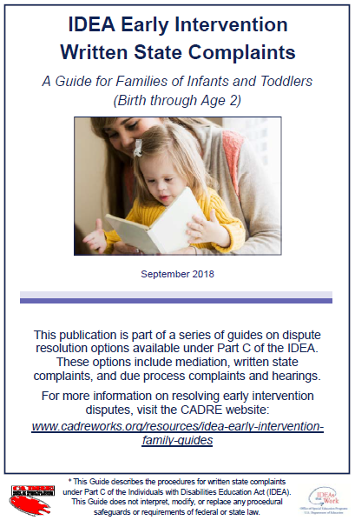
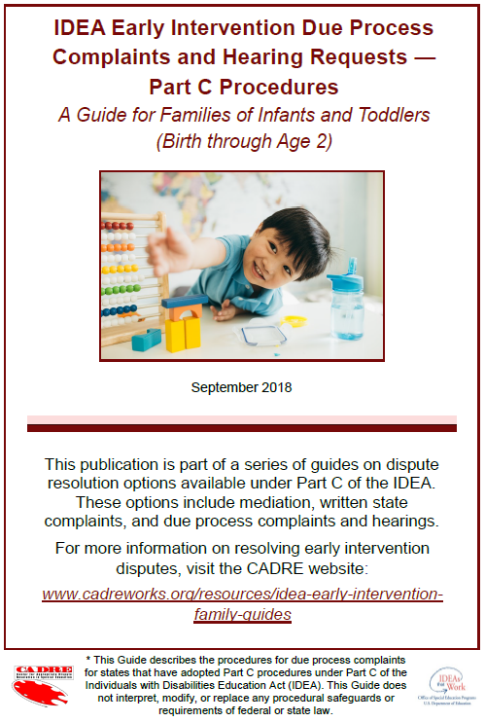
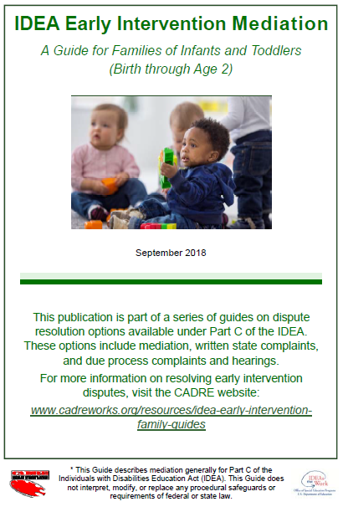
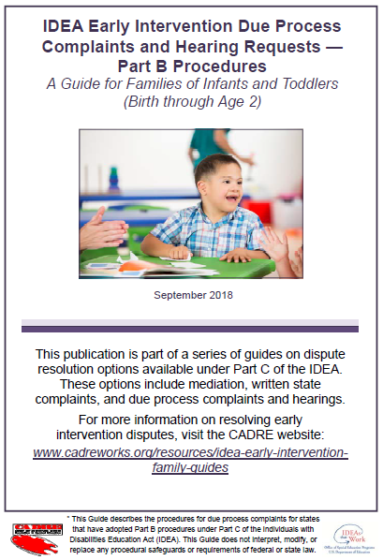
Part C Family Guides
Notes:
REESE: Our IDEA Early Intervention Dispute Resolution Family Guides are now ready to share and we couldn’t be more excited to see them go out into the world!
The four guides cover:
Mediation
Written State Complaints
And Two Due Process Hearings Procedures,
one for states who follow Part C Procedures for DPH and
one for states that have adopted Part B procedures for Part C due process complaints.

Slide 15
Encourages Collaboration and Relationship Building
CADRE aimed to present the dispute resolution options factually and directly, while simultaneously encouraging the building of collaborative relationships.
Sharing information allows families to make informed decisions so they can participate fully in resolving concerns about their children.
Notes:
REESE: Consistent with CADRE’s commitment to promote early dispute resolution and collaborative problem solving, we’ve aimed to present the various processes factually and directly, while simultaneously encouraging the building of collaborative relationships. Early non-adversarial options are presented in all of the guides for consideration.
We hold that sharing information allows families to make informed decisions so they can participate fully in resolving concerns about their children.

Slide 16


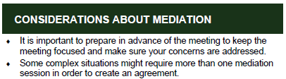
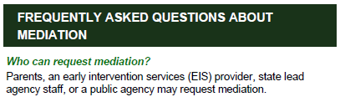

Features
Definitions
Benefits
Considerations
Frequently Asked Questions
Preparation Strategies
Notes:
REESE: Each of the guides are divided into sections.
There will be a definition of the process and examples of when it might be used.
There will be sections that discuss the benefits of the process
As well as things to take into consideration before and during the process.
Additionally, our most popular feature in the Part B guides was the Frequently Asked Questions.
Finally, we’ve included preparation strategies to guide parents in how to prepare effectively.

Slide 17

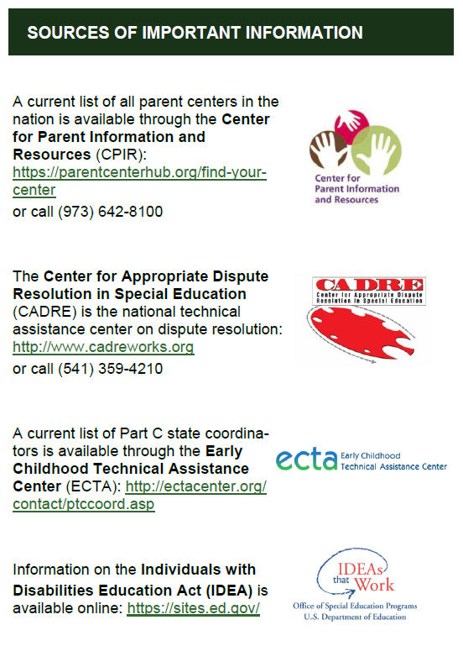
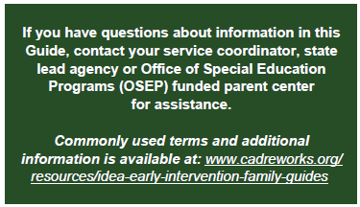
Where to Find
More Information
In each guide:
On the website:
Notes:
REESE:
We have also included suggestions throughout the guides for families to seek additional information from their state lead agency as well as their federally funded parent centers.
We’ve included links to find contact information, and even have a place for agencies to affix a sticker to personalize the contact information to their agency.

Slide 18
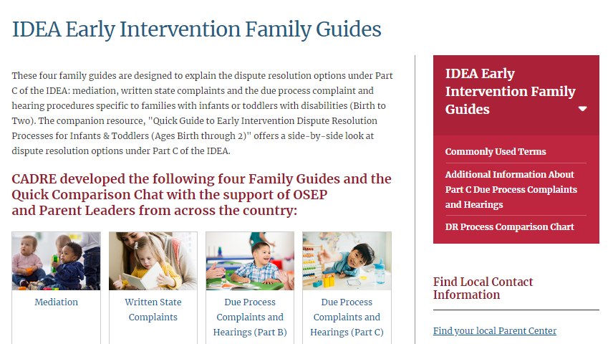
IDEA Early Intervention Guides Web Resources
Link: www.cadreworks.org/resources/idea-early-intervention-family-guides
Notes:
CADRE has developed a companion website for online access to the guides and to find more information.
The website is located here: (click)
On the website, the user can find links to the PDFs of the guides here, as well as locate additional from the navigation bar

Slide 19
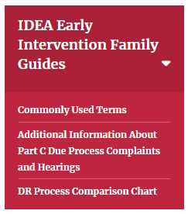
IDEA Early Intervention Guides Web Resources: Commonly Used Terms
Link: www.cadreworks.org/resources/idea-early-intervention-family-guides
Commonly Used Terms:
Early Intervention Services
Individualized Family Service Plan
IFSP Team
Individuals with Disabilities Education Act IDEA Part B
IDEA Part C
Lead Agency (LA)
Parent
Parent Center
Public Agency
Service Coordinator
State Educational Agency (SEA)
Notes:
The website includes several resource to help clarify the guides.
There is a section that covers these eleven commonly used terms:

Slide 20
Additional Information on Due Process Complaints
Additional Information About Part C DP Complaints and Hearings:
What Rules Apply to Your State?
Qualifications of a Hearing Officer
Parents’ Rights at a Due Process Hearing
Notes:
REESE:
We’ve added a section to provide information about Due Process Complaints and Hearings. In addition to outlining the qualifications of hearing officers and an overview of a parent’s rights at a due process hearing, we’ve indicated the rules that apply to specific states.

Slide 21
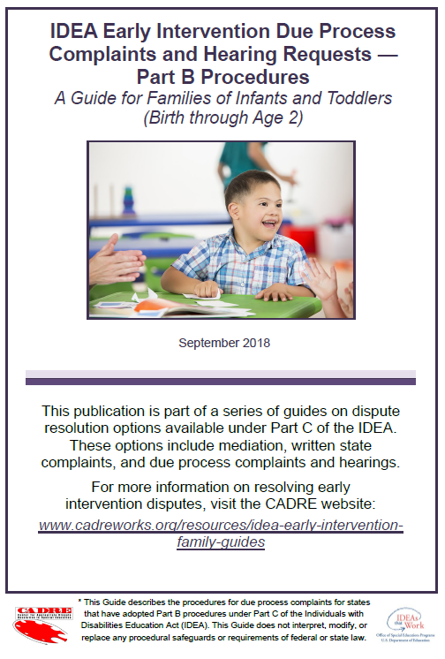
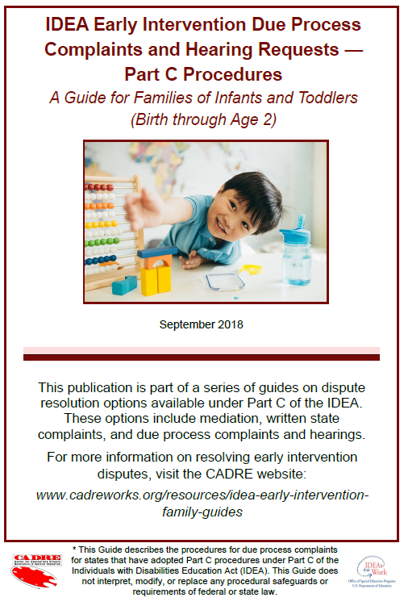
Part B and Part C
Procedures for Due Process
Complaints & Hearings
Under IDEA, states can choose to follow Part C procedures for due process complaints and hearings, or use the Part B system already established in their state.
Notes:
REESE: States procedures for due process complaints and hearings vary. There are those states who have adopted the Part C Due Process Hearing Procedures and those who have not and instead use the Part B procedures. Because these systems are so different, it was necessary to have two different guides available.
Unsure which procedures your state has adopted? You can check on the website.

Slide 22
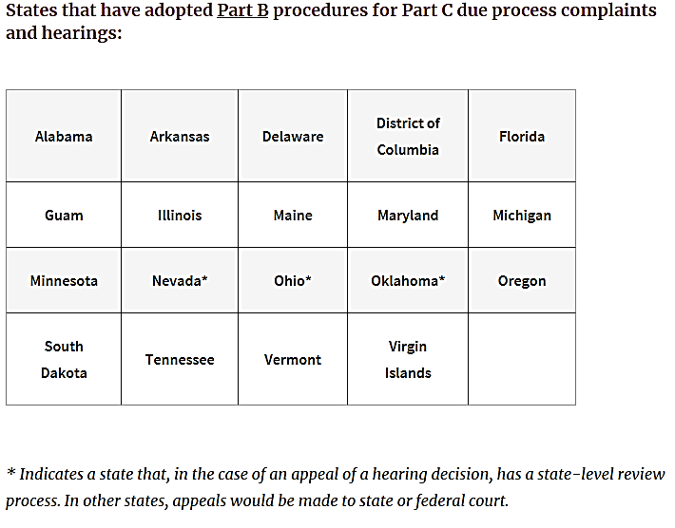
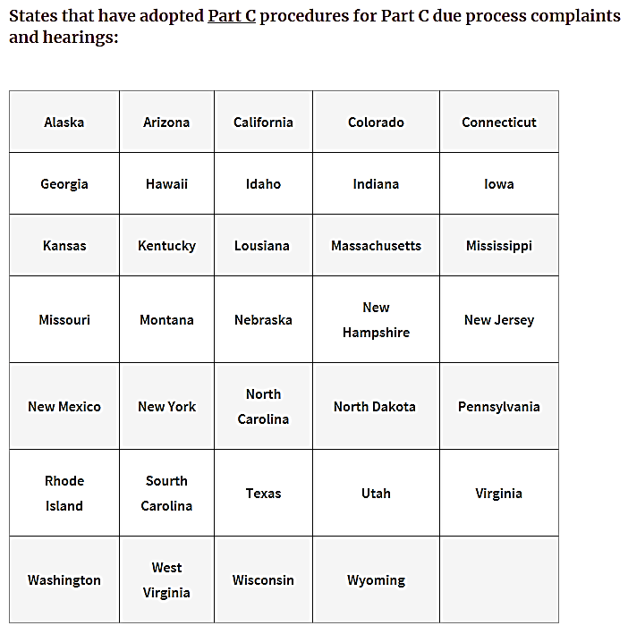
Part B or Part C:
What Rules Apply to Your State?
Notes:
REESE: This chart shows which rules apply to your state. You can see on the left are states who have adopted Part B procedures for Part C due process complaints.
On the right are those state that use the Part C procedures for due process complaints and hearings.
We’ve even noted which Part B states have a state-level review process for hearing decision appeals.
We will do our best to keep these updated. However, we encourage you verify with your state education department which rules apply in your state.

Slide 23
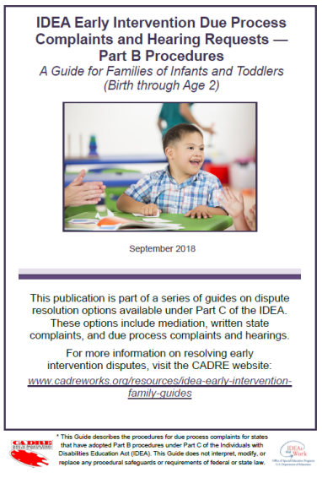
Part B and Part C
Procedures for Due Process
Complaints & Hearings cont.
Differences in Part C and Part B Procedures
  Who can file
  What must be in the written request
  for a hearing
  Timelines for decisions
  Time limit for filing
  Whether there is a resolution meeting
  Other differences
Notes:
REESE: The procedures a state has adopted will affect
who can file
what must be included in the due process request
the timelines for decisions
the time limits for filing a request for a hearing
whether there is a resolution meeting required
And other differences.

Slide 24
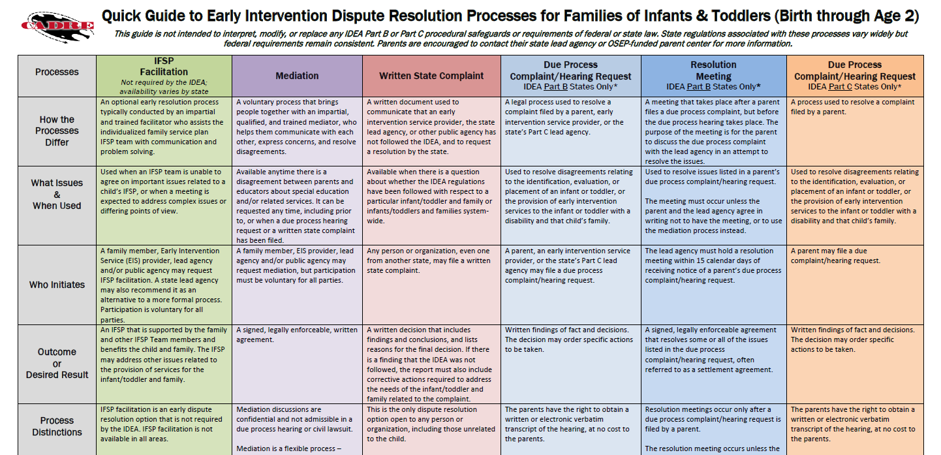
IDEA Early Intervention Guides Web Resources:
DR Process Comparison Chart
Link: www.cadreworks.org/resources/idea-early-intervention-family-guides
Notes:
Just like for Part B, we’ve created a Quick Guide to distinguish between the different processes, including facilitation for those states who offer it.

Slide 25
Quick Guide to Part C Dispute Resolution Processes
Notes:
REESE: This Quick Guide to Part C Dispute Resolution Processes is available online only. The chart compares the dispute resolution processes side-by-side.
This guide will briefly explain:
How the processes of IFSP Facilitation/Mediation/Written State Complaints and Due Process Hearings under Part C rules and part B rules differ
What issues would be appropriate for each and when each would be used
Who initiates each process
The probable outcome
What distinguishes each process
The benefits and considerations for each
Where the decision is made
The role of the third party
The Timeframe
Who pays
The impact of each process on relationships
And how to prepare for each.
The chart may be helpful to keep nearby as a resource to quickly explain the differences to families who may have a dispute.
Now I’ll turn it over to Myriam to talk about how to use these guides.

Slide 26
How to Use the
Family Guides
Know the Part C Lead agency in your state
Share guide with:
- Part C service providers
- Hospitals
- Community centers
- Early Head Start
- Childcare centers
Notes:
ALIZO:
- (Refer to the list by states on http://ectacenter.org/partc/ptclead.asp). Every state has a different lead agency, and the name of the Early Intervention program varies from state to state.
Learn if your state chose to develop a Part C system for due process complaints and hearings, or if it uses the Part B system already established in your state. Share this information with your families.
For example, in Arizona the Early Intervention lead agency is the Arizona Department of Economy Security.
In NJ and FL the lead agency is the NJ Department of Health and the Florida Department of Health, but the name of the program in the states is also different: in Nj it is called NJ Early Intervention System, and In FL it is Early Steps.
- Share the Part C Guides with other stakeholders such as Part C service providers
- Hospitals: find out when they have community fairs and bring your resources and these CADRE guides
- Community centers
- Early HeadStart- organize presentations to their staff about what your parent center does
- Childcare centers

Slide 27
How to Use the
Family Guides (2)
As a resource for families when providing TA
Technical assistance to districts, professionals and partners
Parent groups
Notes:
ALIZO:
Parent center staff already use the Part B guides when they provide individual TA to families. They give out to families as a resource to consider in case they need it, either in person, or via email. They also give them as a handout at Basic Rights and IEP workshops. Part C guides can be incorporated to the list of resources given to families. States have their own regulations but these guides offer the federal guidelines.
Parent centers provide TA to districts. Parent center staff also use the guides when providing TA to school districts and other agencies
- The guides are an excellent tool to share with parent groups, SEPAGs and the state special education advisory council

Slide 28
How to Use the
Family Guides (3)
IDEA and Dispute Resolution presentations
IEP clinics
Train parent center staff
Parent Center website link to CADRE guides
Notes:
ALIZO:
In conversations with parent center staff from different regions, I was informed that they use the Part B guides as a hand out when presenting on Dispute Resolution. Some reported that they also use them as tool to create their Dispute Resolution presentations
Many parent centers conduct IEP Clinics in a regular basis. These tools can be handed during these events. Some parents might have children with IEPs but also have children receiving Early Intervention services.
The guides can also be used to train new and old staff on current topics in Dispute Resolution.
Parent centers could include a link to the Part C and Part B Dispute Resolution Guides on their websites

Slide 29
How to Use the
Family Guides (4)
Short videos in different languages disseminated through social media (such as Facebook, Twitter, Instagram and WhatsApp)
Notes:
ALIZO:
In Part B, undocumented families don’t use Due Process, and Written State Complaints is not very known. The most used procedural safeguard for families, specially undocumented families, is Mediation.
So, an effort is required to get parents familiarized with these dispute resolution options.
When speaking with several parent center staff that work with Spanish speaking populations, there was a consensus in the benefit of using short videos to explain complex concepts, and following with an interactive video, like a Q&A session, in simple and plain language. Parent centers can do that with low technology (a smart phone).
A common social media tool for Spanish speaking families is WhatsApp. Many parents don’t have computers, or tablets, but most of them have smart phones. WhatsApp is a very effective and popular tool to reach out to groups of immigrant parents.
Another possibility is invite parents that have gone through the process to share their stories using short videos

Slide 30
Dissemination
Activities
Post on CADRE website with banner
  Link: www.cadreworks.org
Publicize in CADRE Caucus
Disseminate through CADRE Listservs
Publicize with Partner TA&D Centers
Share at conference presentations
Notes:
REESE:
The four Family Guides are posted on the CADRE website main page.
They were publicized in the CADRE Caucus which is our online newsletter that goes out around 5,200 people,
and will be disseminated through the CADRE listservs.
We’ve have great support from other technical assistance centers in promoting these guides.
We have several opportunities to share these guides at upcoming presentations, as well.

Slide 31
Print & Disseminate
Sending copies to Parent Centers (PTACs, PTIs & CPRCs) this month
Accessible documents are currently available online to print: Link: http://www.cadreworks.org/resources/idea-early-intervention-family-guides
Spanish versions available soon
Notes:
REESE:
The guides are currently being printed and will be sending a few copies to PTACS, PTIs, CPRCs in the next few weeks.
Right now, you can find the PDF versions to print on our website. These PDFs meet accessibility requirements and can be posted on your websites.
We expect the Spanish versions of the documents to be available by the end of the month.

Slide 32

Print & Disseminate cont.
Order through the CADRE website: Link: https://www.surveymonkey.com/r/CADREPublications
Notes:
REESE:
We recognize the need to print and disseminate hard copy versions, being very mindful of the continuing digital divide and recognizing that some who may find these guides useful might not have the kind of computer access to access the documents online.
We will have them available hard copy to send to lead agencies, parent centers and SEAs upon request. Copies may be ordered through CADRE at this link.

Slide 33
Myriam Alizo
Cultural Review Process
Cultural Implications of the guides for Immigrant Parents
Revision of translation using the OSEP Spanish Glossary: Link: http://www.neparentcenters.org/glossary/glossary.html
Notes:
ALIZO:
In general, the Part B guides were well written and easy for parents to understand. The same concept applied to the Part C guides. When there was a part that was not clear to the review team, or a section that might seem too technical for families, we(the review team) let Melanie and the CADRE team about our concerns, and they made the changes.
Immigrants parents DO TRUST parent centers, and they do come to us. Therefore it is important for the parent center network to disseminate these tools with our families, and encourage them to use them. We know as a fact that our immigrant families don’t use Due Process, specially if they are undocumented. It is very intimidating for them to have to hire an attorney (event if it is pro bono the situation could be frightening for the fear of deportation, etc.
Immigrant families prefer mediation (is the most amicable procedure), they don’t know how to use the written complaint, but we can let them know that they can write it in their own language and the Part C Lead agency will translate it to English
The OSEP Glossary is an excellent tool to come to a consensus when translating Part B and Part C terminology to Spanish.
In addition to the dispute resolution options discussed on this webinar, we need to remind our families that IDEA contains the following procedural safeguards for
families in the early intervention system.
• Prior Written Notice requires the system to provide
families with advance notice of decisions and the reasons
for those decisions.
• Use of Primary Language or Mode of Communication
requires the early intervention system to communicate with
families in their primary language whenever feasible to do
so.
• Written Consent requires that the early intervention
system receive signed parental consent before moving
forward with evaluations or providing services.
• Confidentiality and Release of Records prohibits the
early intervention system from releasing information or
records regarding early intervention without prior written
consent from the parent.
• Examination of Records by Families allows families to
access their early intervention records at anytime.
• Equal Partners in Decision-Making indicates that
families are equal members of the IFSP team and share in
the decision-making process along with the early
intervention system.
• Accept or Decline Services without Jeopardy allows
families to reject some services and accept other services.
In addition, it allows families to add services at a later date,
if necessary.

Slide 34
What They’re Saying
  “They did a great job of trying to make this stuff digestible by parents.”
  “Overall it was easy to understand. I like the fact that it gives just enough information without being overwhelming and that it refers to the Parent Center in your area for more information.”
  “I think it will be so helpful to have this document. We all know how hard it is to make this understandable and still consistent with the regs.”
Notes:
ALIZO: Here are just a few comments received about the guides in the review process. “They did a great job of trying to make this stuff digestible by parents.” “Overall it was easy to understand. I like the fact that it gives just enough information without being overwhelming and that it refers to the Parent Center in your area for more information.” “I think it will be so helpful to have this document. We all know how hard it is to make this understandable and still consistent with the regs.”

Slide 35

Questions?
Comments?
Notes:
REESE: Thank you so much for your participation today. Let’s see if there are any questions. If you want to raise your hand we can call on you. Meanwhile, we’ll see if there are any questions asked in the questions box.

Slide 36

Thank you for joining us!
Please take a few minutes to respond to this brief survey about your experience:
Webinar Survey https://www.surveymonkey.com/r/PartCFamilyGuides
Notes:
Thank you again for joining us today. Please let us know what you think about this webinar and the guides.
From CADRE and CPIR, we wish you all a very happy autumn!
Thank you.

