Slide 1

The Potential of Storytelling in Conflict Engagement and Building Relationships
Kiran Singh Sirah
Diana MTK Autin
Jo Anne Blades
Marc Purchin
September 12, 2023

Slide 2
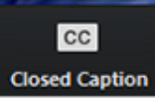

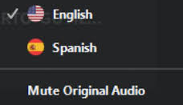
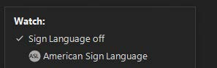
Accessibility
Using Closed Captioning
To start using CC, click the caption button.
Uso de la interpretación de idiomas
Hagan clic en el icono de interpretación.
Seleccionen “Spanish”.
Después de seleccionar “español”, hagan clic "Mute Original Audio“.
Using ASL
On the toolbar, click the interpretation icon.
Under “Watch,” choose the available channel to view.
A floating video window will appear of the interpreter that you can resize or move as needed.

Slide 3
Technical Notes
All lines are muted. The presenters may individually determine if they would like to interact through the chat feature.
Please raise your hand if you have a question and the panelists will respond in a timely manner.
Please post questions in the question box and we will share them throughout the webinar.
Please feel free to turn on your camera.
Thank you in advance for taking the time to respond to the brief survey at the end of this webinar.
This webinar will be posted and archived on CADRE’s website.

Slide 4

Communication is Messy.
It’s not a science. It’s not exact.
It is a negotiation. Always.
4

Slide 5
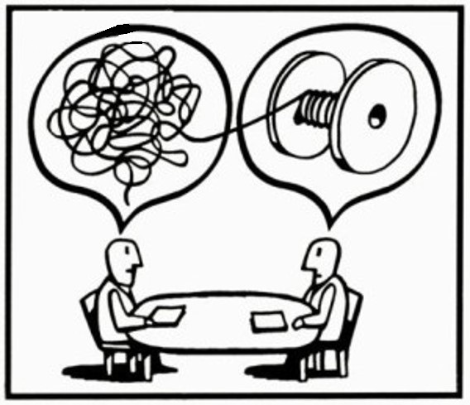
The Act of Making Sense
We are constantly trying to create meaning, and we act based upon the meaning that we create.
5

Slide 6
Why Storytelling is Critical to Productive Conflict Engagement
Your Story
My Story
When our stories are co-constructed, we can work together to create solutions.
6

Slide 7
Today’s Panel
Kiran Singh Sirah: Past President of the International Storytelling Center
Diana MTK Autin, J.D.: Senior Director for Organizational Capacity-Building for the SPAN Parent Advocacy Network (SPAN)
Jo Ann Blades: Program Manager for the Oklahoma Special Education Resolution Center (SERC)
Marc Purchin: Principal of Purchin Consulting

Slide 8

The Power of Stories
The Power of Stories
Presented by
Diana Autin, Senior Director,
Organizational Capacity-Building Programs,
SPAN Parent Advocacy Network

Slide 9
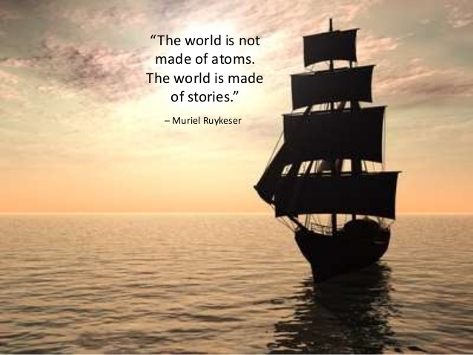
©NationalPlace2022

Slide 10
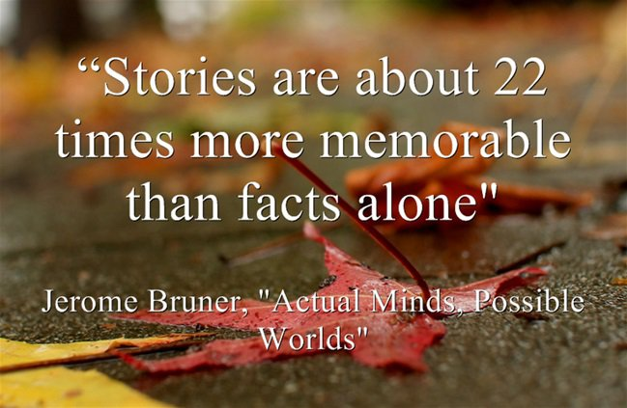
Quote from Jerome Bruner

Slide 11
Why We Use Stories as Tools for Change
Why We Use Stories as Tools for Change
Stories powerfully illustrate strengths and weakness of existing policies, practices, and systems, and highlight needed improvement, for:
  Legislators
  Administrative policymakers
  Providers
  Parent leaders
  General public
It’s all about relationships!

Slide 12
Why We Use Stories as Tools for Change 1
Why We Use Stories as Tools for Change
Stories convey meaning, build empathy and community, and motivate action
Stories can engage both feeling/emotion and logic/rationality
Stories can highlight injustice and create the case for change
Storytelling as a tool for social change is the purposeful use of a specific narrative form (story) to present the lived experience of individuals/groups in a way that helps others perceive the reality of that experience – they provide windows into the impact of policies on people’s lives

Slide 13
Why We Use Stories as Tools for Change 2
Why We Use Stories as Tools for Change
People operate in society based largely on default perceptions of reality and also the societal meta-narratives from which we learn about people based on their age, class, race, gender, location, education, and legal history
The more exposure listeners have to stories from those they consider “other” in some way, the more clarity they have about another’s personal experience
The listener’s perceptions of others and their relation to them changes
Listeners often begin to question and evaluate the source of their ideas about others and whether those ideas are valid
Hearts can be opened – relationships are developed!

Slide 14
Quote from Muriel Ruykeser

Slide 15
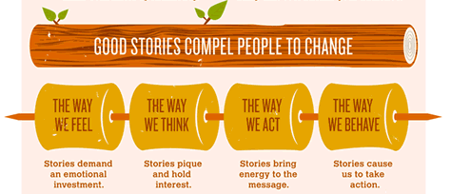
Good Stories Compel People to Change

Slide 16
How We Use Stories as Tools for Change:
Family Resource Specialist Vignettes
HOW We Use Stories as Tools for Change:
Family Resource Specialist Vignettes
Shared with funders, federal and state agencies, federal and state legislators, media
Examples and Impact
  Affordable Care Act advocacy
  Family to Family Health Information Center funding advocacy

Slide 17
How We Use Stories as Tools for Change:
Telling your Story to Make a Change
HOW We Use Stories as Tools for Change:
Telling your Story to Make a Change
Telling your Story to Make a Change training and follow-up support for family leaders examples and impact
  Statewide Children’s System of Care for Children with Mental Health and Behavioral Challenges
  Statewide Primary Child-Child Psychiatrist Consultation
  Community Doulas

Slide 18
How We Use Stories as Tools for Change:
Parent Leader and Professional Development
HOW We Use Stories as Tools for Change:
Parent Leader and Professional Development
Using stories in Parent Leader and Professional development examples and impact:
  Parent-led screening training for professionals
  SPAN Resource Parent and Special Education Volunteer Advocate training for parent leaders
  Staff development on the child welfare system

Slide 19
Tools
Tools
Family Resource Specialist vignette template
Telling your Story to Make a Change Family Story Guide and Template
Maternal and Child Health Block Grant Family Story Template
Healthcare Family Story Book

Slide 20
Other resources
Other Resources
Storytelling as a Catalyst for Systems Change: www.ncwwi.org
Infographic & free Download Guide to Nonprofit Storytelling: https://www.classy.org/blog/infographic-nonprofit-storytelling/
Zero to Three: How to Advocate through Stories: https://www.zerotothree.org/resources/481-how-to-advocate-through-stories-tell-the-solutions-story
SPAN Stories Project: https://spanadvocacy.org/span-stories-project/
An example of parent and self-advocate stories about autism, child care, school district use of child welfare to intimidate parents, how to make schools safe for LGBTQ youth, living deaf-blind in Iowa, developing self-advocacy skills in a child with deaf-blindness
https://www.youtube.com/watch?v=T6D7opL4X-Y
https://www.youtube.com/watch?v=Awv1sSyJJro
https://www.youtube.com/watch?v=2Nd7k2MU8l0
https://www.youtube.com/watch?v=WO9aV3vhQ-w
https://www.youtube.com/watch?v=ifhVUJlja2U
https://www.youtube.com/watch?v=7uoniQwo3oQ

Slide 21
Perspectives on Stories
Perspectives on Stories
Dispute Resolution Manager
Jo Anne Blades
Special Education Resolution Center
Oklahoma State University

Slide 22
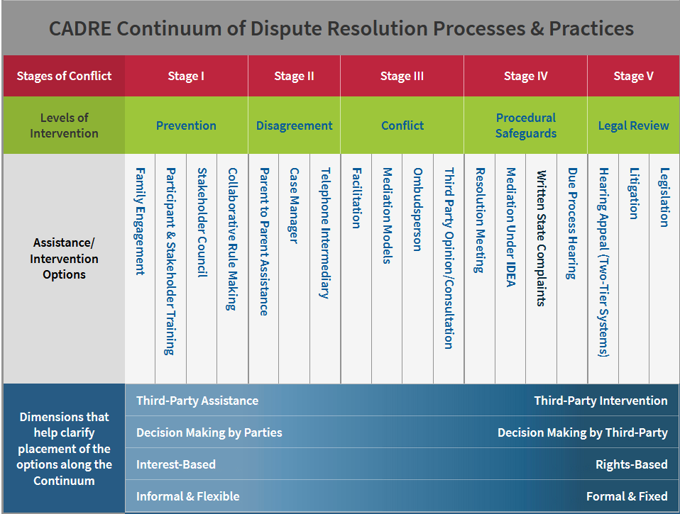
Dispute Resolution Manager
Dispute Resolution Manager

Slide 23
Dispute Resolution Manager 2
Dispute Resolution Manager
Early Intervention
  Participant and Stakeholder Training
    Teach the importance of stories in our lives.
    Use theories upon how those stories are created.
    Theories developed by Chris Argyris (1923-2013).
    We add these concepts in our training of
      Neutrals that perform services.
      SERC Advisory Council
      Stakeholder training in communication for parents and schools (See www.okserc.org - Stakeholder Training & Wisdom Wednesday Webinars)

Slide 24
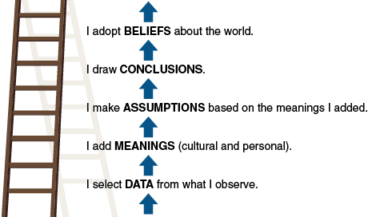
The Ladder of Inference
The Ladder of Inference

Slide 25
Dispute Resolution Manger
Dispute Resolution Manager
Prevention and Disagreement Stages
  Telephone contacts with consumers – parents or school representatives.
    We have people answer the phone and give forms or general information.
    Intake, however, is more of a formal system component. Intake involves a dedicated time for listening to the story that is being shared.

Slide 26
Intake
Intake
Intake with a party takes time.
I listen to the party’s story and ask questions.
  The sharing party experiences their story as true.
  While they share, I discover hidden and embedded stories within the story they are currently telling me. These stories tell me more about the person – their assumptions, judgments, or fears.
  I acknowledge the story they told me. I begin asking questions to develop curiosity.

Slide 27
Scenario 1
Scenario 1
Educator Perspective
Parent Perspective
This parent doesn’t care how the child does in school. His grades are terrible. They don’t come to conferences.
They only get upset when their son isn’t eligible for sports.
My son has a learning disability. He struggles so hard in school. I can’t really help him. He hates school and I am afraid he will drop out at any time.
I worry about his future.
Baseball is all he cares about –and if he losses that then he’ll not want to go back!

Slide 28
Scenario 2
Scenario 2
Educator Perspective
Parent Perspective
These parents are making excuses for their child’s behavior.
These parents think their child should be able to do anything they want in school.
They always defend him and act like we are picking on him.
My child only gets in trouble in that teacher’s classroom.
I think she doesn’t like him. I had a teacher that didn’t like me and it didn’t matter what I did.
Were you okay when your child “did that” in class? NO! But I want to be sure that he is being treated fairly. I’m not there to see what is happening.

Slide 29
Scenario 3
Scenario 3
Educator Perspective
Parent Perspective
The parents just yell at us in meetings.
You can’t talk to them about any issues.
They don’t listen.
They just scream and cuss.
You can’t talk to those people!
I have tried explaining to them but they don’t listen!
I get so tired of it all – I just want them to care about my son!
It’s never better!

Slide 30
The Power of Intake
The Power of Intake
Explain what happens in the process (IEP facilitation, mediation) they have chosen.
I acknowledge their story and explain that the other party is likely to have a story.
They can each listen to the other.
Are they willing to move forward to really talk and listen, and create a new story for this child moving forward?

Slide 31
My Story
My Story
The most valuable part of intake for me is :
  Listening to the whole story.
  Hearing the fear that is driving parent/school concerns.
    Parents/schools often feel isolated.
    Parents/schools don’t know where to turn and they feel helpless.
    Giving parents/schools options they didn’t know they had.
    Offering support through services they didn’t know they had.
  Giving parents and schools stories of hope
  makes my job worth every minute!

Slide 32


The Potential of Storytelling in Conflict Engagement and Building Relationships
Presented by:
Marc Purchin
Alternative Dispute Resolution Services
(310) 202-1155
www.purchinconsulting.com

Slide 33
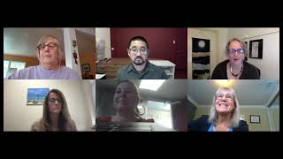

Video Interaction
www.purchinconsulting.com

Slide 34
The Importance of Storytelling
Everyone has a story to tell
Importance of family to be able to tell their story
Putting the “I” Back in Team
Being able to create new stories with new team members
Come from curiosity (Use Question strategies) https://drive.google.com/file/d/12TW_qwTRHXwgAoNUyUDDqfm1CSJTB2If/view?usp=share_link
https://drive.google.com/file/d/1yvwJqEUd5wVTkB9l1Wd19UF4eXvsTfkA/view?usp=share_link ( Spanish)
www.purchinconsulting.com

Slide 35

Quote from Helen Keller
"ALONE WE CAN DO SO LITTLE; TOGETHER WE CAN DO SO MUCH."
- HELEN KELLER

Slide 36
PURCHIN CONSULTING ADR SERVICES INCLUDE:
  Program Development
  Mediation
  Training
  Coaching
  Meeting Facilitation
We Are Advocates for the Process Only
www.purchinconsulting.com

Slide 37

CONTACT US
mpurchin@purchinconsulting.com
www.purchingconsulting.com
Purchin Consulting - Advocates for the Process Only

Slide 38
Need More Information?
Visit CADRE online
www.cadreworks.org
Contact CADRE via email
cadre@directionservice.org
Sign up for the CADRE Newsletter!

Slide 39

Thank you for joining us!
Please take a few minutes to respond to this brief survey about your experience:
Survey Monkey link:
https://www.surveymonkey.com/r/StorytellingWebinarSEPT23

