Slide 1
Engaging Diverse Communities and Stakeholders in Special Education and Early Intervention Dispute Resolutions: The Essential Role of Cultural Brokering
Tawara D. Goode
Associate Professor
Georgetown University National Center for Cultural Competence
University Center for Excellence in Developmental Disabilities
Center for Child and Human Development
Georgetown University Medical Center
March 1, 2022

Slide 2
Technical Notes
Phone lines have been muted to minimize interruptions.
At any point during the presentation, you can enter questions or comments into the Chat Box on your control panel.
The presenter is reserving time at the end to take questions.
Thank you in advance, for taking the time to respond to the brief survey at the end of this forum.
This webinar will be posted and made available to the general public on CADRE’s website.

Slide 3
Engaging Diverse Communities and Stakeholders in Special Education and Early Intervention Dispute Resolutions: The Essential Role of Cultural Brokering
Tawara D. Goode
Associate Professor
Georgetown University National Center for Cultural Competence
University Center for Excellence in Developmental Disabilities
Center for Child and Human Development
Georgetown University Medical Center
March 1, 2022

Slide 4
Participants will:
Define the concept of cultural brokering.
List the attributes, knowledge, and skills of a cultural broker.
Cite guiding principles of cultural brokering.
List six key strategies for engaging diverse communities.
Apply the concept, principles, and practices of cultural brokering to dispute resolution in special education and early intervention including their relationship to cultural and linguistic competence.
Slide Source:© 2022 - Georgetown University National Center for Cultural Competence
Slide Source:© 2022 - Georgetown University National Center for Cultural Competence

Slide 5
The State Department of Education’s Dispute Resolution office relies on several mechanisms to gather stakeholder feedback including but not limited to:
Scenario
1) exit surveys from mediation and state complaint options; 2) commentary and recommendations from the state’s federally funded Parent Center; and
3) quarterly presentations to the state’s special education advisory panel typically given by a representative from the Parent Center and two additional parents.
The State Superintendent received a complaint asserting that the parents on the special education advisory panel are neither representative of the diverse populations that reside in the state in general, nor those racial and ethnic groups who reside in rural areas in particular. Specifically, the complaint stated that the two parents appointed to the panel are “metropolitan, upper middle class, women who know nothing about the struggles of children with disabilities and their families with numerous challenges and who live in under resourced communities.” The parents appointed to the panel live in the largest metro area where the Department of Education is housed and were recommended by the Parent Center.
Slide Source: 2022 - Georgetown University National Center for Cultural Competence

Slide 6
Exactly who are the diverse communities and stakeholders in your state?
Slide Source:© 2022 - Georgetown University National Center for Cultural Competence

Slide 7
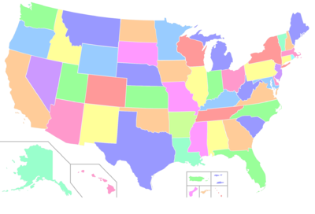
ACS 2020 United States Demographic Estimates
One Race or Latino or Hispanic and Race
Total Population = 329,484,119
RACE | NUMBER | Percent of POPULATION
One Race | 297,600,338
White | 206,619,960 | 76.3%
Black or African American | 39,839,863 | 13.4%
American Indian or Alaska Native | 3,239,492 | 1.3%
Asian | 18,943,940 | 5.9%
Native Hawaiian & Other Pacific Islander | 601,228 | 0.2%
Some Other Race | 22,316,584
Two or More Races | 37,923,052 | 2.8%
Hispanic or Latino and Race
Hispanic or Latino of any Race | 61,133,492 | 18.5%
Data Source: Source: U.S. Census Bureau, 2020 American Community Survey 1-Year Experimental Estimates Table ID: XK200201.
Slide Source:© 2022 -
Georgetown University National Center for Cultural Competence

Slide 8
Languages Spoken at Home in the U.S. in 2019
Estimated Total Population 5 years and over 308,834,688
Speak only English 241,032,343 78.0%
Speak a language other than English 67,802,345 22.0%
Speak Spanish 41,757,391 13.5%
Speak Indo European languages 11,465,631 3.7%
[French (Patois, Cajun), French Creole, Italian, Portuguese, Portuguese Creole, German, Yiddish, Other West Germanic languages, Scandinavian languages, Greek, Russian, Polish, Serbo-Croatian, Other Slavic languages, Armenian, Persian, Gujarathi, Hindi, Urdu, Other Indic languages]
Speak Asian and Pacific Island languages 10,973,317 3.6%
[Chinese, Japanese, Korean, Mon-Khmer, Cambodian, Miao, Hmong, Thai, Laotian, Vietnamese, Tagalog, other Pacific Island languages]
Other Languages 3,606,006 1.2%
[Navajo, Other Native American languages, Hungarian, Arabic, Hebrew, African languages, other unspecified languages]
Data Source: U.S. Census Bureau, American Fact Finder, 2019 American Community Survey- 1-Year Estimates, Table S1601
Slide Source:© 2022 - Georgetown University
National Center for Cultural Competence

Slide 9
Languages Spoken at Home other than English in the U.S. by number of Speakers in 2019
Spanish | 41,757,391
Chinese (Mandarin & Cantonese) | 3,494,544
Tagalog | 1,763,585
Vietnamese | 1,570,526
Arabic | 1,260,437
French (includes Cajun) | 1,171,775
Korean | 1,075,247
Russian | 941,454
Haitian | 924,817
German | 895,309
Derived from 2019 ACS US Census data
Slide Source:© 2022 - Georgetown University National Center for Cultural Competence

Slide 10
Limited English Speaking Households
Limited English Speaking Households formerly (linguistic isolation) refers to households in which no member 14 years old and over: (1) speaks only English or (2) speaks a non-English language and speaks English “very well.”
Limited English Speaking Households in the Unites States in 2019
All households 4.3%
Households speaking--
Spanish 20.5%
Other Indo-European languages 14.7%
Asian and Pacific Island languages 23.5%
Other languages 15.0%
Data Source: U.S. Census Bureau, American FactFinder,
2019 American Community Survey- 1 Year Estimates, Table S1602
Slide Source:© 2022 - Georgetown University
National Center for Cultural Competence

Slide 11
Quick Facts about U.S. School-Age Children who Speak Languages other than English
In 2019, about 23% of school-age children spoke a language other than English at home, and 4% of school-age children both spoke a language other than English at home and had difficulty speaking English.
In 2019, about 5% of school-age children spoke a language other than English at home and lived in limited-English-speaking households.
The percentage of school-age children who spoke a language other than English at home varied by region of the country in 2019, from a low of 13% in the Midwest to a high of 32% in the West.
In 2019, the percentage of school-age children who had difficulty speaking English also varied by region, from a low of 3% in the Midwest to a high of 5% in the West.
Approximately 55% of school-age Asian-alone children and 60% of school-age Hispanic children spoke a language other than English at home in 2019 compared with 6% of White-alone, non-Hispanic and 8% of Black-alone, non-Hispanic school-age children.
In 2019, approximately 12% of school-age Asian-alone and 11% of school-age Hispanic children spoke another language at home and had difficulty speaking English compared with about 1% of White-alone, non-Hispanic and 1% of Black-alone, non-Hispanic school-age children.
Data source: Federal Interagency Forum on Child and Family Statistics.
Retrieved on 2/22/22 from https://www.childstats.gov/americaschildren/family5.asp#f18
Slide Source:© 2022 - Georgetown University National Center for Cultural Competence

Slide 12
Polling Questions 1-2
Does your state system routinely collect and analyze data to:
Compare the racial and ethnic demographic makeup of children and families involved in dispute resolution to those receiving special education or early intervention services?
□ yes □ no □ “I think so” □ in progress
Determine the number of families who request and receive dispute resolution services in languages other than English?
□ yes □ no □ “I think so” □ in progress
Slide Source:© 2022- Georgetown University National Center for Cultural Competence

Slide 13
Let’s Take a Closer Look at these Concepts
Community Outreach
Community Engagement
Slide Source:© 2022 - Georgetown University National Center for Cultural Competence

Slide 14
Community Outreach vs. Community Engagement
The NCCC asserts that there is a distinct philosophical difference between outreach and engagement, particularly as it relates to the values and principles of cultural and linguistic competence.
Outreach implies a unilateral or one-way approach from the organization or agency to the community, whereas engagement implies the bilateral or two-way exchange.

Slide 15
Differentiating Community Outreach from Community Engagement
Community outreach is defined as the act of reaching out by an organization, program, or other entity for extending assistance or services to the community, generally as acts of goodwill, information dissemination, or education.
.
Slide Source:© 2022- Georgetown University National Center for Cultural Competence

Slide 16
Differentiating Community Outreach from Community Engagement
Community Engagement is “the process of working collaboratively with and through groups of people affiliated by geographic proximity, special interest, or similar situations to address issues affecting the well-being of those people.”
Principles of Community Engagement, Center for Disease Control and Prevention, Second Edition U.S. Department of Health and Human Services (2011). Retrieved on 2/21/22 from https://www.atsdr.cdc.gov/communityengagement/pdf/PCE_Report_508_FINAL.pdf
Slide Source:© 2022 - Georgetown University National Center for Cultural Competence

Slide 17
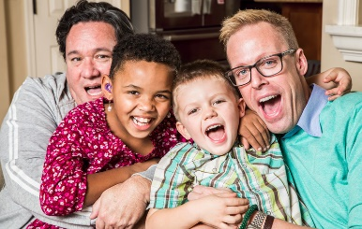
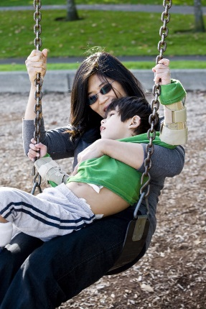
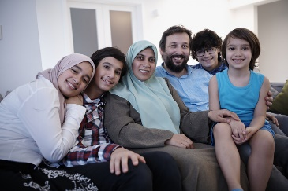
A Word About Family Engagement
“…Building and maintaining relationships is a shared responsibility of families and professionals that requires mutual respect for the roles and strengths each has to offer. Family engagement means doing with—not doing to or for—families.”
Data Source: Parent, Family, & Community Engagement Framework for Early Childhood Systems
https://childcareta.acf.hhs.gov/sites/default/files/public/pfce-framework_for_ec_systems_final_508.pdf
Slide Source:© 2022- Georgetown University National Center for Cultural Competence

Slide 18
THOUGHTS ABOUT COMMUNITY ENGAGEMENT
If truth be told… some within our special education systems
Give lip service to community engagement
Fail to recognize and appreciate the knowledge and resilience of diverse communities
Want members of diverse communities to believe, think, and act “like us”
Have minimum capacity to learn from and partner with diverse communities
Have few staff who are members of the diverse communities they serve
Slide Source:© 2022- Georgetown University National Center for Cultural Competence

Slide 19
Polling Question3
Does your Dispute Resolution System differentiate community outreach from community engagement for families and stakeholders in your state?
□ yes
□ no
□ “not sure”
Slide Source:© 2022- Georgetown University National Center for Cultural Competence

Slide 20
Rationales for Cultural Brokering in Special Education
and Early Intervention Dispute Resolution
Current and projected demographic trends among children ages birth-21 years
Experiences of marginalization and discrimination in education and human services
Cultural beliefs and practices about conflict resolution
Growing evidence base
Slide Source:© 2022 - Georgetown University National Center for Cultural Competence

Slide 21
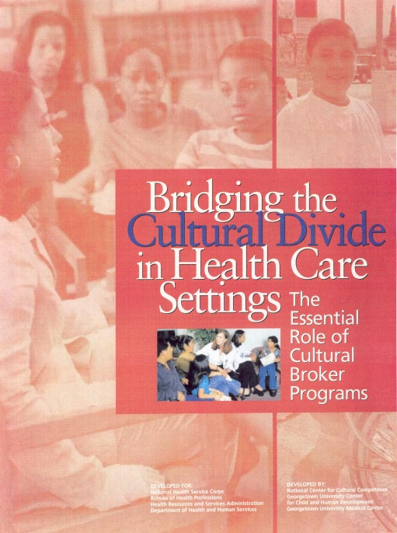
Concept of Cultural Brokering
The act of bridging, linking or mediating between groups or persons of different cultural backgrounds for the purpose of reducing conflict or producing change (Jezewski, 1990).
Slide Source:© 2022 - Georgetown University National Center for Cultural Competence

Slide 22
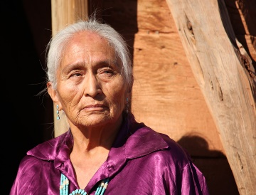
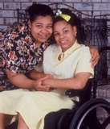
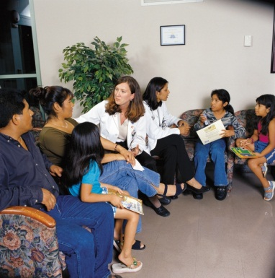
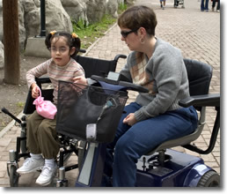
Definition of Cultural Broker
a go-between, one who advocates on behalf of an individual or group
(Jezewski & Sotnik, 2001)
Slide Source:© 2022 - Georgetown University National Center for Cultural Competence

Slide 23
Who is the Cultural Broker?
liaison
cultural guide
mediator
catalyst for change
Slide Source:© 2022 - Georgetown University National Center for Cultural Competence

Slide 24
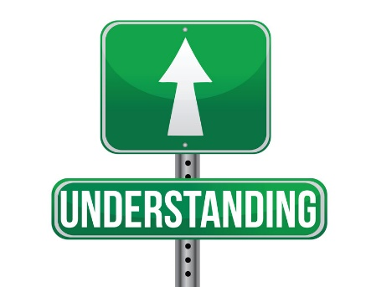
Characteristics & Attributes of a Cultural Broker
Trust & respect of the community
Knowledge of values and beliefs about disability of diverse racial, ethnic, and cultural groups
Understanding and connections with traditional and indigenous networks of support within diverse communities
Experience navigating disability, education, and social services systems
Slide Source:© 2022 - Georgetown University National Center for Cultural Competence

Slide 25
Guiding Principles for Cultural Broker Programs
Cultural brokering …
honors and respects cultural differences among populations and communities
is community-driven
provides services and supports that are accessible and tailored to cultural contexts of communities served
acknowledges reciprocity and the transfer of assets between communities and organizations and programs
Slide Source:© 2022 - Georgetown University National Center for Cultural Competence

Slide 26
What’s Getting in the Way?
TRUST. Some members of racially, ethnically, and culturally diverse groups are reticent to trust educational systems because of historical and present day experiences with bias, stereotyping, discrimination, and racism in education, and social services.
EQUITY. Some communities have not equitably benefited from legal proceedings.
DIFFERING WORLD VIEWS. Differing values and social and cultural beliefs related to conflict resolution.
LACK OF TRUE COMMUNITY ENGAGEMENT & CLC. Many educational systems continue to struggle with how to engage racially, ethnically, culturally, and linguistically diverse communities (in any geographic locale) using culturally and linguistically competent principles and practices.

Slide 27
Key Strategies to Engage Diverse Communities in Special Education and Early Intervention Dispute Resolution
Learn about communities.
Enter communities respectfully.
Elicit and consider the interests and needs of communities before declaring the goals of your program.
Explore areas of mutual interests and benefits.
Foster relationships and partnerships that are built on mutual trust, reciprocity, and respect.
Commit to the long-haul.

Slide 28
Polling Questions 4-5
To what extent has your State Dispute Resolution System used cultural brokering (by any other name) to engage diverse communities and stakeholders?
□ Never □ Seldom □ Sometimes □ Often
How likely is your State Dispute Resolution System to use cultural brokering as an approach to engage diverse communities and stakeholders?
□ Never □ Seldom □ Sometimes □ Often
Slide Source:© 2022- Georgetown University National Center for Cultural Competence

Slide 29
Let’s revisit the scenario.
Small group dialogues for 20 minutes.
Slide Source:© 2022 - Georgetown University National Center for Cultural Competence

Slide 30
The State Department of Education’s Dispute Resolution office relies on several mechanisms to gather stakeholder feedback including but not limited to: 1) exit surveys from mediation and state complaint options; 3) commentary and recommendations from the state’s federally funded Parent Center; and 4) quarterly presentations to the state’s special education advisory panel typically given by a representative from the Parent Center and two additional parents.
Scenario
The State Superintendent received a complaint asserting that the parents on the special education advisory panel are neither representative of the diverse populations that reside in the state in general, nor those racial and ethnic groups who reside in rural areas in particular. Specifically, the complaint stated that the two parents appointed to the panel are “metropolitan, upper middle class, women who know nothing about the struggles of children with disabilities and their families with numerous challenges and who live in under resourced communities.” The parents appointed to the panel live in the largest metro area where the Department of Education is housed and were recommended by the Parent Center.
Small group reflection and discussion questions
What are the implications for engaging diverse communities raised by this scenario?
What actions can be taken to ensure that the special education advisory panel’s demographic makeup and diversity of interests are represented?
Slide Source: 2022 - Georgetown University National Center for Cultural Competence

Slide 31
Applying Principles and Practices of Cultural and Linguistic Competence to Cultural Brokering
Applying Principles and Practices of CLC to Cultural Brokering
Value diversity Implement approaches to community engagement and stakeholder engagement that are responsive to the diversity among children, families, and the communities in which they live. Support and maintain a workforce that is representative of the diverse populations in the state.
Conduct self-assessment Take a go at the CADRE’s Cultural and Linguistic Assessment for Dispute Resolution Systems to determine program/system strengths and areas for growth.
Manage the dynamics of difference Prepare and support staff, at all levels of the system/program, to communicate with and to interact effectively with each other as well as with students, their families, and stakeholders who are members of diverse cultural groups and/or who speak languages different from their own.
Embed cultural knowledge Share knowledge and experiences about cultural practices, traditions, and norms related to disability, special education, early intervention, and related social services. Engage cultural brokers to acquire knowledge about lived experience of students with disabilities, their families, and the communities in which they live.
Adapt to diversity and cultural contexts of children, families, and communities served Use cultural brokers, linking to community-based organizations concerned special education and disability rights to engage families/stakeholders to serve as liaisons that are both vested in and reflect the communities served.
Slide Source:© 2022 - Georgetown University National Center for Cultural Competence

Slide 32
To Engage Communities Successfully, Dispute Resolution Systems and Programs must understand…
Their own organizational culture and the cultures of their personnel
The diverse cultures represented within the communities they serve or seek to serve
The social and political climates that affect communities historically and in real time
The inherent strength within communities to recognize their own problems and intervene appropriately on their own behalf
Slide Source:© 2022- Georgetown University National Center for Cultural Competence

Slide 33
In many instances, what it takes to engage diverse communities and stakeholders is
Slide Source:© 2022 - Georgetown University National Center for Cultural Competence

Slide 34
CONTACT US
Georgetown University National Center for Cultural Competence
http://nccc.georgetown.edu
cultural@georgetown.edu
The content of and this PowerPoint presentation are copyrighted and are protected by Georgetown University's copyright policies.
Permission is granted to use this PowerPoint presentation in its entirety and/or individual slides for non-commercial purposes if:
the material is not to be altered and
proper credit is given to the author(s) and to the National Center for Cultural Competence.
Permission is required if the material is to be:
modified in any way
used in broad distribution.
To request permission and for more information, contact cultural@georgetown.edu.

Slide 35
Questions

Slide 36
Need More Information?
Visit CADRE online
www.cadreworks.org
Contact CADRE via email
cadre@directionservice.org
Sign up for the CADRE Newsletter!

Slide 37
Thank you for joining us!
Please take a few minutes to respond to this brief survey about your experience:
Survey Monkey link:
https://www.surveymonkey.com/r/TawaraGoode-CulturalBroker

