Slide 1
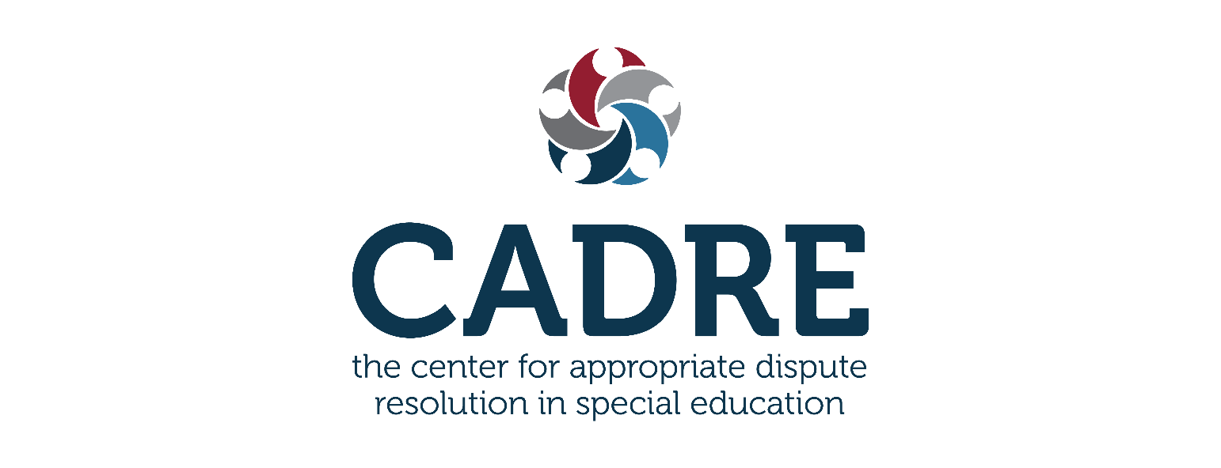
CADRE’s Cultural &
Linguistic Competence
Self-Assessment for
Dispute Resolution Systems
Noëlla Bernal
Diana Nadeau
Melanie Reese
Kelly Rauscher
Manny Guendulay
CLC Tool Webinar 2023
1

Slide 2

Welcome!
Noëlla Bernal
Diana Nadeau
Melanie Reese
Kelly Rauscher
Manny Guendulay

Slide 3
Agenda
Supporting data for Cultural and Linguistic Competence (CLC) in Special Education DR systems
Understanding diverse communities in your state
Why a CLC assessment is important
Lessons Learned from the Pilot
Walkthrough of the CLC Tool
CADRE’s CLC Tool Supplemental Resources
CADRE’s Webpages
Q & A

Slide 4
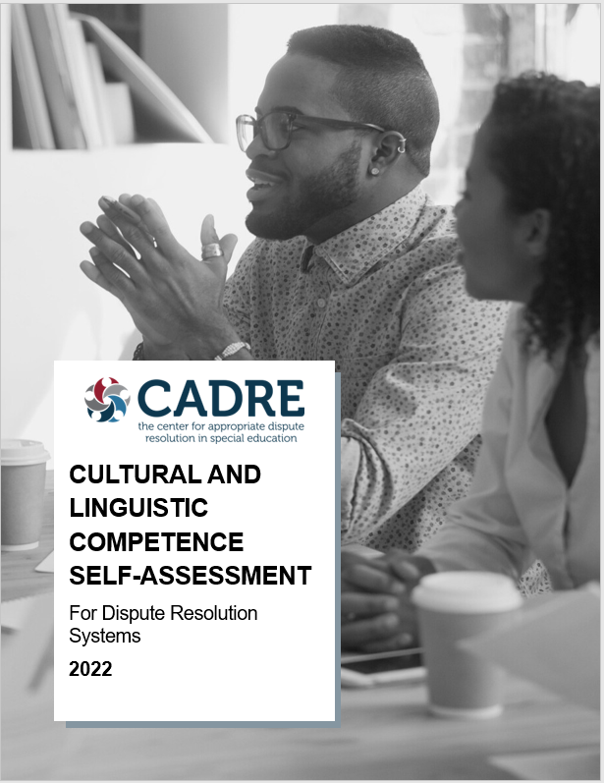

CLC Self-Assessment for
Dispute Resolution Systems

Slide 5
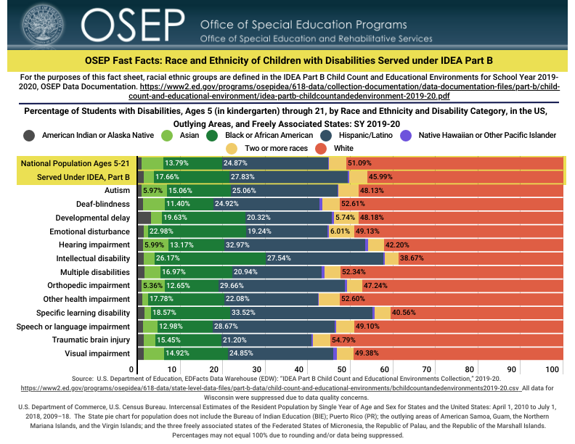
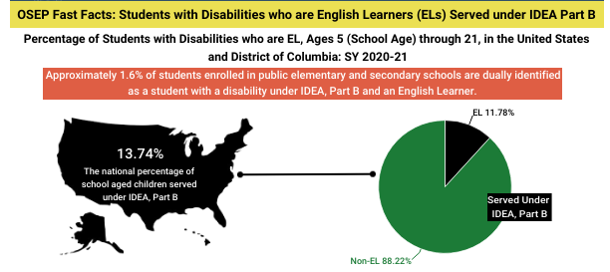
Students with Disabilities by Race, Ethnicity, and English Learners
SOURCES: U.S. Department of Education, National Center for Education Statistics, Statistics of Public Elementary and Secondary School Systems, 1980-81; Common Core of Data (CCD), "State Nonfiscal Survey of Public Elementary/Secondary Education," 1985-86 through 2019-20 and 2020-21 Preliminary; National Elementary and Secondary Enrollment Projection Model, through 2030; and U.S. Department of Education, EDFacts Data Warehouse (EDW): “IDEA Part B Child Count and Educational Environments Collection,” 2020-21

Slide 6
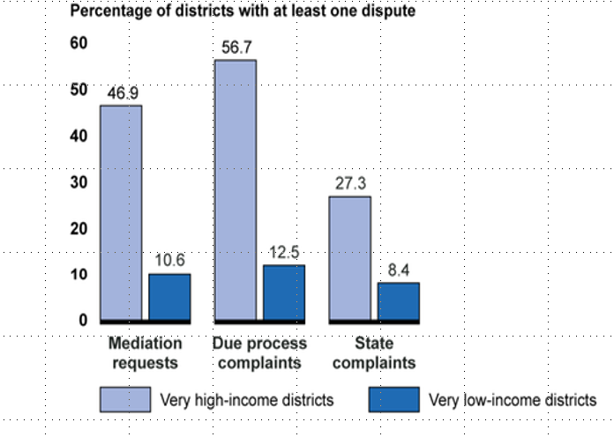
GAO Report: Income

Slide 7
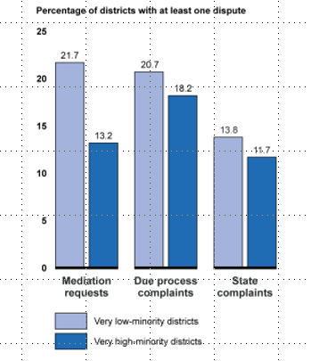
Gao Report: Race/Ethnicity
GAO Report:
Race/Ethnicity

Slide 8

Why do high income/low minority districts have more dispute resolution activity than low income/high minority districts?
Availability, accessibility, and cost of legal help
Likelihood of prevailing at due process is much less for parents
Concern for privacy in low population areas
Lack of options to public education if it becomes too contentious
Additional barriers such as:
  Cultural differences in challenging authority figures
  Language barriers
  Fear of retaliation (e.g., CPS, immigration)
  Time constraints (e.g., taking time off work)
  Incidental factors (e.g., transportation, Internet access)

Slide 9



Diversity and Culture
‘Cultural diversity’ is used to describe differences that distinguish one group or individual from another.
9

Slide 10

Why is CCL Self-Assessment important
Why is CLC Self-assessment Important?

Slide 11
Understanding Needs and Interests
    Stakeholder engagement and family voice are crucial to the CLC self-assessment process.

Slide 12

Developing CADRE’s CLC Assessment Tool
Collaborated with:
CADRE stakeholders
CADRE consultants
OSEP project officer
Used the tool for our own internal assessment
Piloted the product with three SEAs

Slide 13

WA (OSPI) Pilot State
CLC Self-Assessment
Washington State Experience
Alyssa Fairbanks of Washington State Education Agency, Dispute Resolution Team Lead

Slide 14
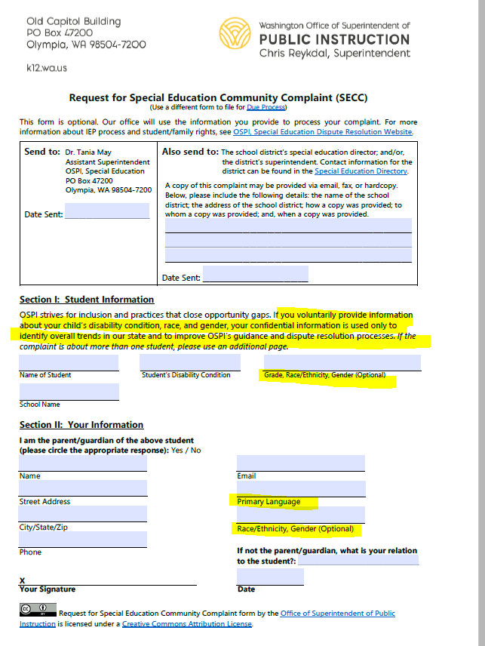
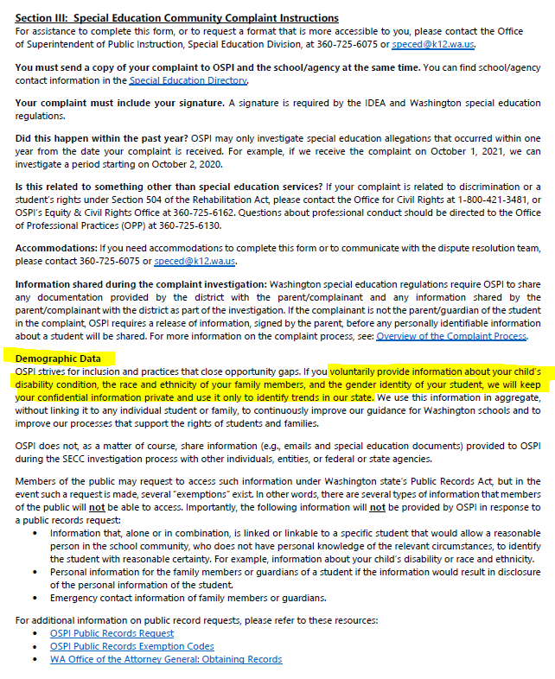
A look at the Washington Complaint form

Slide 15
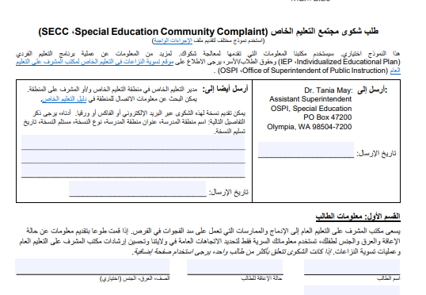
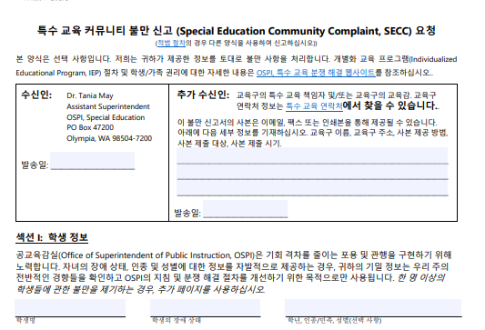
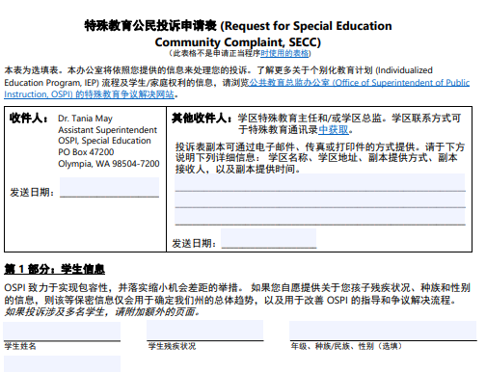
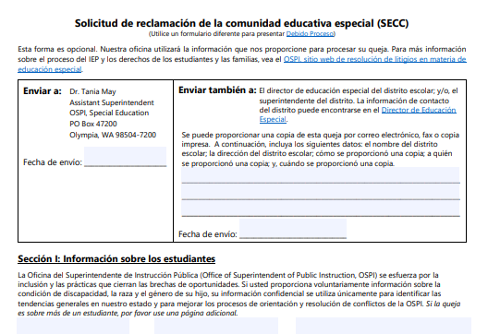
The Washintgon form in multiple languages

Slide 16
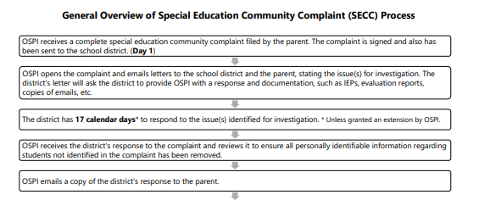
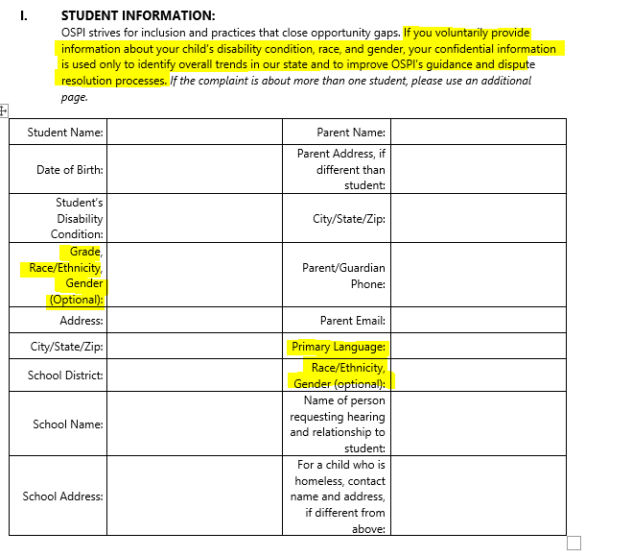
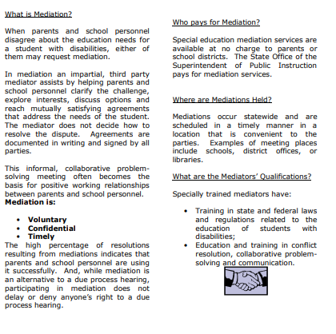
The complaint process in Washington

Slide 17
2022 Due Process Filing by Race/Ethnicity

Slide 18
2023 Due Process Filing by Race/Ethnicity
Data as of 2/14/23

Slide 19
Pilot Feedback and Lessons Learned
Unforeseen Barriers:
Benefits of the assessment:
Staff capacity and turnover
Diversity, equity, access awareness
Change in leadership
A shift in previous views/assumptions
Strained stakeholder relations
More empathetic when helping DR system users
Impact of politics
Areas of SEA Improvement:
Translated Materials
Website content
Intake forms
Data intake
Engaging diverse groups
Identifying future goals

Slide 20
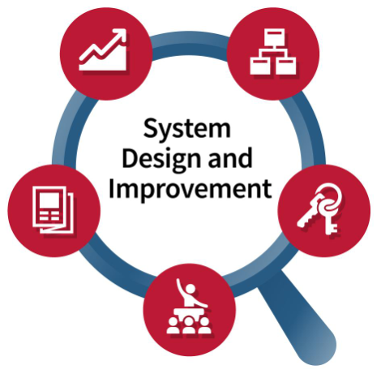
The Tool: Understanding Your System’s Strengths and Opportunities to Grow
There are five function areas:
Systemwide values, infrastructure, and organization
Program access and delivery
Practitioner standards and professional development
Public awareness and outreach
Evaluation and continuous improvement (CQI)

Slide 21

Function Area:
Program Access and Delivery
This area examines the mechanisms in place that enable people across racial, ethnic, cultural, and linguistic groups to easily access all available DR options and the practices in place that ensure community engagement.

Slide 22
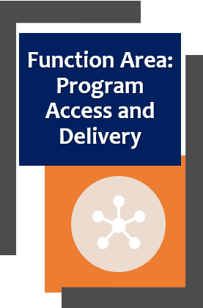
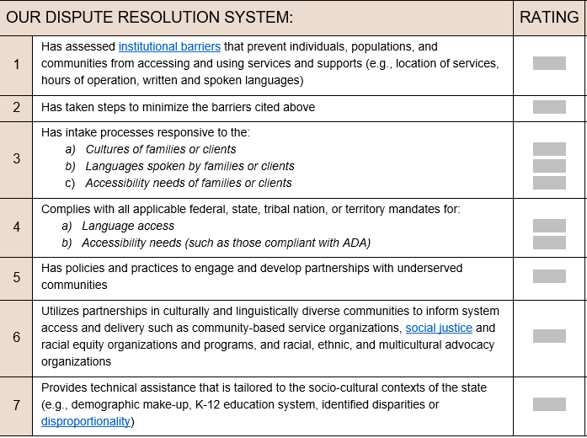
Function Area: Program Access and Delivery
Indicators within Function Area

Slide 23



Program Access and Delivery Indicators
Program Access & Delivery Indicators
Our Dispute Resolution system…
has assessed institutional barriers that prevent individuals, populations, & communities from accessing and using services and supports
has intake processes responsive to the:
a) Cultures of families or clients
b) Languages spoken by families or clients
c) Accessibility needs of families or clients
has policies and practices to engage and develop partnerships with underserved communities

Slide 24

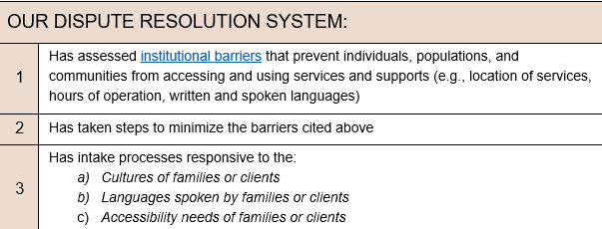
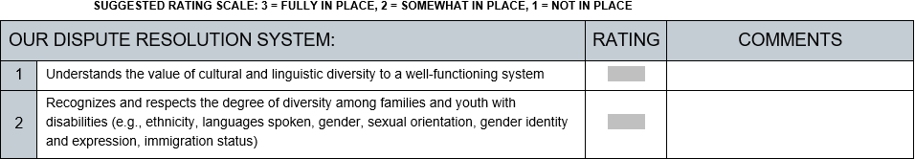
Ratings and Comments
Indicators

Slide 25

Function Area:
Public Awareness and Outreach
This section examines the dispute resolution system’s commitment to providing clear, consistent, and accessible information to the diverse communities they serve.

Slide 26
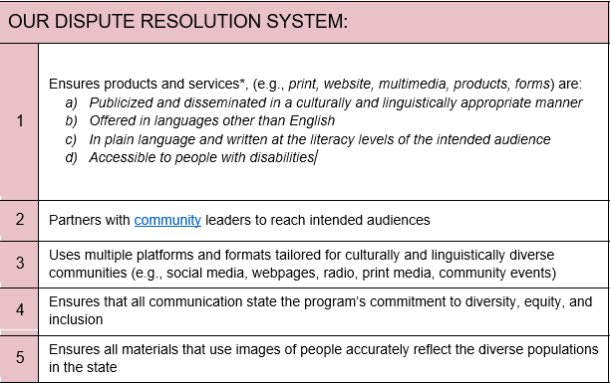

Indicators within Function Area

Slide 27



Public Awareness and Outreach Indicators
Public Awareness & Outreach Indicators
Our dispute resolution system:
Ensures products & services are:
a) Publicized & disseminated appropriately
b) Offered in multiple languages
c) In plain language & at appropriate literacy level
d) Accessible
Uses multiple platforms and formats tailored for culturally and linguistically diverse communities
Ensures all materials that use images of people accurately reflect the diverse populations in the state
27

Slide 28

CADRE’s CLC Assessment Tool and Resources
Creating a successful assessment team
Tips on getting started
An overview of the function areas
Action planning
Coaching questions and group norms
Stakeholder engagement and family voice
Glossary of terms

Slide 29
Supports Embedded into the Tool
Why the team approach is important
Qualities that make a successful team
Question bank to help you get started
Tips for completing the tool and process
Guidance on creating priority areas of focus
Support on how to develop impact statements

Slide 30
Companion
Resources
ACTION PLANNING TOOL
Designed to help focus a team’s efforts:
Step1
Select no more than 2-3 indicators
Indicators
Determine one achievable goal for each improvement area of focus
Goals
Step 2
Step 3
Assign a staff lead for each goal
Assign
Identify a completion
Step 4
Identify
Step 5
Check-in along the way
Check-in

Slide 31
Companion
Resources
COACHING QUESTIONS: Program Access & Delivery
Why might they not be accessing them?
Who isn’t accessing our various dispute resolution options?
How might barriers to access be minimized?

Slide 32
Companion
Resources
COACHING QUESTIONS: Program Access & Delivery
Are our materials culturally relevant to these families?
What languages are our materials translated into?
Are these languages representative of our state’s demographics?

Slide 33
Companion
Resources
GLOSSARY OF TERMS
Institutional barriers: policies, structures, practices, procedures, or situations that systematically disadvantage certain groups of people
Biases: tendencies, (either explicit or implicit) to prefer one thing over another that influences understanding and outcomes

Slide 34
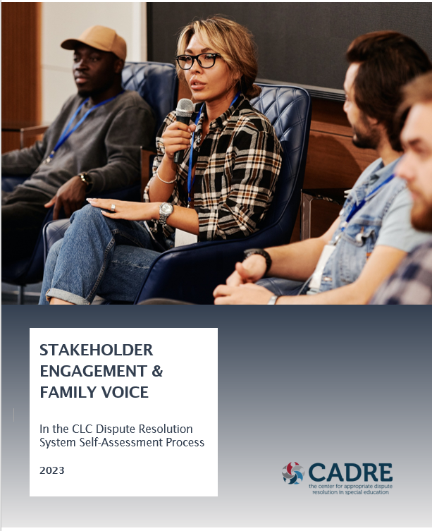
Companion
Resources
STAKEHOLDER ENGAGEMENT AND FAMILY VOICE GUIDE

Slide 35
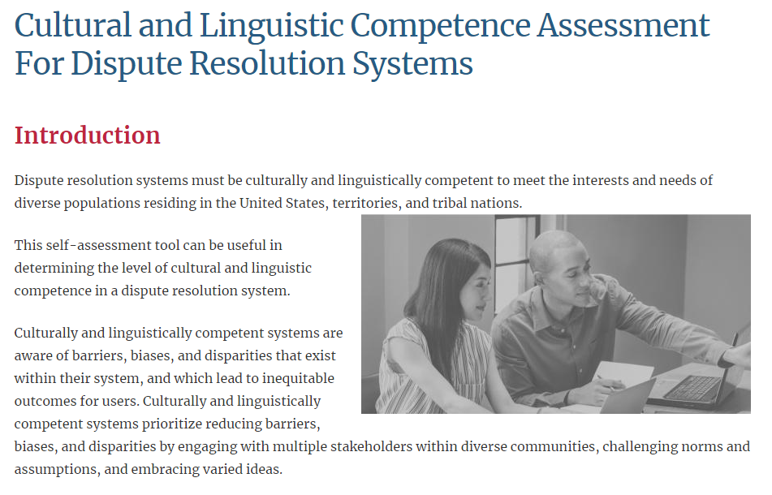
CADRE CLC Tool Webpages
https://www.cadreworks.org/clc/clc-assessment-dr-systems

Slide 36

Questions?

Slide 37

CADRE is here for you!
https://www.cadreworks.org/

Slide 38

Thank you for joining us!
Please take a few minutes to respond to this brief survey about your experience:
Survey Monkey link: https://www.surveymonkey.com/r/CLCDRS2023

Slide 39
Upcoming Webinar
CADRE is planning …
Case Law Review Webinar, Spring 2023
More information will be posted in our next newsletter and the CADRE Website at
http://www.cadreworks.org

