Slide 1
Community-Led Systems Change in a Public School District through Parent Participatory Evaluation
Presented by:
Maren Henderson - Evaluation Specialist, Minneapolis Public Schools
Amanda Dionne - Engagement, Education and Outreach Specialist, Minneapolis Public Schools
August 20, 2020

Slide 2
Technical Notes
Your phone lines are currently muted.
The Control Panel has a “questions” feature.
Please submit all questions to the question box: this will be monitored.
We will take about 15 minutes at the end of the presentation for questions and answers.
Thank you in advance for taking the time to respond to the brief survey at the end of this webinar.

Slide 3
Parent Participatory Evaluation
Minneapolis Public Schools
Notes:
Superintendent

Slide 4
Objectives
Have an understanding of Parent Participatory Evaluation (PPE) and how this research and evaluation approach resulted in parent-led evaluation and improvement at Minneapolis Public Schools (MPS)
Hear from some of our parent evaluators about their experience and findings
Dive deep into Special Education memo and district response
Gain insight into what it takes for this work to be successful and facilitate change

Slide 5
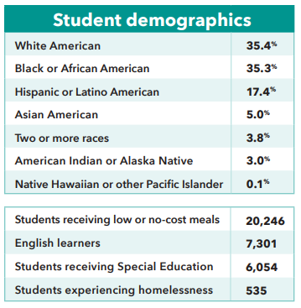
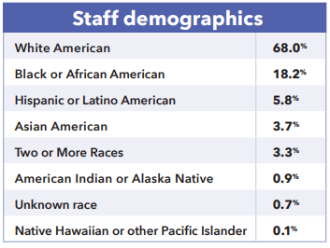
MPS Context

Slide 6
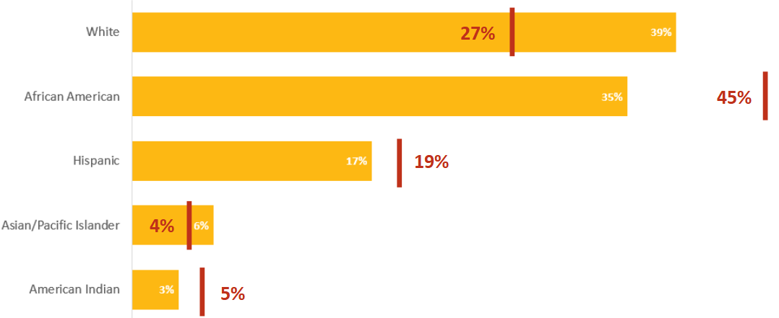
MPS Context - Special Education
Percent of total MPS population
Percent of MPS population receiving Special Education services

Slide 7
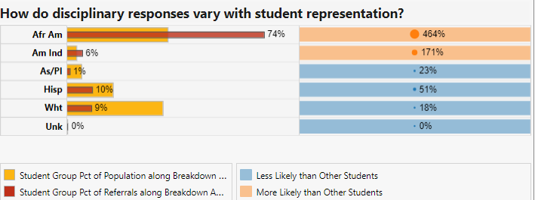
Disproportionality in Disciplinary Response

Slide 8


Special Education & Identity
The definition of identity is who you are, the way you think about yourself, the way you are viewed by the world and the characteristics that define you. An example of identity is a person's name. An example of identity are the traditional characteristics of an “American.”
-yourdictionary.com
Notes:
Providing context
“American” = Assimilation
We wanted to raise awareness and bring the concept of identity to this webinar, because we are constantly hearing across our BIPOC communities and in our PPE program that identity has critical role in shaping one's life, education experience and social/quality of life outcomes. This ties in with students and families in Special Education because for students to receive Individual specialized instruction they have to be “labeled”, which in turn will have a lasting effect and shape one's identity and potentially their future quality of life outcomes. This is also an important topic to keep in mind because as a BIPOC when you begin your education in the American school system you have an added weight of navigating your personal identity to that of which you are being bombarded with in a system rooted in a eurocentric ideology. This itself can be traumatizing for the student and for a family. For example as we will hear through video testimony from one of our parents who son is autistic having to make hard adult decisions about his hair length or which name to call him. We will hear from another PPE parent about the lasting trauma of mislabeling of an EBD or case managers copy and pasting IEPs of other students without even changing the name of that student.
As a person, parent, student, human of color connected to culture and traditions as you enter and progress through the school system you enter into a space where you are comforted to make identity decisions at a very young age. Sometimes what you experience in school directly contradicts values and norms that are part of your identity and that can be traumatizing. As we learned in the last few slides those that are in special education are Special Education are more often than not children of color.

Slide 9
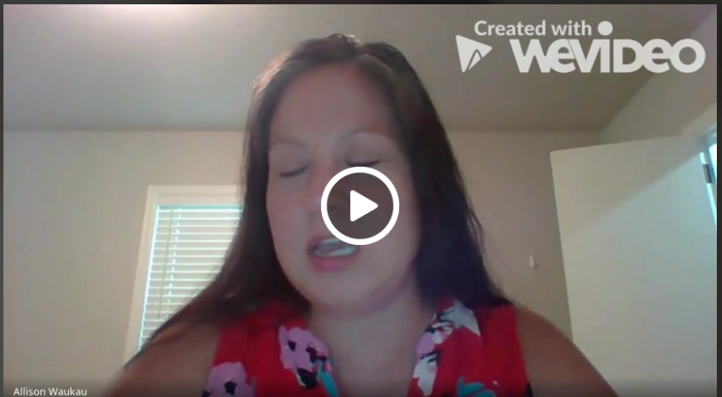
Parent Voice
Notes:
https://www.wevideo.com/view/1791695876

Slide 10
Overview of PPE
Notes:
Eric

Slide 11
Program Overview
Minneapolis Public Schools promises an inspirational educational experience in a safe, welcoming environment for all diverse learners to acquire the tools and skills necessary to confidently engage in the global community. To honor this vision, the District has utilized participatory evaluation, which empowers the people who are closest to the issue to take the lead in the evaluation.
MPS has supported a Youth Participatory Evaluation (YPE) program since 2015, and launched the PPE program in 2018. By partnering with students and parents, MPS engages key stakeholders to identify opportunities for improvement and partner on innovative solutions that best reflect the priorities of our community.

Slide 12

Participatory Evaluation
Notes:
The WHY.
Participatory evaluation, empowers the people who are closest to the issue to take the lead in the evaluation. MPS has supported a Youth Participatory Evaluation program (YPE) for four years, and launched the PPE program this fall after a small pilot last spring. By partnering with students and parents, MPS engages key stakeholders to identify opportunities for improvement and partner on innovative solutions that best reflect the priorities of our community.
The Fall PPE Cohort was made up of 51 parents representing 5 distinct cultural groups: African American, American Indian, Hmong, Latinx and Somali.
It was important for the district to authentically engage with these groups for this project because, Historically, MPS has experienced little success engaging these diverse communities in research and evaluation, even though these cultural groups represent a large population in our MPLS community and schools:

Slide 13
Cultural Humility
Cultural humility is a lifelong process of self-reflection, self-critique and commitment to understanding and respecting different points of view, and engaging with others humbly, authentically and from a place of learning (Tervalon & Murray-Garcia, 1998).

Slide 14
Engaging the Community in Research
MPS serves a racially and ethnically diverse community of students and families
MPS has experienced limited success engaging these diverse communities in research and evaluation
MPS Student Demographics
White: 36.4%
Black or African American: 34%
Latinx or Hispanic: 17.2%
Two or More: 4.8%
Asian: 4.7%
American Indian: 2.7%
Native Hawaiian/Pacific Islander: 0.1%
In a recent survey, MPS collected data from over 3,000 family members, but only 16% identified as a person of color, 11% spoke a language other than English at home, and only 14% reported living on the North side of the city.
Notes:
Over 30% of MPS students identify as Black or African American, with nearly one-third of those students (about 11% of all MPS students) speaking Somali at home.
Over 4% of MPS students identify as Asian/Pacific Islander, with over 40% of those students (about 2% of all MPS students) speaking Hmong at home.
Over 17% of MPS students identify as Latinx or Hispanic, with almost 80% (78%) of those students speaking Spanish at home.

Slide 15
PPE Model in MPS is Built on Partnership
Data collection methods
Analysis
Identifying Themes
Reporting
Engagement
& External Relations
Research, Evaluation, & Assessment
Authentic relationships
Parent engagement
Communication
Language
Parent Evaluators
Community connections (African American, American Indian, Hmong, Latinx, and Somali) x10
Experience with MPS
Notes:
The HOW
Collaboration built on strong relationships
All groups bring expertise to the table: EER, REA, PE

Slide 16
PPE Model in Practice
5 parent groups; 10 parents per group
2 phases; data collection and data analysis
10 meetings total; year long program
1 district leadership meeting responding to parent recommendations
2 parent presentations to district leaders and community stakeholders
3 parent and district leader table conversations
Ongoing one-on-one meetings with District content holder
Progress monitoring

Slide 17
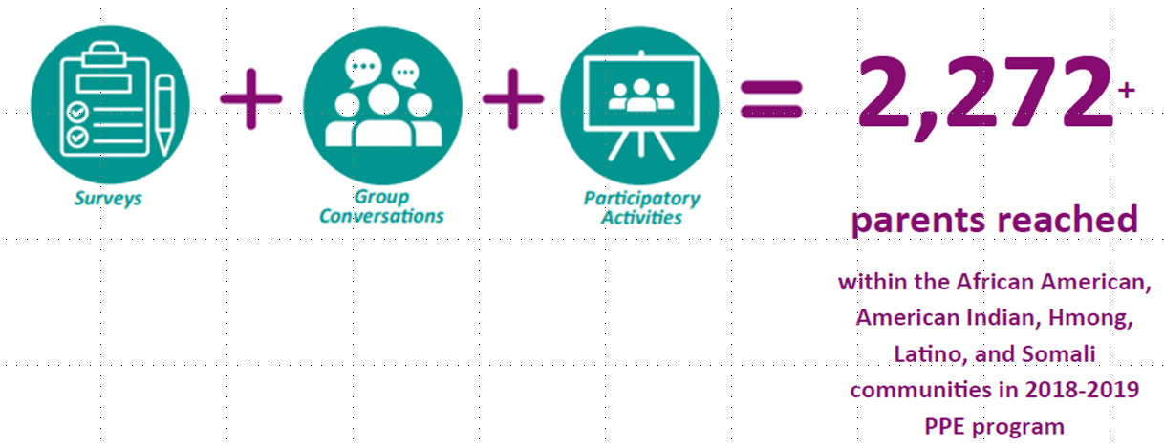
Research Question + Data Collection
How can a school value and respect your child for who they are?
Notes:
Research question connected to strategic priorities of SEL and Equity

Slide 18
Themes Across Groups
For families to feel valued and respected at MPS schools, parents need:
Ongoing commitment that staff will learn about and embed students’ cultures and histories into their instruction and schoolwide practices.
Positive and accessible communication that builds relationships between parents and teachers to partner in support of each child in MPS.
Staff-especially teacher and school leaders-who look like and speak the languages represented in our schools.
Programming and courses throughout the academic experience that reflect and value the cultures and histories of MPS students.
A system of support that empowers parents to advocate for and support their child’s development, especially within special education.
A safe school experience.
Clear communication about schools’ expectations for behavior and equitable treatment in response to behavior.
Notes:
Celina (1-3) and Eric (4-7)

Slide 19
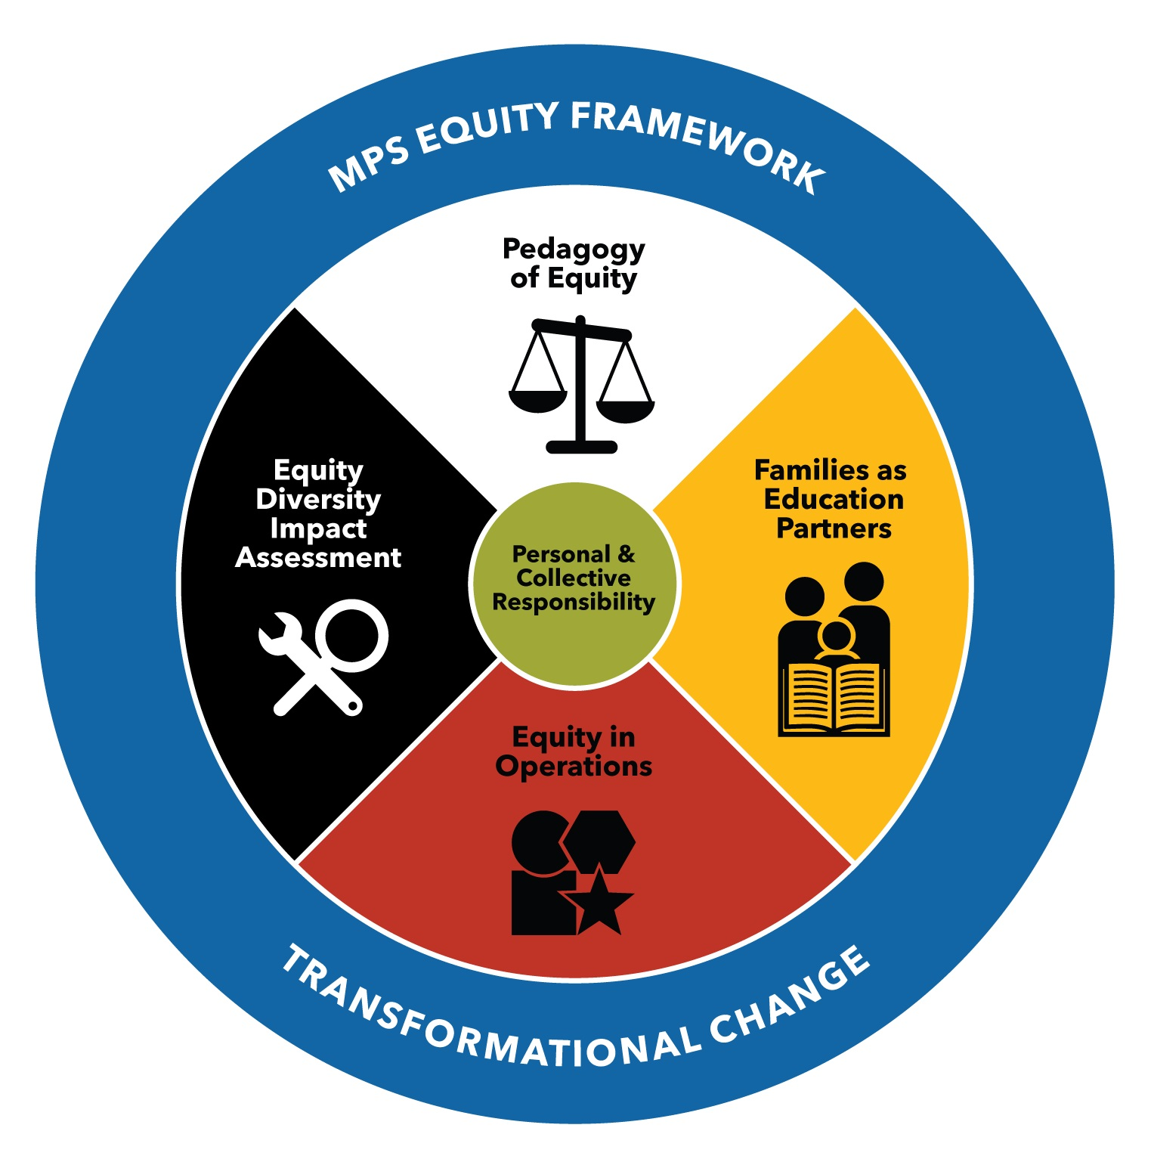
Core Component of PPE: Facilitating Use & Action
Culturally-Specific Groups’ Findings & Recommendations
+
Themes Across Groups
11 Memos with Specific Recommendation for MPS Owner
Notes:
Organized by Equity Framework for Chief-level sponsor -- ensure accountability
Name the image draws from Medicine Wheel

Slide 20

Pedagogy of Equity
Parents feel the MPS academic experience does not reflect and value the languages, cultures, and histories of MPS students.
Parents expect staff to create safe learning environments by addressing issues of bullying and student conflict.
Parents need better communication about schools’ expectations for behavior, as well as equitable treatment in response to behavior.
Parents of students in Special Education programming want to better understand Special Education services and the progress their child is making.

Slide 21

Families as Education Partners
Parents want to be partners in their child’s education, but need schoolwide structures to support them in this role.
Parents seek more positive communication from the District and their child’s school.
Parents want to be able to communicate with school staff, but often do not find multilingual staff or interpreters at MPS schools.
Parents find it essential that schools make their cultures visible by creating and displaying culturally-specific works and languages, and acknowledging important cultural holidays.

Slide 22

Equity in Operations
MPS must prioritize hiring staff who represent the students who attend schools in the District.
Parents want MPS staff to know more about their students’ cultural histories, values, and practices.
It is important to many parents that MPS provide transportation to all students.

Slide 23
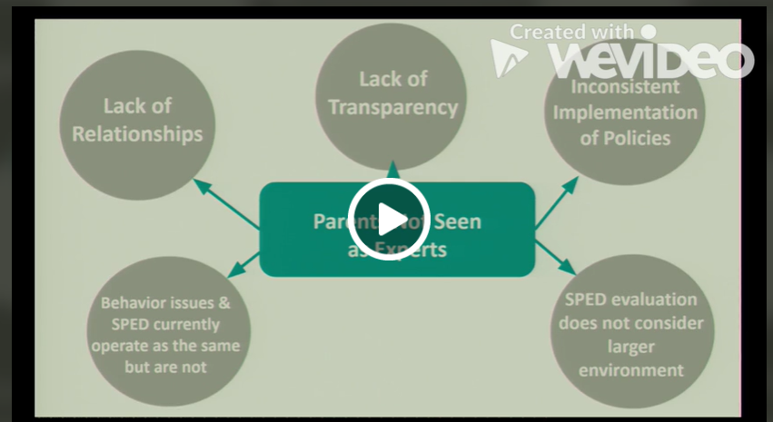
Parent Presentations
Notes:
https://www.wevideo.com/view/1790144998

Slide 24
MPS Responsibility and Accountability
ALL PPE Parent groups made it clear:
they expect action from MPS in response to their research and recommendations

Slide 25
Facilitating Systems Change:
What does it take?
Notes:
Eric

Slide 26
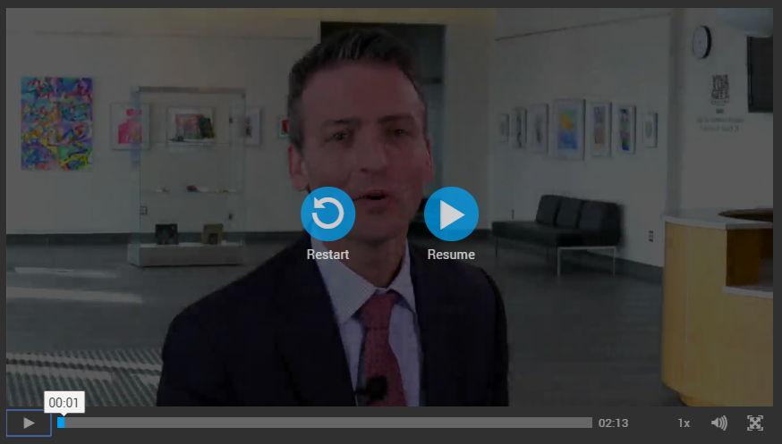
Commitment from Leadership
Available on our webpage: https://rea.mpls.k12.mn.us/parent_participatory_evaluation
Notes:
https://mpls.rev.vbrick.com/#/videos/05413af3-a50e-4d1a-883e-94f447df6e4a

Slide 27
How Have Findings Produced Change?
MPS Action Steps (Spring ‘19)
Increased budget for Interpretation and Translation services
Hired additional Recruitment and Retention Coordinator to increase staff of color
Increased budget for Arts department for more culturally-specific arts displays
Increased Special Education Cultural Liaisons working weeks to include projects that improve relevancy and accessibility of parent communication
Henry HS added a full time teacher for Hmong language course
Heritage HS added a full time teacher for Somali Studies course
MPS Updates (Spring ‘20)
Hired Video Storyteller to produce oral/visual communication in four languages
Included three pathways - American Indian, Hmong Language (new!), and Spanish Language - in Comprehensive District Design
Increased use of non-traditional communication channels to connect with families (e.g. Somos MPS podcast, WhatsApp, Facebook groups, community-led radio)
Released mandatory video training series for all staff on bullying
Amended the Minneapolis Federation of Teachers (MFT) union contract to integrate Restorative Practices districtwide starting August 2021
Empowered parent leadership in Special Education Advisory Committee to expand parent education, communication, and resources

Slide 28
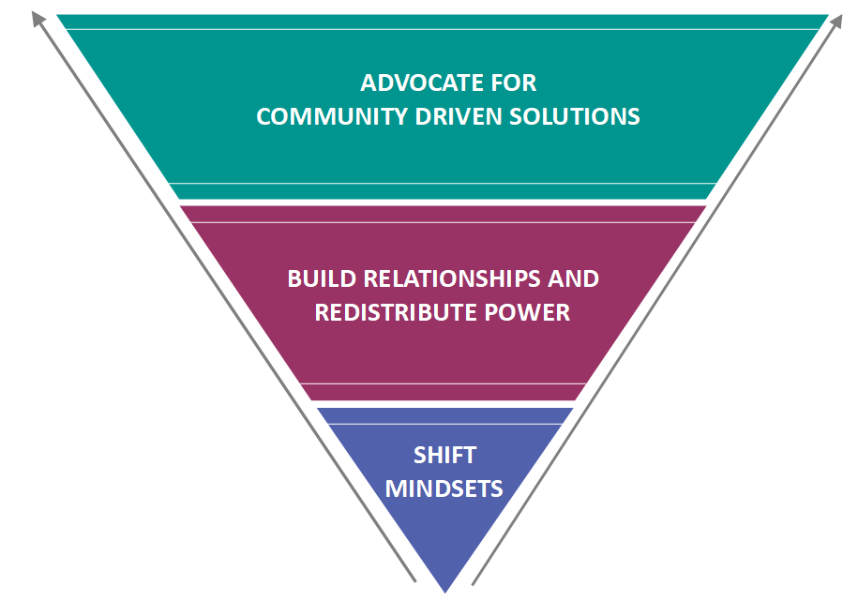
Systems Change Framework
Systems Change Framework (Kania, Kramer, Senge 2018)
Notes:
Solutions must recognize that culture and language are assets to be valued, and that decisions should be made in partnership with parents to avoid tokenization or misappropriation

Slide 29
Diving into the Special Education Memo
4. Special Education: Parents of students in Special Education programming want to better understand Special Education services and the progress their child is making.
Parents need support from MPS to ensure parents can partner with their child’s school to support their child’s Special Education needs.
For parents, this means:
(1) Provide parent trainings to help parents understand Special Education services, (2) set attainable goals and communicate progress with parents; (3) accurately estimate and deliver on needed services of academic and behavior support, (4) ensure documentation (e.g. IEPs) are in accessible language, and (5) hire culturally representative staff.

Slide 30


MPS Response - Technical (Checklist)
PPE Recommendation | MPS Identified Tasks | Completed? | Comments
Parents need support from MPS to ensure parents can partner with their child’s school to support their child’s Special Education needs. | Adapt the Parental Rights document into a short video |  | The PPE team and Special Education Advisory Council ranked their priorities and made the decision to start with an informative video on Hennepin County resources. This is located on our Parent Page.
 | Produce a glossary of Special Education terms in parent-friendly language |  | A brochure titled “What Did They Say?” was created in partnership with our Special Education Advisory Council and PPE Leadership Group.
 | Develop a template to highlight stories of success with Minneapolis families |  | This project is in progress. Committed to being sensitive to family privacy.
 | Expand time for Special Education Cultural Liaisons to better support multilingual families through these communication projects |  | We have been able to offer extended time as needed. Attended Special Education Parent Advisory Council meetings and provided additional parent support.

Slide 31
MPS Response - Adaptive (Implementation Science)
 |  | Current Status: Spring 2020
PPE Recommendation | MPS Identified Actions | Exploration Research & Piloting Decision Date |  | Installation Investment, Training, Communications & Set Up | Initial Implementation More Intensive Support, Time & Resources as Work Begins | Full Implementation Continuous Improvement, Autonomy & Sustainability
Parents need support from MPS to ensure parents can partner with their child’s school to support their child’s Special Education needs. | Create a video library of short, accessible trainings on IEPs to support the partnership between parents and case managers | Department is willing to commit staff capacity to continue partnership with parents on this project if there is interest, especially in languages other than English. |  | Continued broader efforts to address cultural stigmas related to Special Education labels and therefore want to continue parent leadership on these topics. | One video is complete.
 | Empower parents to teach other parents how to navigate the system and advocate for their children and their needs. |  |  | Our Parent Advisory Council (SEAC) has taken on this role. They have one part of the meeting that is led by parents and they also make connections with parents through the Council. | Culturally-specific support through Special Education funding and staff management American Indian staff member in Indian Ed department Office of Black Student Achievement

Slide 32
Closing & Next Steps

Slide 33
Core Values of PPE
Shared Power
Between district staff and parents
Compensating Parents
Providing stipends for the work
Alignment with District Decision-Making Process
Parents gain awareness of district wide processes
Evaluation and Engagement Partnership
Cross-divisional work and equity-minded staff
Honoring Time
Need to allot adequate time to the program (including interpretation and translation services) and process of progress monitoring

Slide 34
PPE Adaptations - Planned
Contract Model
Hired PPE graduates to collect parent voice for Equity and Diversity Impact Assessment on Student Placement Process.
Utilizing parents’ prior experience and expertise in collecting data.
Limited choice and parent leadership on design of data collection tools.
Site-Based Model
Two-year pilot, starting this year
Model will run out of two MPS schools in North Minneapolis.
Initiative will explore the potential for site-based PPE to leverage more tangible change at the school level.

Slide 35
PPE Adaptations - Unplanned
Parent engagement and leadership in the time of COVID
Prioritize relationships
Meet parents where they are at (technology support, one-on-ones, schedules, unique set of circumstance, etc.)
Ask this critical question in order to adapt methods: How do you as a parent stay connected to others in your community?
Convert in-person training to videos rather than virtual meetings to accommodate various schedules
Be strategic with your use of video conferencing. Ensure the platform works on computer and phone; pay attention to oral and visual communication

Slide 36
Questions?
MPS PPE Co-Leads
Email: Amanda.Dionne@mpls.k12.mn.us (E&ER) Email: Maren.Henderson@mpls.k12.mn.us (REA)
Website: https://rea.mpls.k12.mn.us/parent_participatory_evaluation

Slide 37
Need More Information?
Visit CADRE online
Website: www.cadreworks.org
Contact CADRE via email
Email: cadre@directionservice.org
Sign up for the CADRE Caucus Newsletter!

Slide 38

Thank you for joining us!
Please take a few minutes to respond to this brief survey about your experience.
Survey Monkey link: https://www.surveymonkey.com/r/cadremps820

