Slide 1
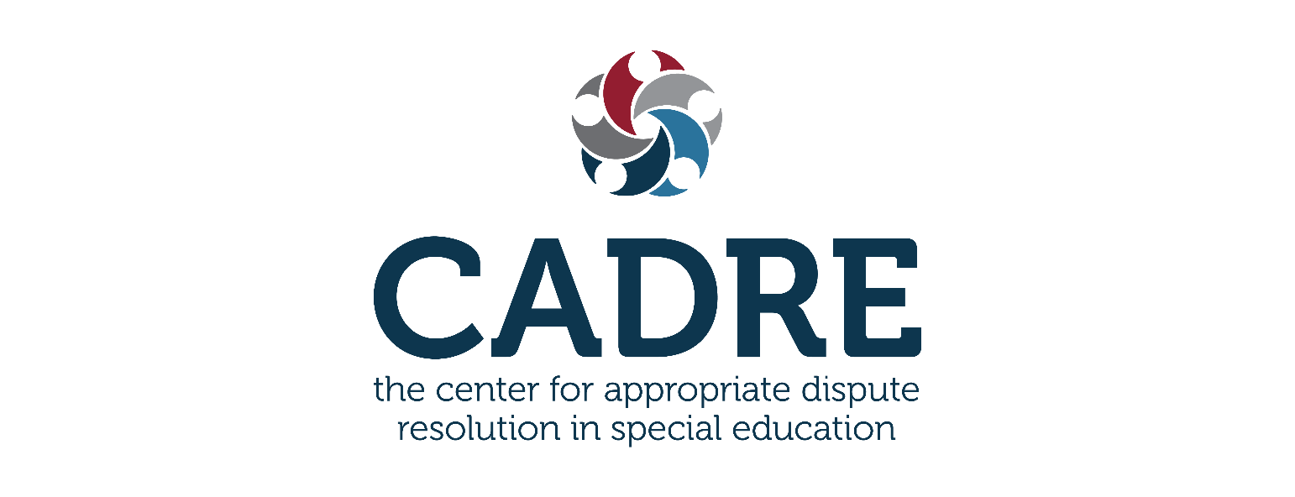
A Critical Look at the IDEA Due Process Hearing System and Suggested Improvements
David Bateman, Ph.D.
Mitchell Yell, Ph.D.
January 25, 2024

Slide 2
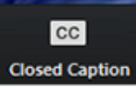

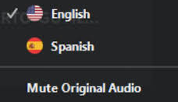
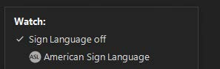
Accessibility
Using Closed Captioning
To start using CC, click the caption button.
Uso de la interpretación de idiomas
Hagan clic en el icono de interpretación.
Seleccionen “Spanish”.
Después de seleccionar “español”, hagan clic "Mute Original Audio“.
Using ASL
On the toolbar, click the interpretation icon.
Under “Watch,” choose the available channel to view.
A floating video window will appear of the interpreter that you can resize or move as needed.
Notes:
Van a ver en la banda o cinta negra un globo que indica "interpretation". Hagan click alli. Luego seleccionan español, y opriman donde dice "mute original audio". Esto último filtra completamente la presentación en inglés para que puedan escuchar con claridad a XXXXXX
Using ASL- On the toolbar, click the interpretation icon. Under “Watch,” choose the available channel to view. A floating video window will appear of the interpretor that you can resize or move as needed.

Slide 3
Technical Notes
All lines are muted.
Please post questions in the question box and we will share them throughout the webinar.
Thank you in advance for taking the time to respond to the brief survey at the end of this webinar.
This webinar will be posted and archived on CADRE’s website.

Slide 4
CADRE’s Disclaimer
The information shared in this webinar is not intended to serve as, nor should it replace, legal advice. Opinions expressed by today’s presenters are not represented to be an official or unofficial interpretation of legal guidance from the U.S. Department of Education or CADRE. Application of information presented may be affected by your State’s statutes, regulations, local policies and practices.

Slide 5
Special Education Due Process: Problems and Suggestions for Change
CADRE Proudly Presents:
David Bateman, PhD, and Mitchell Yell, PhD
January, 2024
5

Slide 6
Presenters’ Disclaimer:
The views expressed herein are those of the presenters; they do not necessarily reflect the views of their employers.
6

Slide 7
David Bateman, PhD
About the Presenters
Former teacher
Former building level administrator
Former professor
Former First Tier Due Process Hearing Officer
Current:
Principal Researcher, American Institutes for Research
Second Tier Hearing Officer
Author
7

Slide 8
Lead IDEA Center
Goal: Create a Leadership Learning System (LLS) that provides continuous learning from initial education to professional development. This system will improve the abilities and support structures at various levels, including state, regional, district, and individual program levels. The goal is to better prepare, support, and keep administrative staff in schools and early intervention services, focusing on improving the educational experiences and success of students with disabilities (SWDs) and their families.
Establish and maintain state-level partnerships to ensure leaders have competencies to implement IDEA.
Identify IDEA-related professional competencies.
Develop and disseminate resources.
Deliver high-quality professional learning.
Cultivate inclusive leadership practices.
Evaluate effectiveness.
Foster Community Engagement and Collaboration.
Enhance the capacity of state-level partners to use Center products to deliver high-quality professional development.
For More Information:
David Bateman Lynn Holdheide
dbateman@air.org lholdheide@air.org
8

Slide 9
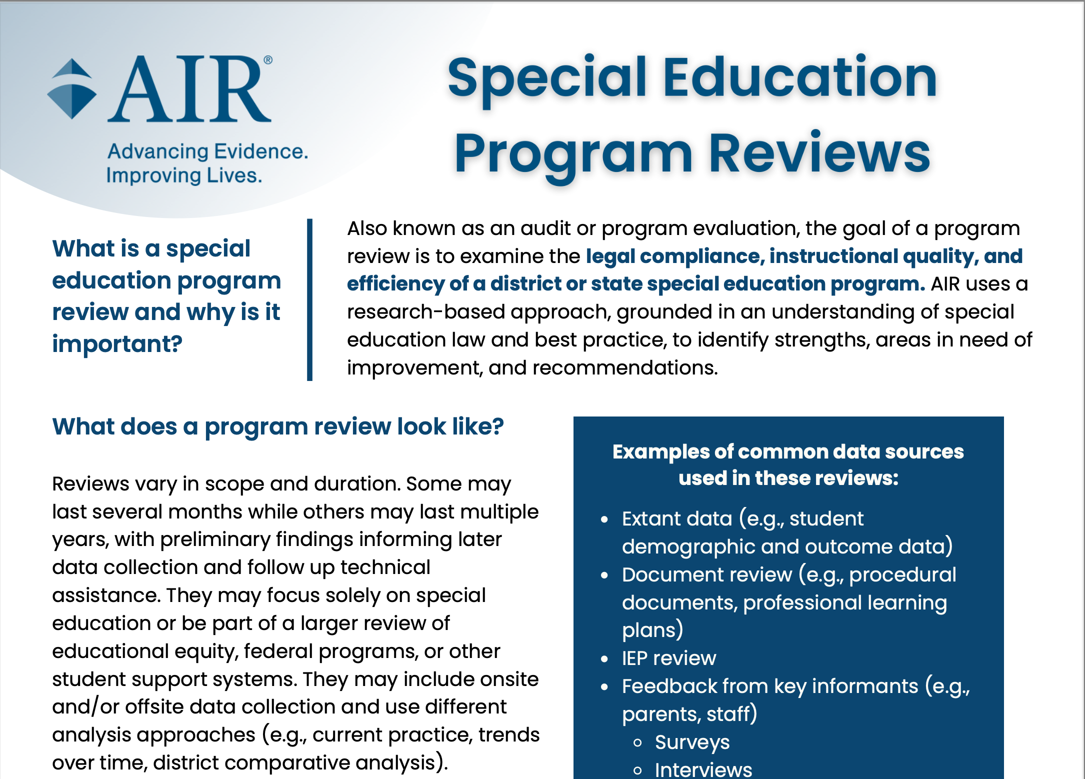
AIR
AIR Special Education Program Reviews
9

Slide 10
About the Presenters
Mitchell L. Yell, PhD
Former:
Special education teacher
Special education administrator
IEP Facilitator
Expert witness for hearings and cases brought by school districts and parents
Current:
Fred and Francis Palmetto Chair of Teacher Education
& professor of special education at the University of South Carolina
State Review Officer for SC (Two-tier system)
Special education expert in two discrimination cases under the ADA
10

Slide 11
Two Parts to this Presentation
1. Problems with the DPH System
2. Suggestions for Improvement
11

Slide 12
First:
We are not Anti-DPH
1. History
2. Need a system
3. Other mechanisms (Alternate dispute)
12

Slide 13
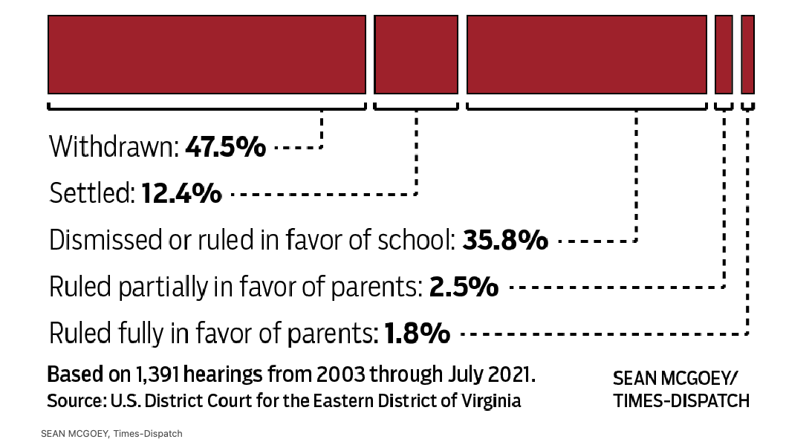
But, There are Problems
13

Slide 14
Cost of Legal Representation and Expert Witnesses
14

Slide 15

How does hiring a no win, no fee attorney work
15

Slide 16
Parental Reluctance to Initiate Disputes
16

Slide 17
Time Constraints for Parents
17

Slide 18
Complexity of Hearings
18

Slide 19
Excessive Length and Expense
19

Slide 20
Adversarial Nature
20

Slide 21
Emotional Impact
21

Slide 22
Educational Disparities
22

Slide 23
Barrier to Enforcement
23

Slide 24
Limited Accessibility
24

Slide 25
ALJ’s understanding of all the special education acronyms
25

Slide 26
Recommendations
26

Slide 27
Question:
Was the dispute resolution system of IDEA ever intended to be so adversarial and legalistic?
Answer: Probably not!
27

Slide 28
Joe Ballard and the most unintended outcome of the law, 2003
We had intended that “disagreements (on the IEP process) would be resolved in a reasonable manner by persons who had the background to make informed educational judgements. Due process was not intended to be confrontational as it is all too often now, nor so highly legalized, nor populated by lawyers throughout administrative due process. Hearings were not intended to evolve into Administrative law courts. In fact, at the time of enactment, judges were encouraging us to get these cases out of courts and into nonjudicial resolution settings. And the original procedural safeguard mechanisms were designed to do that” (Hulett, 2008).
28
Notes:
In early 70’s Fred Weintraub, Alan Abeson, Joe Ballard – CEC, Lisa Walker, Martin LaVor, & Jack Duncan Hill staffers worked to together on the EAHCA-To protect students with disabilities from arbitrary and ill conceived school district decision-making, parents were given a number of procedural rights to exercise in behalf of their children. Only when these procedural rights were not successful, did the DPH come into play. According to Ballard (2003), original authors never intended due process hearing to become so legalistic and adversarial

Slide 29
Question:
Is the dispute resolution system of IDEA cumbersome, inefficient, and too procedural?
Answer: Probably so!
29
Notes:
Also, it is expensive. Although many districts insure against the costs of attorneys fees, hearing costs, and financial awards much of the costs are paid out of general funds and special education budgets, which in essence robs Peter to pay Paul

Slide 30
Problems Identified by Advocates
The due process system is too legalistic.
    Make assistance available to pro se parents (e.g., insufficiency).
The due process system is too adversarial.
The due process system is not a level playing field
    e.g., Expert fees are not recoverable by parents.
Too short a period between resolution meeting and hearing/decision.
    Lack of preparation time
Hearing officers often not trained in the substantive requirements of the IDEA.
30

Slide 31
Problems Identified by LEA Officials
The due process system is too legalistic.
    Time/resource required takes away from time to teach
    Do away with the two-tier system
The due process system is too adversarial.
    Harms or severs any opportunity of a working school/parent relationship
    Very stressful for teachers and administrators
Problem of too many complaints (harassment) by certain parties.
    Contributes to teachers leaving the profession
Hearing officers should be trained in the substantive requirements of the IDEA
31

Slide 32
A Suggestion Common to Advocates and LEA Personnel
States should have a certification or licensing requirement for Special Education Advocates.
32
Notes:
May not be related to the webinar today

Slide 33
Question:
How can we fix the dispute resolution system?
Answer:
Consider these possibilities
33

Slide 34
Three Models for Change
American Association of School Administrators
Perry Zirkel
Angie Balsley
34

Slide 35
Rethinking Special Education Due Process
American Association of School Administrators
Problem: The current due process system causes school districts to expend considerable resources and impedes a districts ability to provide enhanced academic experiences to students with disabilities
Problem: Lack of evidence that students whose parents invoke due process hearings fare better academically after a hearing
Problem: The cost and complexity of hearings hinder low- and middle-income parents in challenging a school district’s special education services
Problem: Both parents and school district officials express dissatisfaction with the due process system despite parents request the majority of hearings and usually school districts prevail
Problem: Both parents and school district personnel are profoundly affected by DPHs
35
Notes:
Survey of 200 randomly selected school superintendents from large, small, rural, urban, & suburban school districts-Describe the challenges faced by districts in the due process system
Problem parents and school district personnel are profoundly affected by DPHs-95% of superintendents reported the stree levels of DPHs as high or very high

Slide 36
Recommendations for Improving
Dispute Resolution
Add IEP facilitation to the list of options available to school districts.
  Authorize districts to contract with state-approved, trained IEP facilitators.
If a formal due process hearing is requested, mediation is offered.
  Trained mediator, parent & district representatives, no attorneys or advocates.
If mediation fails, the district and parents would jointly select an independent, neural special education consultant designated by the state to review the situation in dispute and advise the parties on how to develop a suitable compromise IEP.
  Expert has 21 days to assess, observe, and write a report. Obligation of both parties to adhere to the agreement for a set period of time.
• If either party is dissatisfied a lawsuit could be filed in state or federal court.
36

Slide 37
AASA Model*
Due Process Complaint
Optional Mediation
Resolution Session
Due Process Hearing
IDEA Model
Litigation
AASA Model
Facilitated IEP
Optional Mediation
Consultant IEP Process
Litigation
* https://www.aasa.org/docs/default-source/resources/reports/aasarethinkingspecialeddueprocess.pdf
37

Slide 38
Over-Due Process Revisions for the IDEA
Perry Zirkel
Problem: The process has become unduly time-consuming and open-ended.
Problem: The process has become overly adversarial.
Problem: The costs are excessive, particularly in light of tight education budgets.
Problem: The majority cases that reach the courts are about disputes regarding attorneys’ fees or fact-based determinations about a specific student’s IEP.
Problem: Parents tend to view the process as unfair.
38
Notes:
Adversarial-formal judicial proceedings, controlled by lawyers and hired experts
Disputes-Apply rather than refine concepts of FAPE and do not serve as generalizable precedents

Slide 39
Recommendations for Improving Dispute Resolution 2
The due process hearing should be the final stage in most cases, with the decision binding on both parties. With only a few cases that present a legal issue being reviewable in courts.
  The model would be like binding arbitration in labor law.
  Single tier at state level.
Regulations should specify that the hearing officer has expertise in special education
  Matters such as legal updates, decision writing, conduct of a hearing would be addressed through training.
The conduct of the training would be conducted in accordance with a problem-solving, rather than an adversarial model
• Attorneys’ fees would be limited to the judicial stage.
Hearings should be limited to one day.
  45-day rule would be strictly enforced.
39

Slide 40
Perry Zirkel’s Model*
Due Process Complaint
Optional Mediation
Resolution Session
Due Process Hearing
IDEA Model
Litigation
Due Process Hearing-Usually final stage
Litigation-Limited to very few appeals
Due Process Complaint
Optional Mediation
Resolution Session
Zirkel’s Model
* https://scholarworks.umt.edu/cgi/viewcontent.cgi?article=1633&context=mlr
40

Slide 41
Special Education Directors’ Perceptions
Angie Balsley
Problem: Many requests for due process hearings came unexpectedly.
Problem: Many attorneys discouraged the use of mediation.
Problem: Most hearing requests are settled, indicating use of alternative dispute resolution can be successful.
Problem: Hearings are very resource intensive, extremely time-consuming, and expensive.
Problem: Huge emotional drain on principals, teachers, and staff.
Problem: Harms the relationship between school personnel and parents.
Problems: Presence of attorneys escalates conflict, strain relationships, increase litigation costs, and inhibits collaboration.
41

Slide 42
Recommendations for Improving Dispute Resolution 3
Use trained IEP facilitators to enhance communications
Ensure that mediators are well trained in special education
Limit the involvement of attorneys
Alternative dispute resolution systems should not be voluntary
Principals, teachers, staff, and parents should receive training on handling dispute within the LEA’s system.
Special education directors should receive training on special education law, negotiation skills, and organizational leadership.
Require a tiered system of alternative dispute resolution before a hearing request may be filed.
42

Slide 43
Angie Balsley’s Model*
Due Process Complaint
Resolution Session
Due Process Hearing
IDEA Model
Optional Mediation
Litigation
Angie Balsley’s Model
Due Process Hearing
File a Hearing Request
Resolution Session
State Complaint
Required Mediation
* https://scholarworks.iu.edu/dspace/handle/2022/22221
43

Slide 44
For Consideration:
There should and must be a wide variety of dispute resolution procedures available for both parents and school districts to use…binding arbitration available upon election by both of the parties. I suspect many parents and schools would be willing to waive their rights of appeal from such decisions if they were fair, impartial, and fast.
Testimony of James Rosenfeld to the President’s Commission on Excellence in Special Education, 2002
44

Slide 45
Recommendations 2
Require IEP facilitation. No attorneys present.
Make mediation mandatory. No attorneys present.
If mediation is not successful, resolution meeting is required. No attorneys present.
Require good faith efforts during mediation and resolution sessions. If not completed in good faith that factor will be considered by the special education arbitrator in step 5.
State appoints an independent special education content expert to arbitrate.
Arbitration by a state-appointed Sped Content Expert
IDEA Dispute Resolution Model
Required IEP Facilitation
Required Resolution Session
Required Mediation
45

Slide 46
Recommendations 3
Streamlined Procedures
Increased Transparency
Enhanced Training for Hearing Officers
Improved Communication
Parental Support and Resources
Alternative Dispute Resolution
Timely Resolution
Consistent Application of Law
Feedback and Evaluation System
Technological Integration
46

Slide 47
Questions?
David Bateman dbateman@air.org
Mitchell Yell
Myell@sc.edu

Slide 48
About CADRE
Visit CADRE online
www.cadreworks.org
Contact CADRE via email
cadre@directionservice.org
Sign up for the CADRE Newsletter!

Slide 49

Thank you for joining us!
Please take a few minutes to respond to this brief survey about your experience:
Survey Monkey link:
https://www.surveymonkey.com/r/BatemanYellWebinar

