Slide 1
Expanding the Circle:
Restorative Practices in Special Education
Diana Cruz, Dispute Resolution Specialist
Candace Hawkins, Policy Analyst
Leila Peterson, SchoolTalk DC
March 7, 2017
2:30 pm – 3:45 pm ET (11:30-12:45 PT)
Note: The presentation is currently available on the CADRE website http://www.cadreworks.org/events/expanding-circle-restorative-practices-special-education
Technical Stuff:
Please enter any questions or technical difficulties into the questions box.
Thank you, in advance, for taking the time to respond to the brief survey at the end of the webinar!

Slide 2
What is Restorative Justice?
“Restorative justice promotes values and principles that use inclusive, collaborative approaches for being in community.”
Validates the experiences and needs of everyone
Focuses on relationship and community
Promotes healing over alienation
The Little Book of Restorative Discipline for Schools, Amstutz & Mullet (2005)

Slide 3
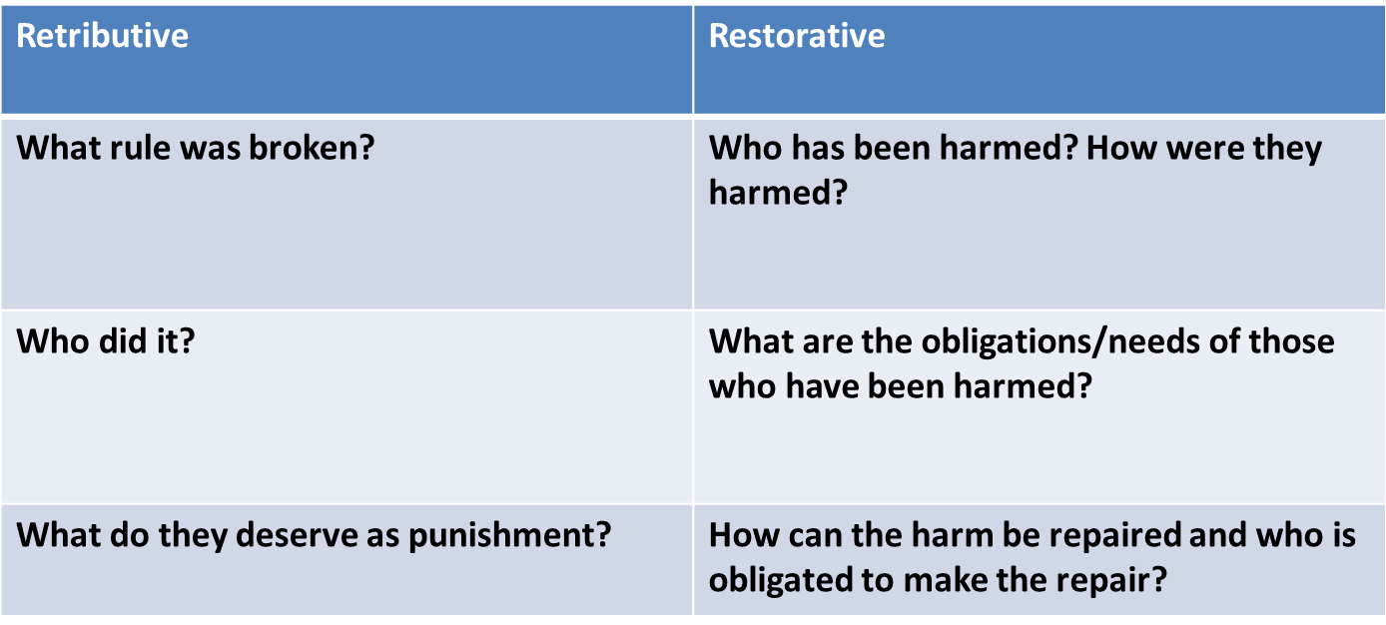
Two Paradigms for
Addressing Wrongs

Slide 4
Guiding Questions
Who has been hurt?
What are their needs?
Whose obligations are these?
What are the causes?
Who has a stake in the situation?
What is the appropriate process to involve stakeholders in an effort to address causes and put things right?
The Little Book of Restorative Justice, Zehr (2015)

Slide 5
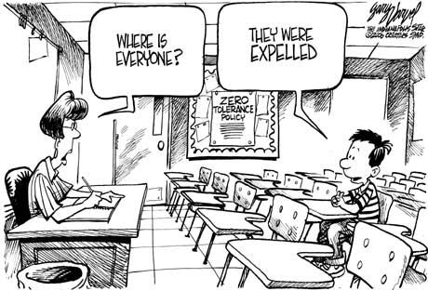
Why Use RJ in Schools?
Shift in current practices due to the long term impact of traditional approach to discipline

Slide 6
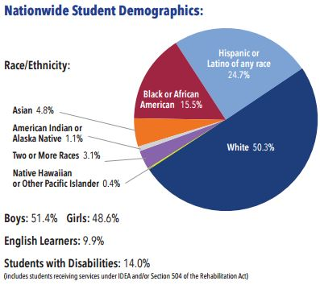
Nationwide Data
Student with disabilities make up 14% of the student population nationwide
2013-2014 CIVIL RIGHTS DATA COLLECTION
U.S. Department of Education Office for Civil Rights

Slide 7
The Effects of
Suspension and Expulsion
Young students who are expelled or suspended are as much as 10 times more likely to:
  drop out of high school
  experience grade retention
  hold negative school attitudes
  face incarceration
U.S. DEPARTMENT OF HEALTH AND HUMAN SERVICES
U.S. DEPARTMENT OF EDUCATION
POLICY STATEMENT ON EXPULSION AND SUSPENSION
POLICIES IN EARLY CHILDHOOD SETTINGS

Slide 8

What the Numbers Say
Students with disabilities served by IDEA are more than twice as likely to receive one or more out-of-school suspensions as students without disabilities (12% v 5%).
2013-2014 CIVIL RIGHTS DATA COLLECTION
U.S. Department of Education Office for Civil Rights

Slide 9

What the Numbers Say
More than one out of five male students of color* with disabilities served by IDEA received one or more out-of-school suspensions, compared to one out of ten white male students with disabilities served by IDEA
*American Indian or Alaska Native (23%),
Native Hawaiian or other Pacific Islander (23%),
black (25%), and multiracial (27%)
2013-2014 CIVIL RIGHTS DATA COLLECTION
U.S. Department of Education Office for Civil Rights

Slide 10
What the Numbers Say
Black students are 1.9 times as likely to be expelled from school without educational services as white students
Black students are 2.2 times as likely to receive a referral to law enforcement or be subject to a school-related arrest as white students

Slide 11
Identification in Special Education
2011-12 SY: National Center for Education Statistics
Black students
19% of IDEA eligible students
27% of students w/ED
28% of students w/ID
14% of students w/Autism
White students
54% of IDEA eligible students
54% of students w/ED
47% of students w/ID
60% of students w/Autism
Notes:
Could make the point that boys of color are more likely to be identified as Emotional Disturbance or Intellectual Disability rather on the autism spectrum or learning disability.

Slide 12

Behavior is Communication
Disruptive or problematic behavior by a student might be caused by:
A manifestation of the disability
Result of frustration, anger, anxiety, depression as a result of not having educational needs met
Or a combination of both

Slide 13
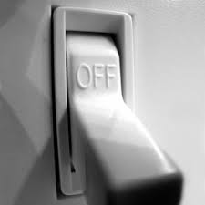
Flipping the Switch
Too often problematic behavior flips the switch to a focus on controlling or punishing behavior
Addressing educational needs becomes secondary

Slide 14
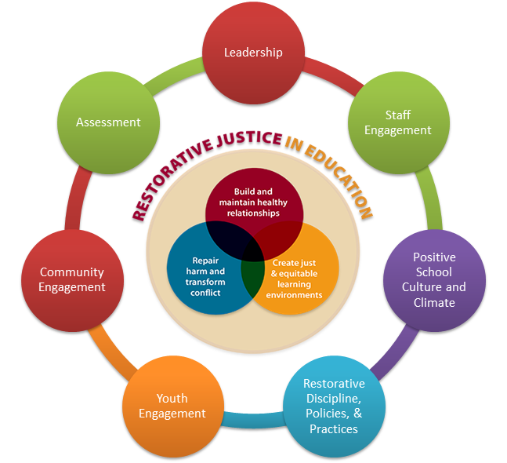
Restorative DC is working with 11 schools to implement a
Whole School Restorative Model
Adapted from Evans, K.R. and Lester, J.N. (2013). Restorative Justice in Education: what we know so far. Middle School Journal. 44(5), 57-63.

Slide 15
Why restorative practices for sped processes?
Team members (especially parents) have lots of feelings around the special education experience
Helps team move from letter-of-the-law to spirit-of-the-law
Good practice is good practice

Slide 16
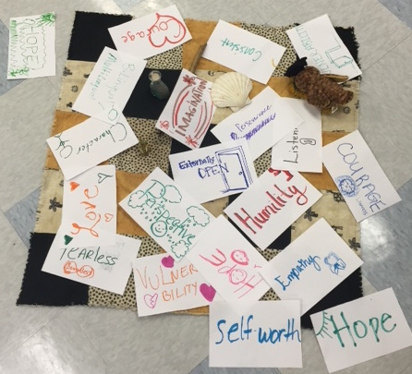
Applying the circle process to IEP meetings

Slide 17
Meeting Set up
Circular Seating: equality and connectedness & improves focus and visibility
Plan for documentation, while still keeping the integrity of the circle and the focus on the centerpiece. (Ex: laptop vs. flip chart, or both)
Centerpiece: Include items representing the values of the core self, the foundational principles, a shared vision.
Focus the meeting on the student and values of inclusion and education. ALL can contribute items. (Ex. student work, photos, personal items)
Talking piece: Support the sanctity of the space, full expression of emotions, thoughtful reflection, and equal voice.
Involve students and families in creating or choosing what will be used

Slide 18
Keeping the Circle
Facilitator/Keeper: Creates and maintains a space for speaking honestly and openly. Does not control issues or outcomes.
Do not have the person responsible for this student’s IEP be the facilitator.
Values/Guidelines: voluntariness, confidentiality, safety, openness
Can be established before or during circle

Slide 19
Key Elements of the flow (agenda)
Opening Ceremony – marks the circle as a special space
Explain the process/Set guidelines – involve participants
Guiding Questions – per student/family-centered IEP process
Get acquainted
Storytelling
Explore issues and concerns
Clarify future
Agreements – made by consensus, can everyone live with it?
Closing Ceremony – acknowledge, affirm connections, convey hope

Slide 20
Tips for Restorative
Approaches in IEP Meetings
Choose an IEP meeting that you don’t expect to be too complicated or contentious
Provide all participants with advance notice
Keep in mind that you may have to spend extra time with students, families, and school staff to prepare them
Consider student-led approach for guidance in how to prepare and involve the student
Allow adequate time for the meeting
NOTE: We assume the involvement of an experienced RJ practitioner

Slide 21
Conflict Prevention and Intervention
Conference
Restorative Chats/
Dialogue
Family Engagement

Slide 22

Restorative Process for
Active/Post Dispute
Address feelings of hurt, betrayal, anger, hostility
Promote empathy and understanding
Strengthen relationship
Rebuild trust
Promote cooperation
Find a way forward
Restore focus on the student

Slide 23
Restorative Questions
What happened?
What has it been like for you?
What did you want to happen?
What has been the worst part?
What is needed to make you feel better?
What can I do to help?
What can we do to make sure this doesn’t happen again?
Restorative Practices and Special Needs, Burnett & Thorsborne (2015)

Slide 24


Questions/Comments
Contact:
Diana Cruz: dcruz@directionservice.org
Candace Hawkins: chawkins@directionservice.org
Leila Peterson: leila.peterson@schooltalkdc.org

Slide 25

Thank you for joining us!
Please take a few minutes to respond to this brief survey about your experience:
Webinar Survey https://www.surveymonkey.com/r/expandingcircle

Slide 26

Upcoming Webinar
Written State Complaints:
Issues, Outcomes, and Remedies from A Road Less Traveled
June 6, 2017 11:30-12:45 PST
Presenter:
Perry Zirkel, University Professor Emeritus of Education and Law,
Lehigh University
Registration Open Soon – Check the CADRE Website!

Slide 27
Restorative Practices
Strengthening Family Engagement
Parent involvement at home and at school has a measurable impact on student performance in school, and is particularly important for English learners and students from low-income families.
Improved communication between teachers and parents increases student engagement as measured by homework completion rates, on-task behavior and class participation.
At-risk behaviors such as alcohol use, violence and other anti-social behaviors decrease as parent involvement increases.
(Thigpen & Freedburg, 2014)

Slide 28
Restorative Questioning to Engage Families
What do you expect from the school?
What do you think of the school?
What are the barriers to your involvement?
What do you expect from parents?
Restorative Practices and Special Needs, Burnett & Thorsborne (2015)

Slide 29

Restorative Chats/Questions to Address Parent Concerns
Show respect
Develop empathy and understanding
Clarify concerns and expectations
Define responsibility
Strengthen relationship
Build trust
Prevent further conflict

