Slide 1

Dispute Resolution in Special Education and
The Bigger Picture

Slide 2
Disclaimer
This resource is not intended to interpret, modify, replace requirements of federal or State law, or serve as a definitive treatment of the regulations. Application of information presented may be affected by State statutes, regulations, departmental and local policies, and any new guidance not issued at the time of this publication.

Slide 3
Special Education History.
Prior to 1975, districts unilaterally decided ‘who’ received public education.
After the enactment of the Education of all Handicapped Children Act in 1975, districts were mandated to provide education to all children with disabilities.
The 1980’s increased focus on inclusion in general education.
The 1990’s focused on accountability for achievement and outcomes.
Notes:
Prior to 1975, public education did require serving all students, allowing districts to determine who could participate. The result was that many students with disabilities were not provided a public education.
Due to concerted and diligent efforts at education reform, Congress passed the Education of all Handicapped Children Act in 1975. With this law, all students were to be provided education services. However, many students with disabilities were separated from their peers in contained classrooms or in separate institutions.
As time went on, disability advocates successfully made the case that students with disabilities should be educated in the least restrictive environment, and, if possible, with their non-disabled peers. Ultimately, this led to the creation of the Individuals with Disabilities Act in 1997.

Slide 4
Special Education History Continued…
In 1982, the Supreme Court articulated the Rowley Standard.
In 1990, the Individuals with Disabilities Act (I D E A) was signed into law.
In 2004, the I D E A was reauthorized with a renewed focus on general education and accountability.
In 2017, the Supreme Court ruled on the Endrew F. v. Douglas County School District case and determined that IEP’s must give students with disabilities more than a de minimiss, or minimal, educational benefit.
Notes:
The Rowley case required that IEPs must be “reasonably calculated to result in educational benefit” and that states must provide a “basic floor of opportunity to disabled students, not a potential-maximizing education.”
The GW Bush Administration signed the IDEA into law in 1990, and it was reauthorized in 2004. The law addresses how to provide a free, appropriate, public education (FAPE); the process of IEPs; Least Restrictive Environment (LRE); Evaluation, Identification, Parent and Educator Participation and Procedural Safeguards.
In 2017, the Endrew F. case reinterpreted the basic floor of special education expressed in the Rowley decision (1982) and established that IEPs must go beyond providing minimal educational benefit.

Slide 5
Individuals with Disabilities Education Act (I D E A)
Purpose:
  … to ensure that all children with disabilities have available to them a free appropriate public education (FAP E) that emphasizes special education and related services designed to meet their unique needs and prepare them for further education, employment and independent living… [and] to ensure that the rights of children with disabilities and parents of such children are protected.

Slide 6
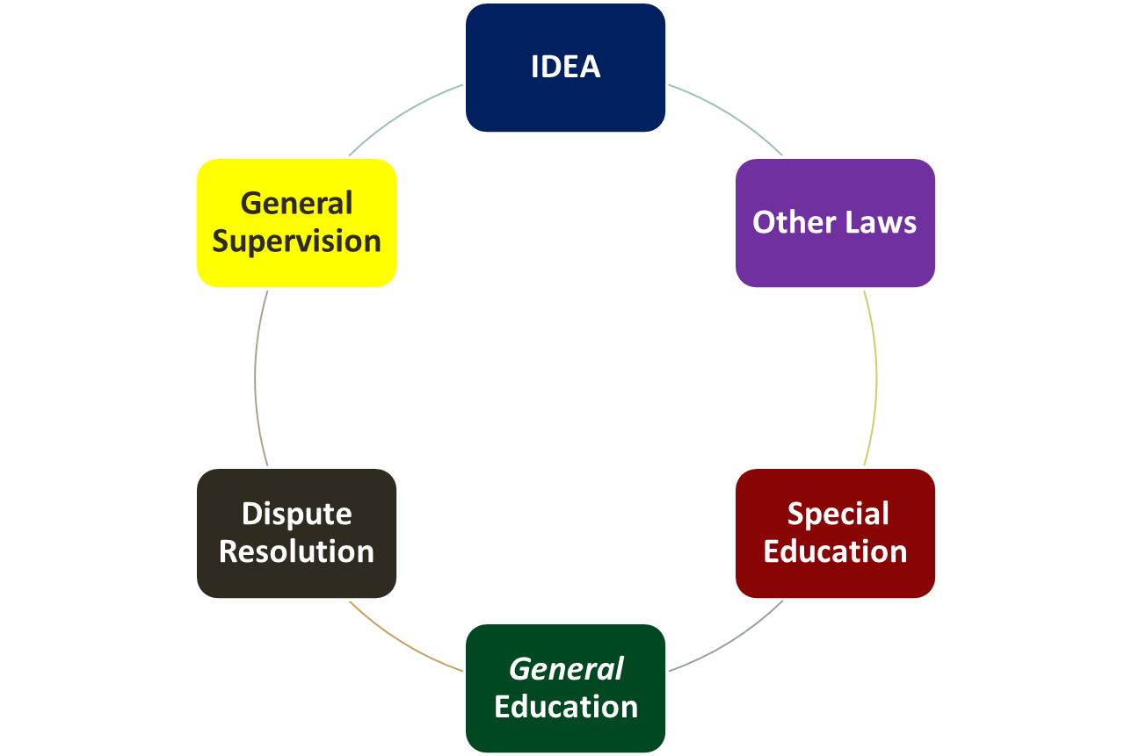
Know the Basics
Notes:
IDEA: This is the federal law applicable to all who receive federal funds for education.
IDEA’s relationship to other federal and state laws: The IDEA holds primacy over laws in states.
The IDEA (Part B) addresses students who are or may be eligible for special education in public agencies.
Under the IDEA, procedural safeguards for parents and students are outlined, including options for addressing disputes arising from identification, eligibility, educational placement, or provision of a free, appropriate, public education for students with disabilities.
The IDEA also addresses the supervisory responsibilities that State agencies have for General Supervision & Monitoring of local education agencies.

Slide 7
Federal and State Laws.
A D A
Broadly protects all people with disabilities from discrimination at school, work, and other environments.
(Provides the lowest level of protection but covers the most people)
Section 504
Students with disabilities, not receiving special education services under I D E A, have the right to reasonable accommodations.
504 plan
Protections for people with disabilities.
IEP
I D E A
Mandates a free appropriate public education to children with disabilities that emphasizes special education and related services designed to meet their unique needs.
(Greater protections than A D A & 504)
State Laws
State laws can interpret federal laws. They should not provide less than the federal law requires but may provide more protections.
(May provide greatest protection)
Notes:
ADA, Section 504, and IDEA are federal laws that tell states what they must do to protect students with disabilities. ADA is broad and protects all people with disabilities from discrimination at school, work, and other environments.
Under 504, students with disabilities (who are not receiving special education services through IDEA) have the right to reasonable accommodations and a 504 plan is developed for these students.
IDEA provides greater protections than ADA and Section 504. Individualized Education Programs (IEPs) are developed for students eligible for special education and related services under IDEA.
State laws can interpret federal laws. They should not provide less than the federal law requires, but they may offer more protections.

Slide 8
Special Education Eligibility.
Child find: States must ensure that children with disabilities in need of special education and related services are identified, located, and evaluated.
Assessments and other evaluation measures are completed.
Procedures for interpreting evaluation data must draw upon information from a variety of sources.
Group of qualified professionals and the parent of the child carefully consider information from all of these sources and eligibility requirements under §300.8 to make their determination.
If child is found eligible, an IEP must be developed in accordance with §300.320 through §300.324.
Notes:
State must have in effect policies and procedures to ensure that children with disabilities in need of special education and related services are identified, located, and evaluated.
Upon completion of the administration of assessments and other evaluation measures, a group of qualified professionals and the parent of the child determines whether the child has a disability and is eligible for special education and related services under IDEA.
Procedures for determining eligibility and educational need.
(1) In interpreting evaluation data for the purpose of determining if a child is a child with a disability under §300.8, and the educational needs of the child, each public agency must—
(i) Draw upon information from a variety of sources, including aptitude and achievement tests, parent input, and teacher recommendations, as well as information about the child’s physical condition, social or cultural background, and adaptive behavior; and
(ii) Ensure that information obtained from all of these sources is documented and carefully considered.
(2) If a determination is made that a child has a disability and needs special education and related services, an IEP must be developed for the child in accordance with §§300.320 through 300.324.
Prior to an evaluation and the initial provision of special education and related services, informed consent from the parent must be obtained.

Slide 9
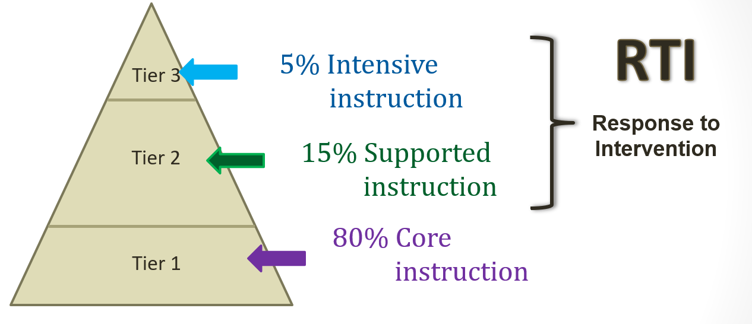
General Education Model:
Response to Intervention.
RTI cannot be used to delay or deny the evaluation of a child who is suspected of having a disability.
Notes:
General education models include a multi-tier system of supports, often referred to as response to intervention (RTI). RTI means a comprehensive continuum of evidence-based, systemic practices to support a rapid response to a child’s needs, with regular observation to facilitate data based instructional decision-making. The implementation of RTI strategies is often used to ensure that children who are struggling academically and behaviorally are identified early and provided needed interventions in a timely and effective manner. Children who do not respond to interventions and are potentially eligible for special education and related services must then be referred for evaluation.
The implementation of RTI, however, cannot be used to delay or deny the evaluation of a child who is suspected of having a disability.

Slide 10
Special and General Education.
Students must be provided access to the general education curriculum to the greatest extent possible.
Special education and related services should take place in the least restrictive environment (LRE) possible.
Other important federal education statutes that provide protections to all students:
  The Family Educational Rights and Privacy Act (FERPA).
  The McKinney-Vento Homeless Assistance Act of 1987 (if applicable).
Public agencies must also adhere to the Every Student Succeeds Act (ESSA).
Notes:
Underpinning the provisional mandates of IDEA, is the requirement that students are educated with their non-disabled peers and have access to the general education curriculum as much as is possible.
Also incorporated by reference, is the Family Educational Rights and Privacy Act of 1974 (FERPA) that requires schools to protect the confidentiality of student records. Additionally, the IDEA must be adhered to in conjunction with the McKinney-Vento Homeless Assistance Act, providing education and services to student with disabilities who are homeless.
The No Child Left Behind Act, which required states to meet certain educational standards and progress marks, was not reauthorized in 2007 – particularly important for schools who predominantly served poor and minority students. The NCLB was seen as a “one-size fit all” approach to education, and did not have support for reauthorization. The law was rewritten and was passed in 2015 as the Every Student Succeeds Act. The ESSA addresses student achievement standards and how to assess them.

Slide 11
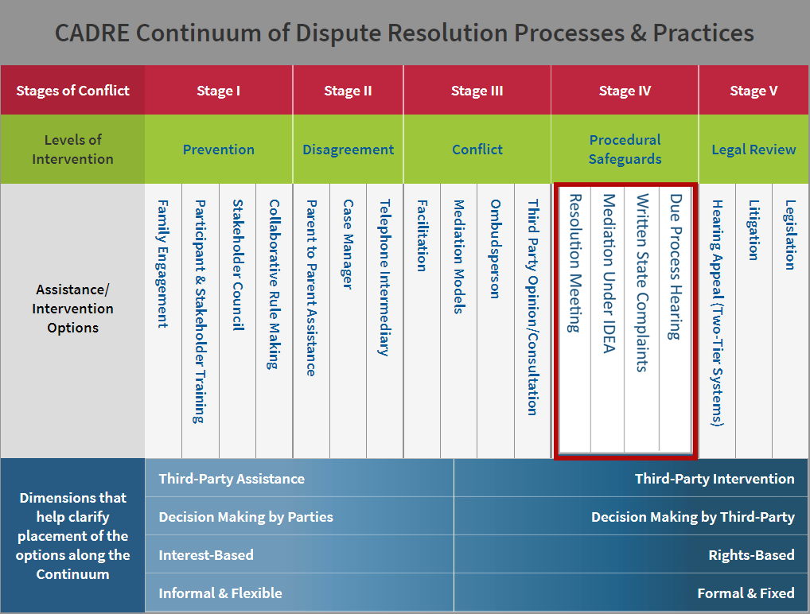
The CADRE Continuum: Procedural Safeguards.
https://www.cadreworks.org/cadre-continuum
Notes:
The Procedural Safeguards under the IDEA require these formal dispute resolution mechanisms be in place by States.

Slide 12

I D E A Mediation Defined.
Mediation is an impartial and voluntary process that brings together parties who have a dispute concerning any matter arising under 34 CFR part 300 to have confidential discussions with a qualified and impartial individual. Mediation provides the parties the opportunity to reach a
mutually agreeable resolution
to the dispute.
34 CFR § 300.506
Notes:
Mediation is an impartial and voluntary process that brings together parties who have a dispute concerning any matter arising under 34 CFR part 300 of the IDEA (Part B) regulations to have confidential discussions with a qualified and impartial individual. The goal of mediation is for the parties to resolve the dispute and execute a legally binding written agreement reflecting that resolution. Questions and Answers On IDEA Part B Dispute Resolution Procedures, Question A-1 (United States Department of Education, Office of Special Education and Rehabilitative Services (2013))
Mediation may not be used to deny or delay a parent’s right to a hearing on the parent’s due process complaint, or to deny any other rights afforded under Part B [34 CFR §300.506(b)(1)].
Mediation must be included in the procedural safeguard notice given to parents [34 CFR 300.504(c)(6)].

Slide 13

Issues Subject to Mediation.
Mediation can address any issue under the I D E A:
Identification,
Evaluation,
Educational Placement and,,
Provision of FAP ,E.
34 CFR § 300.506
Notes:
The mediation process offers an opportunity for parents and public agencies to resolve disputes about any matter under 34 CFR part 300, including matters arising prior to the filing of a due process complaint. This includes matters regarding the identification, evaluation, or educational placement of a child with a disability, or the provision of a free appropriate public education (FAPE) to a child with a disability, as well as any other matters arising under 34 CFR part 300 that may not be the subject of a due process complaint. Questions and Answers On IDEA Part B Dispute Resolution Procedures, Question A-6 (United States Department of Education, Office of Special Education and Rehabilitative Services (2013))

Slide 14
Written State Complaints.
States are required to resolve any complaint that meets the requirements of 34 CFR §300.153 of the I D E A, including a complaint alleging that a public agency failed to provide FAPE to a group of children with disabilities.
The S E A is in the best position to determine what information is necessary to resolve a complaint, based on the facts and circumstances of the individual case.
Notes:
States have been required to establish and implement their own State complaint procedures, separate from their due process procedures, since 1977. A State’s complaint procedures must specify whether complaints are to be filed with the State Education Agency, or with a different public agency.
The SEA is in the best position, and should have the flexibility, to determine what information is necessary to resolve a complaint, based on the facts and circumstances of the individual case. Therefore, if an SEA elects to use guidance from other sources, in its resolution of Part B State complaints, an SEA should ensure that such guidance is consistent with the IDEA and its implementing regulations, and applicable written policy guidance from OSEP interpreting these IDEA requirements.

Slide 15

Due Process Complaints.
States are required to oversee and monitor a due process system to resolve I D E A related complaints. Parents or a public agency can file a due process complaint to request a hearing on any matter relating to the identification, evaluation, or educational placement of a child with a disability or the provision of FAPE to the child.
Notes:
In order to request a due process hearing under the IDEA, a party (a parent or a public agency) or the attorney representing the party, first must file a due process complaint consistent with 34 CFR §§300.507 and 300.508. OSEP Memo 13-08: Question and Answers on IDEA Part B Dispute Resolution Procedures, 2013, C1.
A parent or a public agency may file a due process complaint to request a due process hearing on any matter relating to the identification, evaluation, or educational placement of a child with a disability or the provision of FAPE to the child. 34 CFR §300.507(a).
Some matters necessitate an expedited hearing. Information on expedited hearings can be found in the State Administration of IDEA Expedited Due Process Hearings slide deck. OSEP Q&A, 2013, C-2
When a student with a disability becomes a legal adult under state law all IDEA rights, including the right to request a due process hearing transfer to the legal adult (exceptions may apply).

Slide 16
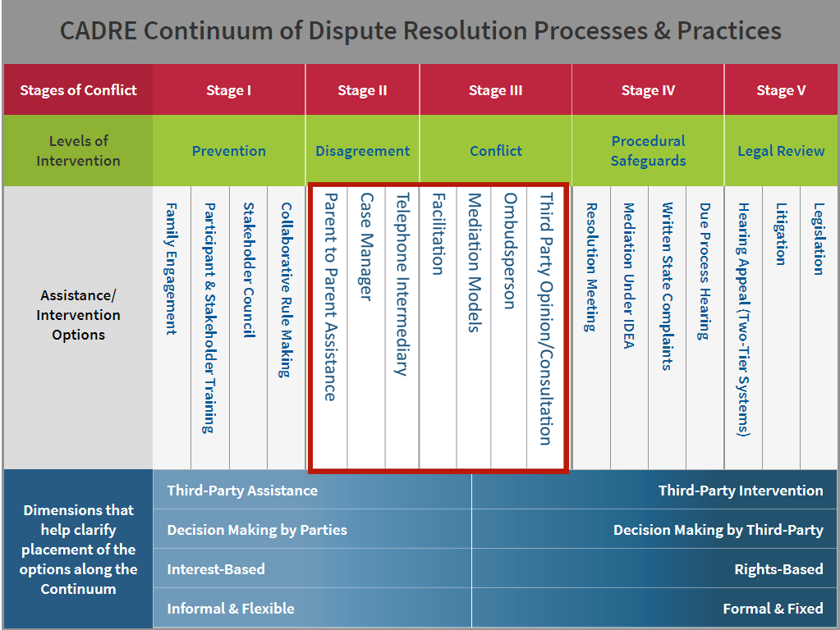
The CADRE Continuum: Disagreement & Conflict.
https://www.cadreworks.org/cadre-continuum
Notes:
As noted earlier, the Procedural Safeguards under the IDEA require mediation, written state complaints and due process mechanisms to be in place by States. However, there are additional options for addressing disagreements that arise in special education. The goal of these additional options are to prevent escalation and resolve disputes at the lowest level appropriate.

Slide 17
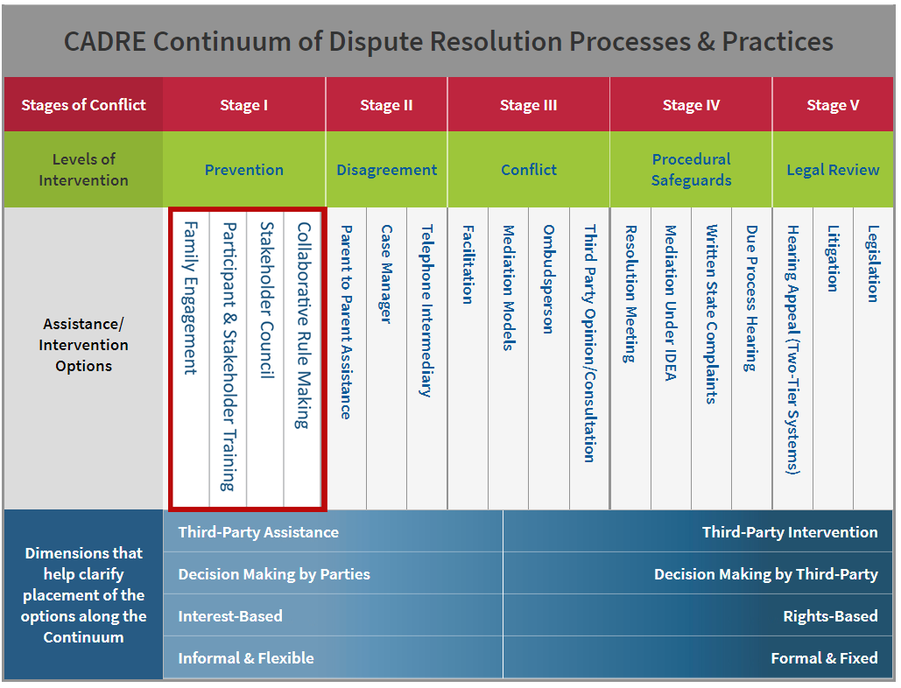
The CADRE Continuum: Prevention.
https://www.cadreworks.org/cadre-continuum
Notes:
Additionally, there are a number of strategies that can help families, educators, and other stakeholders establish and maintain positive relationships, engage in collaborative problem solving, and partner with others to support students with disabilities. Strategies include:
family engagement activities and practices, stakeholder trainings, stakeholder councils, and collaborative rule making.

Slide 18
Alternative Dispute Resolution.
Most states offer additional options to support family and educator collaboration and address special education issues. Examples include:
IEP Facilitation.
IDEA Meeting Facilitation.
Intermediaries or Case Managers.
Ombuds or Third-party Consultations.
And more!
Notes:
ADR can serve as prevention strategies and/or early resolution opportunities instead of more formal options under IDEA (e.g., state complaints and due process complaints).

Slide 19
Additional State Responsibilities
In addition to maintaining an I D E A dispute resolution system, States are required to:
Collect and Report Data through their State Performance Plans and Annual Progress Reports (SPP/APR)
Provide General Supervision and Monitoring of Local Education Agencies

Slide 20
Data Reports.
The State Education Agency must report to the federal Office of Special Education Programs their annual dispute resolution data.
Data is collected to inform performance on federally required indicators, with two indicators specifically addressing I D E A dispute resolution systems.
Notes:
Dispute resolution indicators include: B15 (percent of hearing requests resolved through resolution session settlement agreements), and B16, (percent of mediations held that resulted in mediation agreements).
Although not required, states are encouraged to collect additional data to better understand how their dispute resolution system is functioning.

Slide 21
General Supervision & Monitoring.
States must have monitoring policies and procedures in place to ensure public agencies are meeting the requirements of Part B, including those related to dispute resolution.
§300.149
Notes:
§300.149
States have a responsibility to ensure that the IDEA is followed. This includes fiscal, implementation of policies and procedures, and activities that fall under DR, such as overseeing completion of corrective actions with regards to written state complaints. States are encouraged to establish effective communication mechanisms between General Supervision & Monitoring and Dispute Resolution units.

