Slide 1
Alternative Dispute Resolution
Beyond the I D E A:

Slide 2
Disclaimer.
This resource is not intended to interpret, modify, replace requirements of federal or State law, or serve as a definitive treatment of the regulations. Application of information presented may be affected by State statutes, regulations, departmental and local policies, and any new guidance not issued at the time of this publication.

Slide 3
Dispute Resolution under I D E A.
The I D E A requires states education agencies and lead agencies to provide the following options for resolving special education disputes:
Mediation.
State Administrative Complaints.
Due Process Complaints.
Notes:
Mediation: State agencies must offer a third-party mediator as an option for the resolution of special education disputes. Mediation is voluntary, and if parties agree, the resolution is memorialized in a binding agreement [34 CFR 300.506 (a-b)].
State Complaints: Any individual or agency may file a complaint with the state education agency alleging a district did not follow the IDEA. The state agency investigates, and if the district is found out of compliance, issues remedies [34 CFR 300.151 through 300.153].
Due Process: A parent or a public agency may file a due process complaint on any matter relating to the identification, evaluation, educational placement, or provision of FAPE to a child with a disability [34 CFR 300.507 (a)(1)]. When a parent files a due process complaint, a resolution session, encourages parties to discuss the issues that gave rise to the complaint and provides the opportunity for the district to resolve the issues in the dispute [34 CFR 300.510(a)(2)].

Slide 4
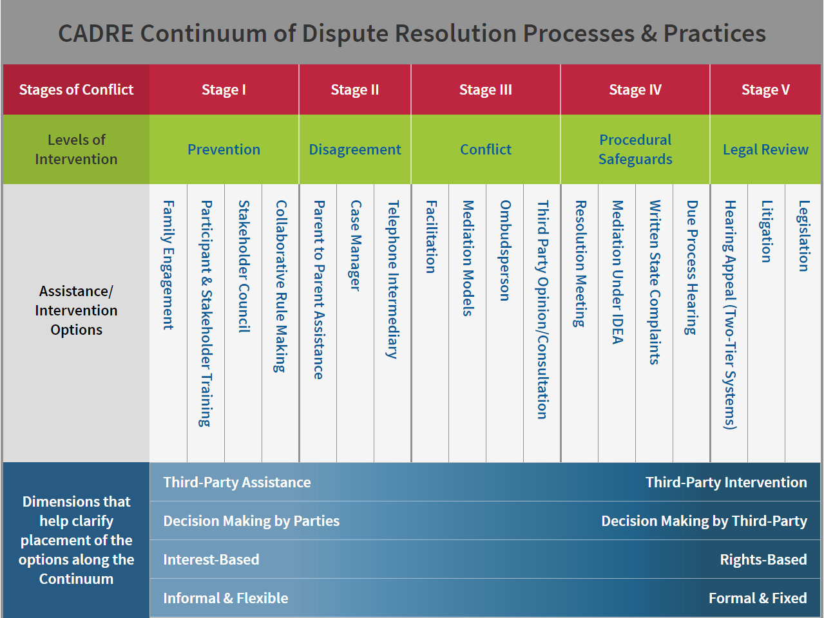
CADRE DR Continuum.
Notes:
The CADRE Continuum identifies dispute resolution options available for addressing disputes related to the provision of services for infants, toddlers, and students with disabilities. The options available differ in terms of the level of third party assistance or intervention, the locus of control over the decisions by the parties, the focus on the interests of the parties or a primary focus on rights, and how formal or informal the process is.
Early dispute resolution processes, also known as alternative dispute resolution, focus on managing conflict collaboratively, as shown in stages 2 and 3. In stages 4 and 5, the interventions are formally managed, with decision making happening at the state or hearing level (except for resolution meetings and mediations).

Slide 5
Alternative Dispute Resolution.
Most states offer additional options to support family and educator collaboration and address special education issues. Examples include:
IEP Facilitation.
I D E A Meeting Facilitation.
Intermediaries or Case Managers.
Ombuds or Third-party Consultations.
And more!
Notes:
Alternative dispute resolution can serve as prevention strategies and/or early resolution opportunities instead of more formal options under IDEA (e.g., state complaints and due process complaints).

Slide 6
IEP Facilitation.
If IEP Team members have difficulty communicating and collaboratively solving problems with each other, the development of a mutually agreeable and high-quality IEP is less likely.
It may be helpful to bring in a neutral third party to facilitate the next IEP meeting.
Notes:
A facilitated IEP has the same objective as any IEP meeting, developing an IEP for the student. During a facilitated IEP meeting, a facilitator focuses on the process and assists the IEP Team with articulating the roles of each member and ensures the voices of all participants are included.
A skilled and capable facilitator encourages collaboration and helps keep members of an IEP Team focused on the development of the IEP while addressing conflicts and disagreements that may emerge during the meeting. This is often accomplished by ensuring that everyone at the meeting can participate fully. The facilitator guides the discussion by asking open-ended, student-focused questions, ensuring members have a shared understanding of the options being discussed. If disagreements arise during the meeting, the facilitator can help by asking questions to clarify points of disagreement, and assisting the team in identifying workable solutions and reaching consensus.

Slide 7
I D E A Meeting Facilitation.
Under the I D E A, parents and educators may meet for a variety of reasons. Some states offer trained facilitators for these meetings, as well as IEP Team meetings. Facilitators can lead:
Evaluation meetings.
Manifestation determinations.
Resolution sessions for due process complaints.
Any meeting involving special education issues.

Slide 8
Intermediaries.
Often as part of the State’s intake process, intermediaries (e.g., consult lines, call centers) help parents navigate how to access their dispute resolution options and explain procedural safeguards. They can work directly with the parent and the district to facilitate problem solving.
Intermediaries would remain neutral while providing support and assisting parties in resolving their concerns.

Slide 9
Ombuds or Third-Party Consultant.
An ombudperson is a neutral-third party who assists parties in identifying concerns and educating about options for dispute resolution. They may actively engage in problem solving with both parties.
A third-party consultant may independently explore the concerns and offer a non-binding opinion on an issue in contention or provide a suggested course of action.

Slide 10
Benefits of Alternative Dispute Resolution
Empowers all team members.
Improves relationships.
Takes less time.
Costs less than formal dispute resolution.
Improves communication skills.
Leads to greater satisfaction with decisions.
Notes:
Through alternative dispute resolution processes, stakeholders are often informed about IDEA and their procedural safeguards and encouraged to share their perspectives and have input in the decision-making process. This allows for more effective advocacy and results in better and more durable IEPs.
The financial and emotional costs of protracted conflict can be high. ADR can restore communication between educators and families, preventing disputes from escalating. A typical due process complaint, even if it does not go to hearing, is far more expensive in staff time, stress, turnover and other expenses than facilitation or other early DR options.
By watching a skilled neutral-third party, parents and educators have an opportunity to observe effective communication skills, such as: listening attentively, asking questions, responding respectfully, and focusing on the collective interests and needs of the child.

Slide 11
Early Dispute Resolution in Formal Dispute Resolution.
When formal dispute options are initiated (such as a State administrative complaint or a due process hearing request), the I D E A explicitly encourages parties to consider resolving differences collaboratively through:
Mediation.
Resolution Meeting.
Settlement Agreements.

Slide 12
Beyond Mediation for State Administrative Complaints.
In addition to I D E A requiring States to offer mediation as an option when a complaint is filed, some offer other early resolution options:
Early technical assistance to parents, districts, and other organizations.
Establishing informal complaint resolution processes at local level.
Notes:
A written State complaint procedure must be available under IDEA in every state. Each State Educational Agency must have written procedures for: resolving any complaint; the filing of a complaint with the State Educational Agency; and, widely disseminating the State complaint procedures.
In resolving a State complaint in which the State Educational Agency has found a failure to provide appropriate services, the State Educational Agency must address: the failure to provide appropriate services, including corrective action; and, appropriate future provision of services for all children with disabilities.
For State examples of written State complaint early resolution practices, visit CADRE’s Continuum: https://www.cadreworks.org/cadre-continuum/stage-iv-procedural-safeguards#continuum-block-2.

Slide 13
Due Process Complaints and Hearing Requests.
States are required to offer mediation as an option when a due process complaint is filed.
Additionally, the I D E A Part B regulations require the scheduling of a resolution meeting when parents file for due process.
Notes:
Filing a due process complaint (a request for a hearing); a variety of options for the resolution of the complaint that involve the parent and the school reaching an agreement that addresses the basis of the complaint and obviates the need for a formal hearing; and, a system for the conduct of an impartial hearing and the issuance of a legally binding decision, where one is needed.
Resolution meetings, often referred to as “resolution sessions,” are required under federal law as an opportunity for families and schools to resolve issues raised in a due process complaint, in a less formal process and setting. While this process occurs at the local level and is the responsibility of LEAs to convene, State Education Agencies have the ultimate responsibility for this process under the general supervision requirements and are required to ensure that the process meets the statutory and regulatory requirements. Several states offer facilitated resolution meetings to aid in parties reaching agreement.

Slide 14
CADRE’s Collection of Continuum Practices.
The CADRE Continuum offers a searchable database of dispute resolution practices in special education.
Notes:
The CADRE Continuum offers a searchable database of dispute resolution practices in special education. Users are able to move from broad process descriptions to specific practice details and can learn information related to program design and oversight, professional standards, public awareness and outreach, and evaluation.

