Slide 1
The Use of Facilitative Skills in the IEP Process
Mary Anne Fleury, Ph.D.- Colorado Department of Education
ACRES Conference
2020

Slide 2
The Curriculum
Mission: To provide a funded support system and toolbox of options, for ALL special education stakeholders in order to increase a more collaborative IEP process and relationships
The curriculum was developed for and approved by the Colorado Department of Education.

Slide 3
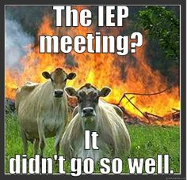
The Challenge
Most special education conflict centers on the development of the IEP.
A natural imbalance of power exists that results in parents feeling undervalued in the IEP process.
School staff members, administrators, and families often become focused on disagreement and engaged in a relationship strained by unresolved conflict.
School districts are spending over $90 million per year nationally on conflict resolution.

Slide 4
In Rural Special Education:
There are fewer special educators doing the work of many
We run our own meetings
We work with families for many years
Contention can impact collaboration for years

Slide 5
Therefore:
Positive relationships are vital
Tools are needed to run smoother meetings
Collaboration is crucial
Parent understanding is essential

Slide 6
Colorado’s Dispute Resolution Statistics
Note: The Special Education population in Colorado has grown by 19,278 from 2010-2018.
Notes:
This is a quick representation of the increase in Mediations, State Complaints and Due Processes since 2010. Since our implementation of IEP Facilitation in the fall of 2017, we have increased as well, with a total of 44 requests in 2018, and now, in 2019, from January to June, we have had 38 requests. This is a positive trend, as more people are valuing impartial facilitation as being a first step in the prevention of disputes.

Slide 7
Findings of State Complaints
Districts Cited For Lack of:
Parent Participation
Implementation of the IEP
Development of the IEP
Comprehensive Evaluations
Appropriate IEP Team Members
Prior Written Notice

Slide 8
Findings of State Complaints
Failure to conduct Comprehensive Evaluations or consider Independent Evaluations
Failure to determine Eligibility/Child Find
Amendments made outside of IEP meeting
Failure to provide parents with progress monitoring
IEP not implemented at beginning of school year

Slide 10
Our Solution: Facilitative Skills for all IEP Stakeholders
THE BEST SOLUTION FOR RESOLVING CONFLICT AND BUILDING COHESIVE TEAMS.
When are facilitative skills helpful?
EVERY day.
At EVERY IEP team meeting.
Before disagreements become disputes.
Notes:
CDE formed an Early Dispute Resolution Advisory Board (Now Alternative Dispute Resolution) 3 years ago and they looked across the US at best practices that were helping improve outcomes for student with disabilities and the use of Facilitative Skills in meetings and sometimes a neutral 3rd party facilitator is making a big difference in the IEP process in other states.

Slide 11
Benefits of Facilitation
According to the American Bar Association, benefits include:
Parties get to decide: All parties, who know the student, control the outcome.
Fosters continuing relationships: Facilitation does not dismantle relationships, it bolsters them.
Facilitation deals with feelings: It respects that a child is at the heart of every disagreement.
Outcomes are durable: There is a higher level of satisfaction, resulting in more durable agreements.
Lower cost: Informal issue resolution is ALWAYS less costly than more formal options. Cost is measured on the human and financial dimensions.
Notes:
Our Goals: Resolve Conflicts, Facilitate Solutions, Productive Meetings, IMPROVED OUTCOMES for students!

Slide 12
Purpose of
Using
Facilitative
Skills
Maintain open communication among all members, using active listening skills
Assist team in understanding resistance and resolving conflicts through consensus decision-making
Needs of the Child
Help IEP team members develop and ask clarifying questions
Help team members stay on task and on time

Slide 13
Taste of Our Training!

Slide 14
IDEA: Know with Precision
Free Appropriate Public Education
Least Restrictive Environment
Special Education & Related Services
Notes:
Timing-> 20 minutes – this slide builds – build the slide and have them do the following activity, break into 6 groups: 2 for FAPE, 2 for LRE, and 2 for Special Education and Related Service: have each group work for 5 minutes to flip chart what they know about each term. Have each group report out and then touch on any points from notes below and refer them to their handout on Know with Precision.
A Free Appropriate Education means special education and related services at public expense delivered in the conformity with the IEP in the LRE. It must be “reasonably calculated to provide educational benefit” and is a “basic floor of opportunity”. FAPE means SOME EDUCATIONAL Benefit, not a Cadillac education and courts continue to uphold that meaning. This is very important because let me ask you, when you describe what you want for kids what do you say? The best? Or SOME EDUCATIONAL benefit? We all wan the best for kids no matter what our role but that is not what the law defines and this is where tension begins to be created in the IEP process and where we as the IEP team members must be creative ad focus on the needs of each child to ensure that what they get – their diploma is as meaningful and meets their needs as possible.
Special Education: Specially designed instruction to address the unique needs of the child that result from the disability, and to ensure access to the general curriculum. It means individually adapting the content, methodology, or delivery of instruction to:
Address the unique needs of the student resulting from the disability; AND
Ensure access to the general education curriculum so that the student can meet the standards that apply to all children.
Special education is the “language of love” on both sides of the table for kids with disabilities – so they CAN meet the standards for all kids! Everything in a child's IEP to tie to the standards. Special education should not create an alternative universe for kids with disabilities and tie as close as possible to the experience of typical kids while meeting the students individual needs.
Related services means transportation and such developmental, corrective, and other supportive services as are required to assist a child to benefit from special education.
Least Restrictive Environment: This is intended to be a fairly high standard. The word maximum is used 3 time in the law.
To the maximum extent appropriate, children with disabilities are educated with children who are nondisabled. 34 C.F.R. §300.114.
To the maximum extent appropriate, children with disabilities are able to participate in extracurricular activities with children who are nondisabled. 34 C.F.R. §300.117.
To the maximum extent appropriate, children with disabilities are provided supplementary aids and services to enable them to be educated with children who are nondisabled.
Teams must be able to justify placements away from non-disabled peers. As a note of caution, it’s easy to confuse placement in the LRE with the location where the services are delivered. Location is different and the two terms should not be used interchangeably.
You should feel a magnetic pull, teams must justify why student CANT be educated with peers! Next-> FAPE in the LRE

Slide 15
Conflict
Conflict is a signal or message that something is not working and needs to be different.
~ Talk Through Conflict Using Interest-Based Problem Solving, Education Service Center Region 4 (2011). ~

Slide 16
Conflict Wheel
When we understand the source of conflict, we can find a way to work through it.
Different sources of conflict produce different challenges.
Find the PRIMARY source(s) of the conflict to find a solution.
Notes:
You have a copy of this conflict wheel and the definition of each segment in your handouts. Let’s get a common understanding of each segment because when we know what is creating the conflict, we are better prepared to deal with it effectively!
NEEDS: Student needs are placed in the center of the wheel. This is a critical frame of reference to keep the team focused on during the meeting. Is what we are currently discussing still focused on the needs of the student and NOT the adults in the room?
1. EMOTIONS: Energy that fuels conflict. It may be a source of power and often controls behavior. We are discussing children, not widgets, of course there will be emotions surrounding students that we ALL care about. And make no mistake, no one around that table went into education because they DON”T care about kids, they may be stressed by what it takes to serve kids, but they went into the job with the intent to help students!
2. HISTORY: Provides momentum for developing conflict; participant history has a powerful influence on current conflict. May be their experience in school, with a certain subject, they were bullied, past IEP meetings, etc. Each person around the table has their own history they wear when they walk in the room!
3. COMMUNICATION: How we interact – both verbally and nonverbally at IEP meetings is full of conclusions drawn from previous interactions or experience. It may rely on inaccurate or incomplete perceptions that may be the result of another students IEP meeting in the past!
4. STRUCTURE: Components include available resources, decision making procedures, time constraints, legal requirements and physical settings. It can be more difficult to alter structural elements and these are common IEP conflicts. Eg: school day is from 8:15 to 3:15 at XYZ elementary, can’t change the school hours but could change how long the student attends or change schools with different start and end times.
5. VALUES: A struggle about values becomes intractable; compromise is difficult when core beliefs are challenged; rational problem solving strategies DON’T work. Eg: How each family parents their child, what religion a family practices – not a good place to attempt to tell someone they must do it differently unless the source of conflict is a lack of knoweldge about how to do it better such as positive behaviors interventions and supports and someone needs to LEARN how to do it differently.
POWER: Obscures the roots of conflict. Using power becomes more important than resolving conflict. I’m the parent versus we are the school and we know what is best kind of power struggles will never get the team into a better IEP for the child unless we can recognize this is strictly a power issue for the adults and figure out how move past it..
CULTURE: Affects conflict because it is embedded in communication styles and structure. It is a body of learned beliefs, traditions and principals and guides individual behavior. Maybe you always nod yes to indicate you are hearing the other person but in my culture the nod means you agree but that is not the case at all and then conflict resurfaces later and the team gets confused as to why. Must be explicit in making sure people are truly agreeing, not just nodding that they hear each other!
8. PERSONALITY: Likely to focus on a particular person and not the issue. Some people are just oil and water trying to mix and it is not going to happen If we can identify we have a true personality issue we can alter the timing and the source of messages to work past or through the personality conflicts.
9. DATA: People can’t reach agreement about things they don’t understand. Misunderstood data tends to escalate conflict. Happens ALL the time in IEP meetings because of acromyns, teacher speak, lack of clarity between 2 sets of data – this can be one of the easiest areas to fix if you realize that it is the source of conflict. (click mouse)
Understanding the sources of conflict in an IEP team in order to know which skills or tools to employ to resolve the conflict and allow the team to move forward. Matching the source of conflict to potential solutions is the goal of this lesson.

Slide 17
Active Listening Techniques

Slide 18
YOUR WORDS: Affirms the speaker.
Notes:
When you paraphrase, you are going to use YOUR OWN WORDS to say what you heard the speaker say. It also helps check for understanding.
It can help control the pace of a meeting, and can help participants who may be stuck on a topic or thought. It builds trust and collateral among participants. It helps us Lean In to the conversation that is happening…
HO the Paraphrase, Mirror and Reframe summary

Slide 19
Mirror
SPEAKERS WORDS: Help the speaker feel understood.
Notes:
Mirroring is a way to increase impartiality and improve trust. It can help a participant who is stuck feel validated and ready to move forward.

Slide 20
REFRAME
Reframe
Negative to Neutral:
Remove the Toxicity
Notes:
This one of the most useful facilitation skills you can develop and use. The entire purpose of reframing is so you can move negative information to neutral so the information can then be used to help the team move forward. Just because there is negativity in the initial thought does NOT mean there isn’t valuable information to learn and leverage in and behind the comments.
Reframing is a tool you can use when a bomb gets dropped in your IEP meeting.

Slide 21
Positions vs. Interests
Dig deep.
Agreement lies in finding the interests underneath and behind the positions.

Slide 22
Focus on Open Ended Questions
Open Ended
Clarifying Questions
Problem Solving
Directed Yes/No
Notes:
There are 3 types of clarifying questions we can use but as we work to initially draw out information and needs, we want to use questions that encourage everyone to say more, to expand/expound upon what they are thinking in their heads. Open ended questions get more information on the table for the parties to work with, particularly if there is some conflict.
Open ended questions help build more collateral and trust among the team members in the room when information is shared openly and genuinely versus directed questions at the bottom of the chart.
Problem solving questions are more direct and may be use to help participants think about something differently.
Directed Yes or No questions are often used for procedural situations such as “Is this a good time to take a break?”
There are definitely times when problem solving and direct yes/no types of questions are needed but to gather information and keep the team moving forward, we should focus on open ended questions.

Slide 23
Space of Change
The concept of space is both mental and physical. Be strategic in creating the space of change.
Speak when you are angry and you will make the best speech you will ever regret.
~Ambrose Bierce

Slide 24
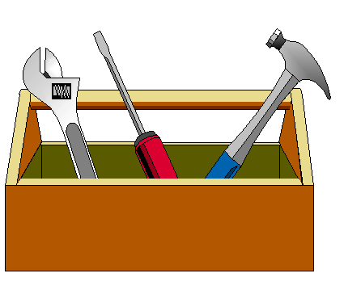
Powerful Tools! Used in Successful IEP Meetings
VISUALS!
Aid in understanding
Keeps team on track
Neutralizes information
Opening Statement Checklist
Agenda Development Form
Parent Input Form
Comprehensive Evaluation Wheel
FAPE Continuum

Slide 25
The Opening Sets the Tone
Welcome and Introductions
Recognize and affirm participation and commitment
Explain purpose of the meeting
Explain agenda use and purpose
Explain meeting norms and seek agreement (if used)
Notes:
When we are rushed and don’t set the tone for the meeting, this can devalue participants and their sense of belonging. It also does not put anyone off guard when you may call a private meeting, reinforce time limits, or clarify roles.
HANDOUT: Checklist for Opening Statement

Slide 26
Agendas
Productive
Meetings
Are living documents.

Slide 27
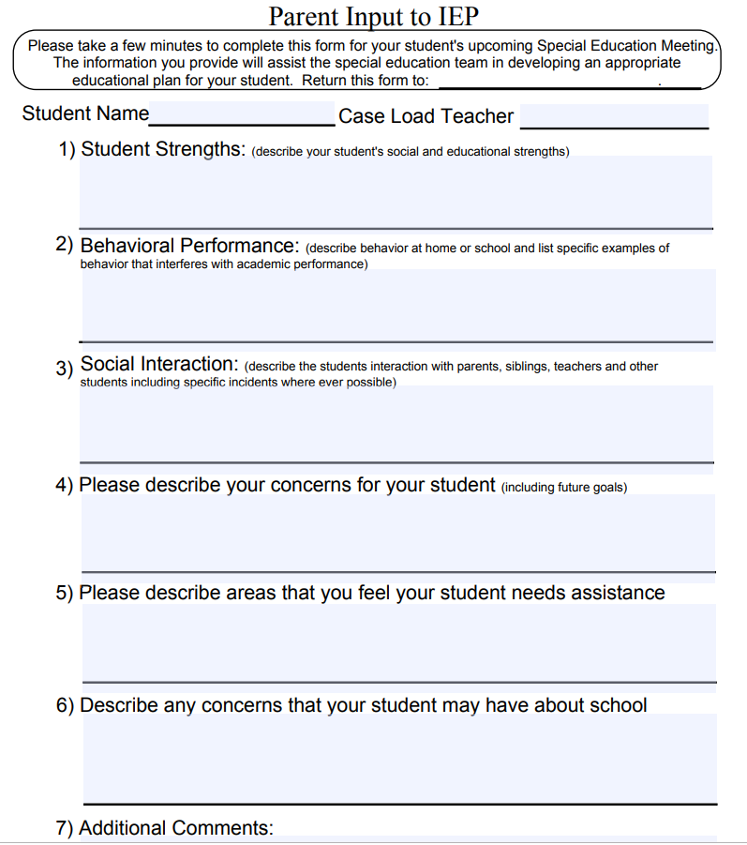
Parent Reports
Purpose is to gain input from the parent, as well as provide meaningful input, and an opportunity for parents to report at the meeting. Report can include:
Student strengths
Behavioral performance
Social interaction
Parent concerns

Slide 28
It Begins with a Comprehensive Evaluation
Without a clear understanding of the student’s educational needs, it is impossible to determine FAPE.
Educational needs means academic, functional, social, or behavioral.
It is a probing question model.

Slide 29
The FAPE Continuum
Evaluation
Present Levels & Need
Measurable Goals
Services in the LRE
Educational Benefit

Slide 30
Alternative Dispute Resolution in Colorado
Prevention-based
Alternative Dispute Resolution Advisory Board (ADRAB) current focus:
Educator training
Parent resources
Restorative Justice practices
Trainings:
Improving IEP Teams: Skills for Resolving Conflict trainings
Facilitator trainings
Specific district requests
Trainings for parent groups
Services:
4 Statewide IEP Facilitators available to support meetings

Slide 31
Colorado’s ADR Data Snapshot Fall of 2017-Present
Trainings
654 trained in the Improving IEP Teams: Skills for Resolving Conflict
128 trained as neutral IEP Facilitators
Skills taught at multiple conferences and shortened trainings in districts
99.5% of participants’ survey responses found the training extremely helpful in their day-to-day IEP meetings, with the visual tools as very valuable.
Facilitations
176 requests for statewide facilitators
Has this reduced the likelihood that other Dispute Resolution options will be utilized?
72% of respondents in the IEP meetings facilitated by a statewide facilitator said YES. (See slide 35)

Slide 32
Evaluation Data from Facilitations in 2019-2020

Slide 33
Evaluation Data from Facilitations in 2019-2020

Slide 34
Evaluation Data from Facilitations in 2019-2020
Outcome of Facilitated IEPs

Slide 35
Evaluation Data from Facilitations in 2019-2020
This question has been changed to a Likert scale for 2020.

Slide 37
Facilitation Continuum
No matter your role, facilitation skills are invaluable and there are many options for engagement!
Use of Facilitation Skills By All IEP Members
Impartial Facilitator From the District, a Neighboring District or Community Agency
Impartial Statewide Facilitator

Slide 39
Questions?
Mary Anne Fleury, Ph.D., CDE
Alternative Dispute Resolution Specialist
303-866-6649
fleury_m@cde.state.co.us

